Slide 1
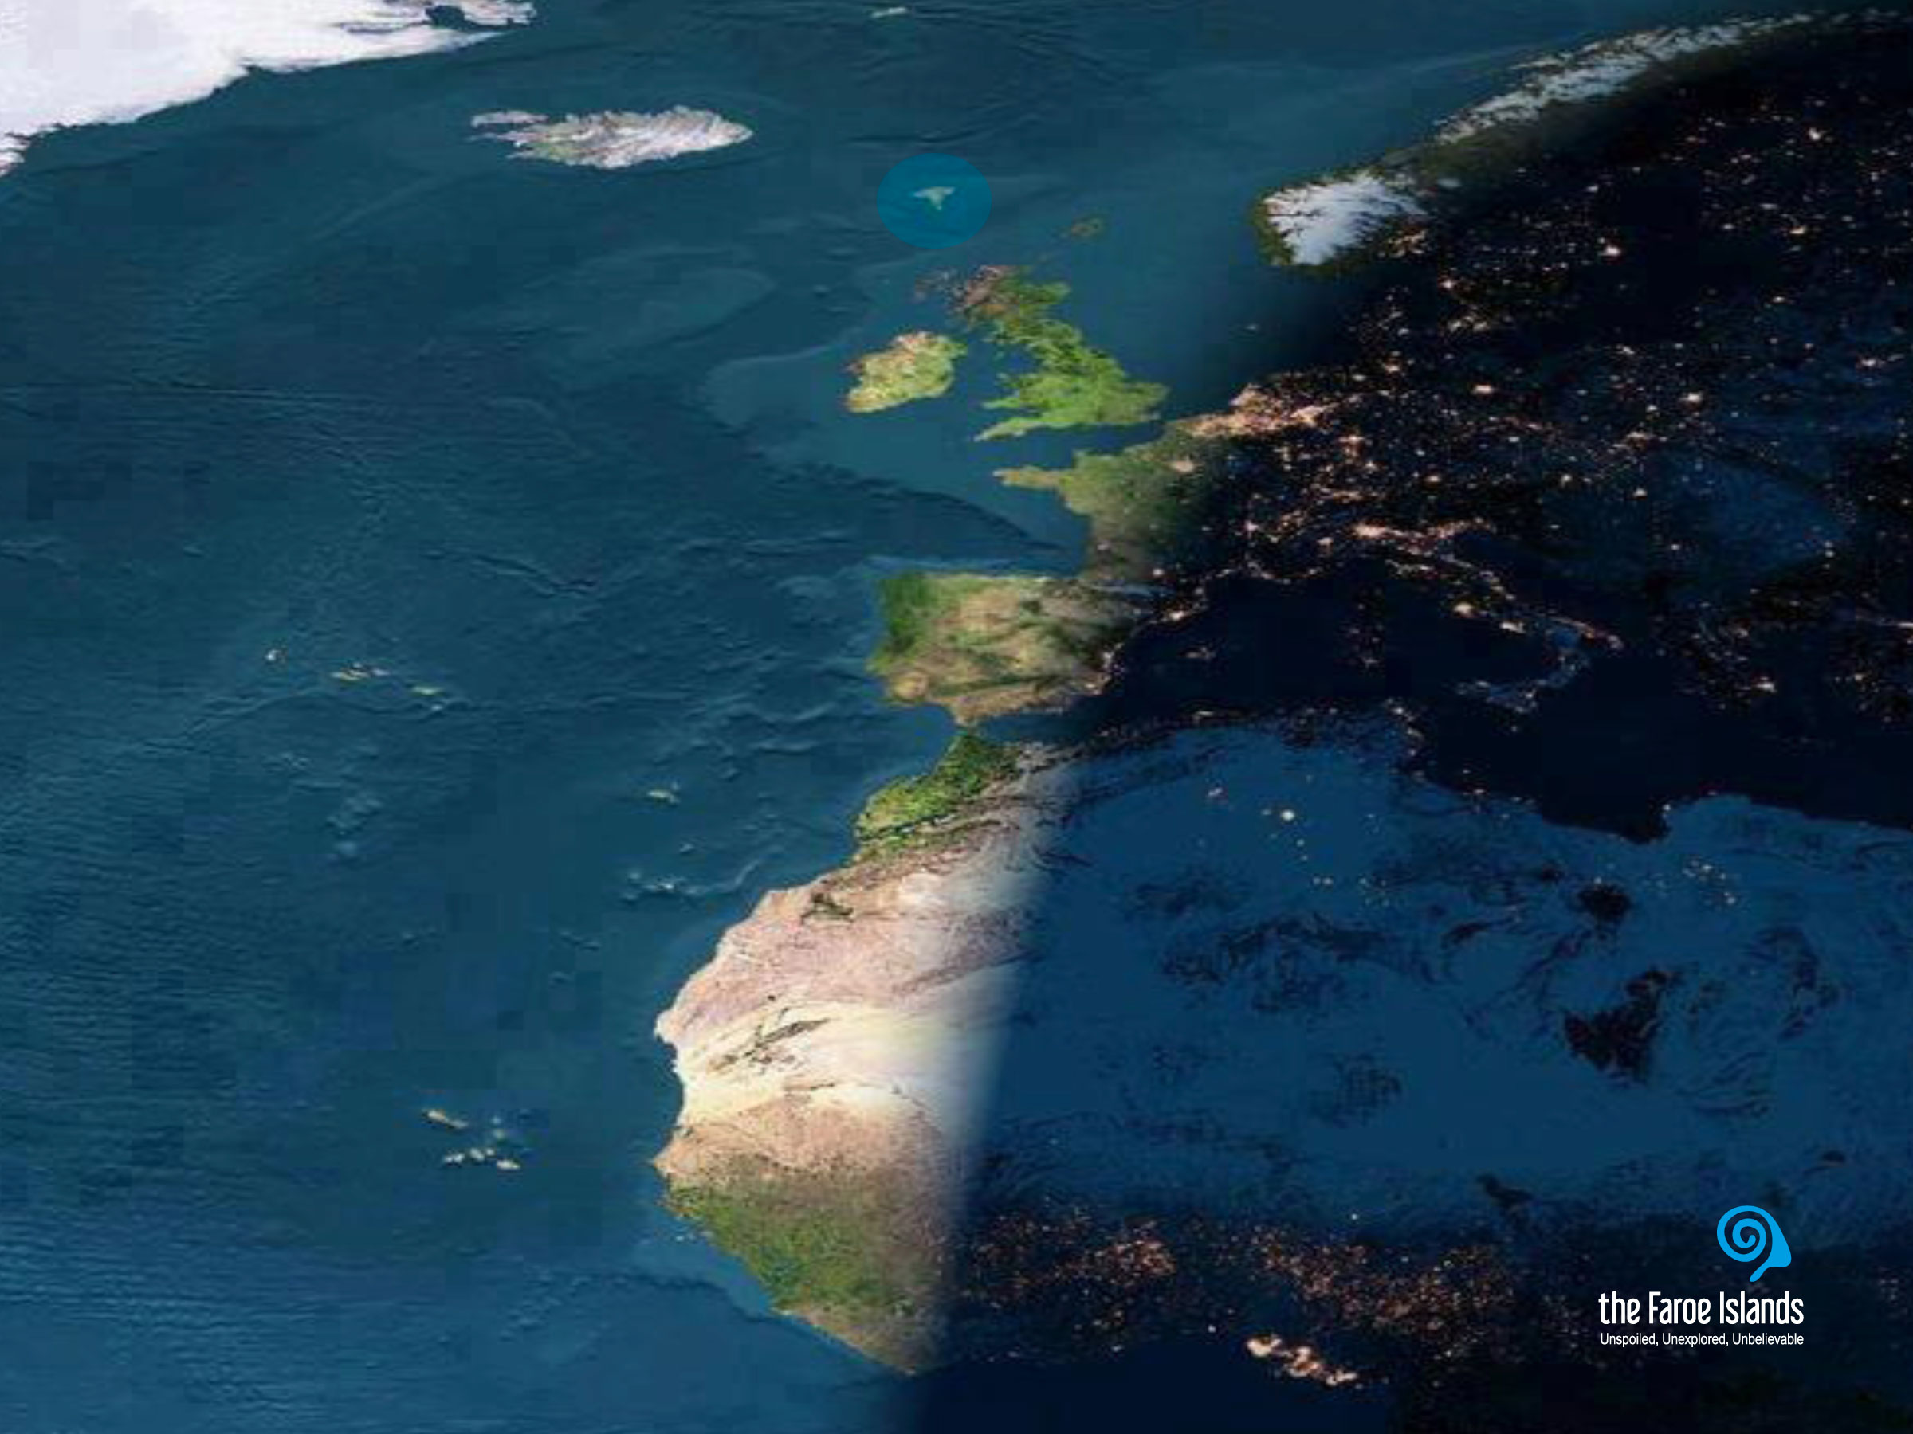
Notes:
Most people don’t seem to know that the Faroe Islands exist. And it is not strange that people do not know about the Faroe Islands. They are not even on most world maps. And if they are, they are marked by two or three small dots hardly visible to the naked eye.
This makes it difficult to imagine the versatility of what the Faroe Islands have to offer and what they are composed of.
Gævi gætur at Visit Faroe Islands eigur rættindi til allar myndirnar í framløgunum og at myndirnar bert kunnu brúkast í hesum líki í samband við framløgur um Føroyar.

Slide 2
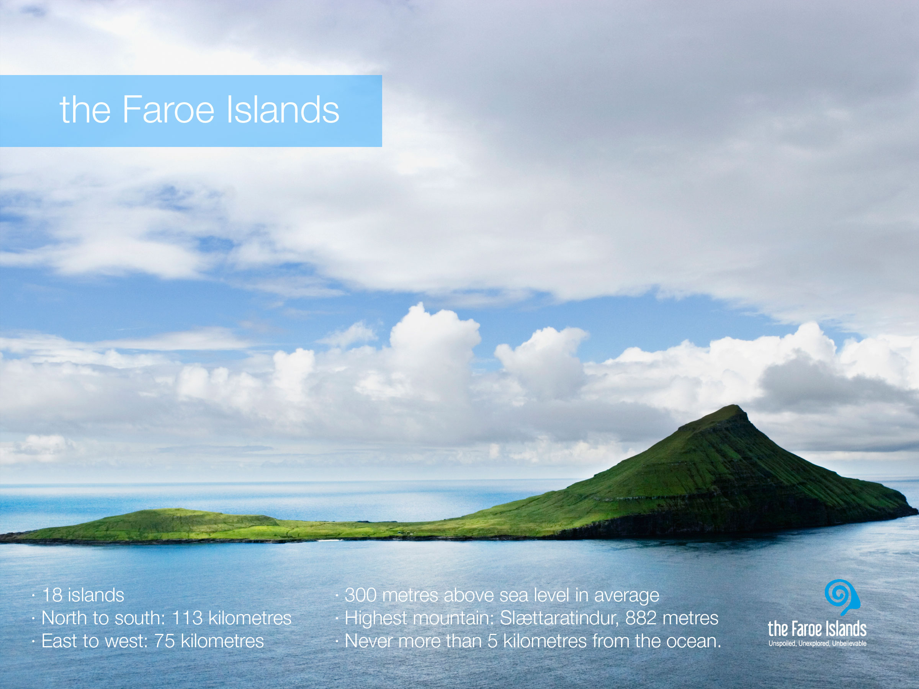
Notes:
The Faroe Islands are characterised by an incredibly fresh and clean air, a dramatic landscape with steep mountains, deep fjords, green grass and the lack of trees. The villages are small and scattered around 17 of the 18 islands. The islands differ both in size and character. In the north they seem more dramatic with higher mountains and tall cliffs, whereas they are greener and more velvety in south.
The Faroese settlement pattern is characterized by a large number of densely populated villages of varying size. There are in all about 100 towns and villages, with Tórshavn the capital, as the largest town where about 40% of the population lives.

Slide 3
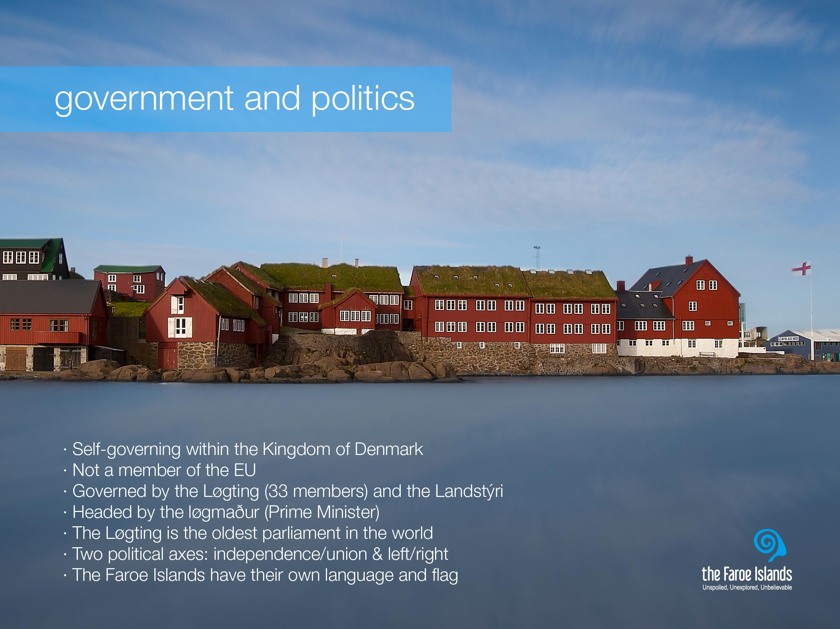
Notes:
The Faroe Islands are a self-governing nation under the external sovereignty of the Kingdom of Denmark. The Faroese political system is a variation of the Scandinavian type parliamentarian democracy, with its own democratically elected legislative assembly, the Løgting (parliament), and an executive government headed by the løgmaður (Prime Minister),
The Løgting, which is the oldest parliament in the world.With economic wealth the Faroese have developed a welfare society much along the lines of the typical Scandinavian welfare state model, e.g. with free education and health care for all.

Slide 4
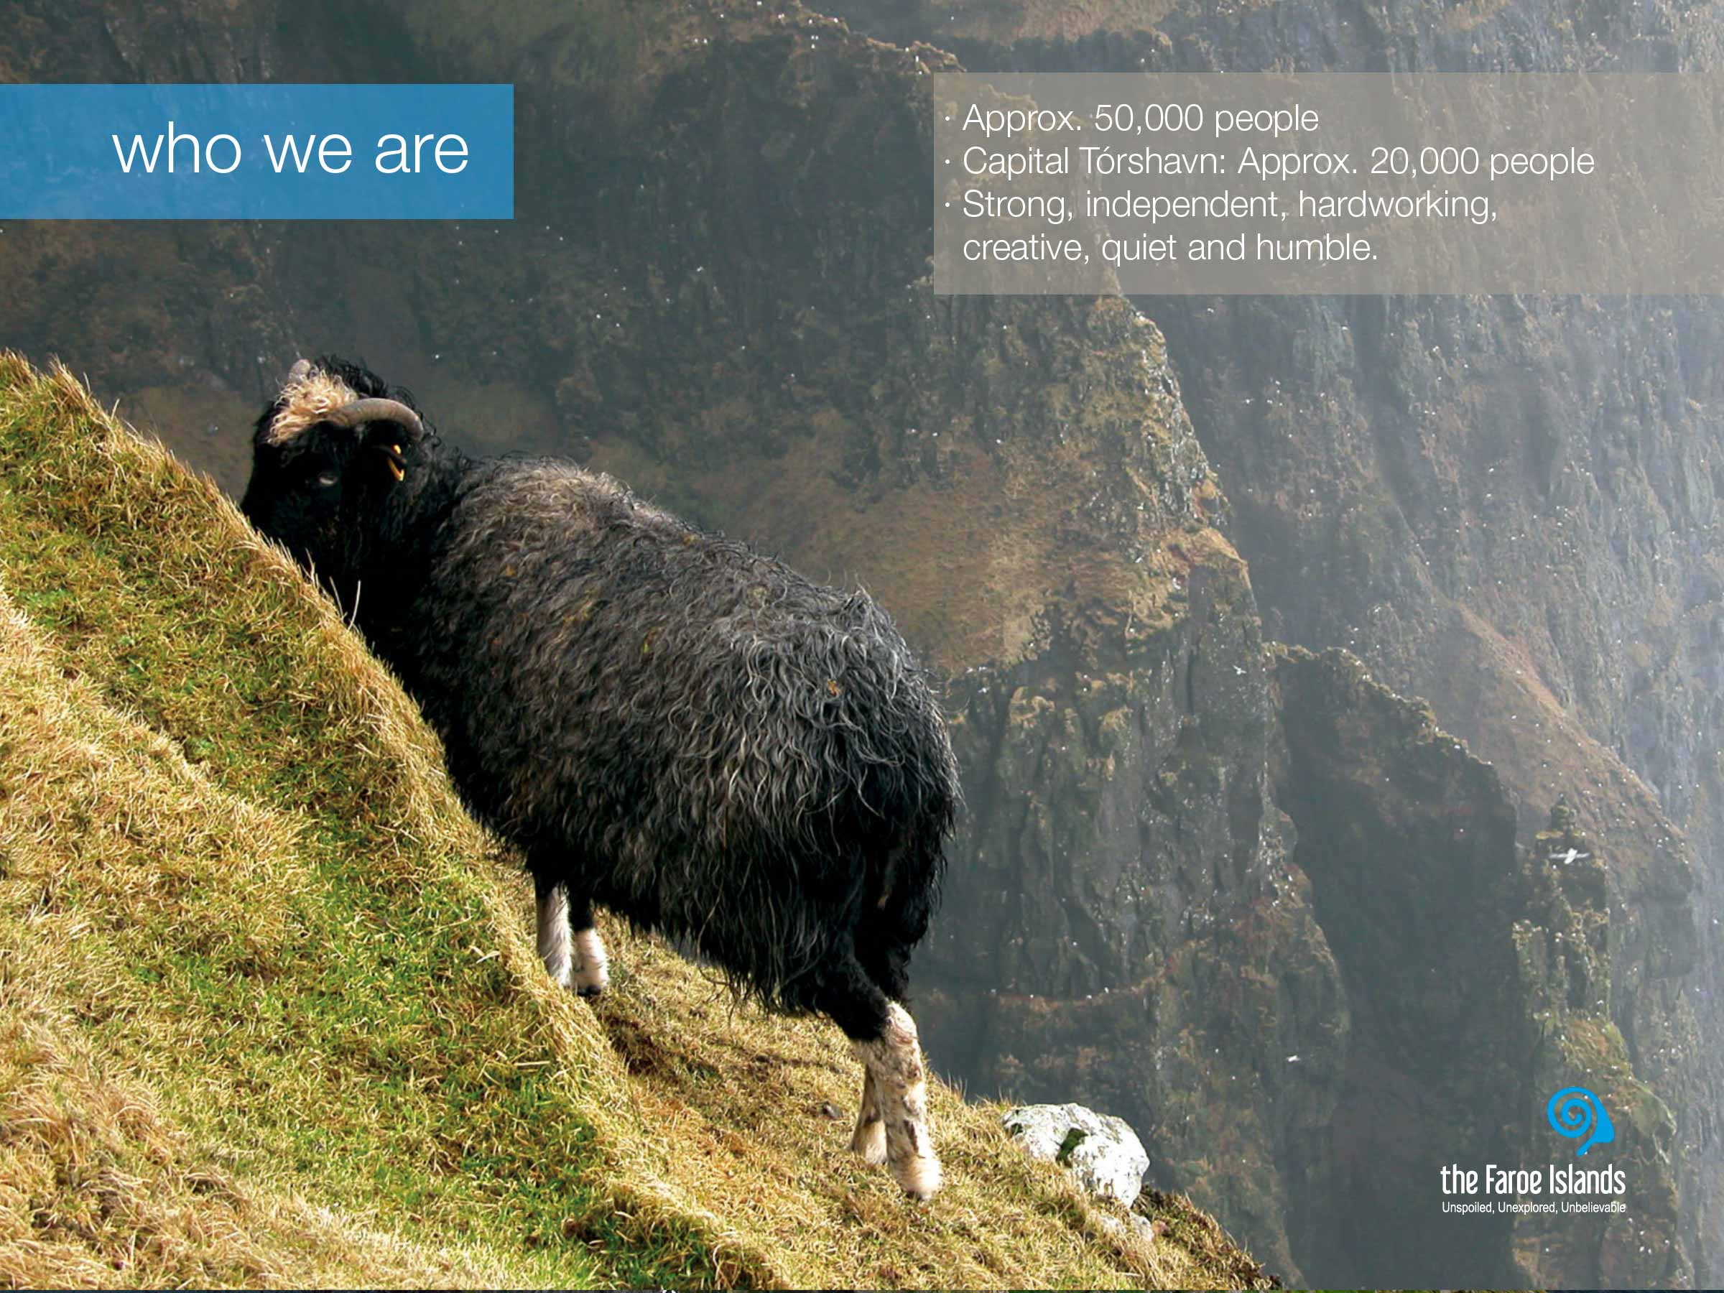
Notes:
The population of the Faroe Islands is approximately 49,000. Twice outnumbered by the sheep and not to mention the 2 million birds.
The sometimes harsh living conditions, history and nature, has had big impact on the Faroe Islanders, and made them both patient and adaptable to change. Other than that, the Faroese are often characterized as being strong, independent, hardworking and creative people. And although they do have a strong belief in their own abilities, they can come across as being quiet and humble. We are a close-knit community, and close to our heritage. There is little distance between high and low and our different varieties as individuals is visible.
Life on the islands hasn’t always been easy. With a firm grip on the realities of island life in the middle of the ocean, they see the North Atlantic as a bread basket and bridge, not a barrier. The sustainable utilisation of the natural resources was the only means of life, both for fishing and aquaculture, and with nature’s mood swings, this challenged life on the Faroe Islands. And today, the Faroese economy is still highly dependant on fisheries and aquaculture.

Slide 5
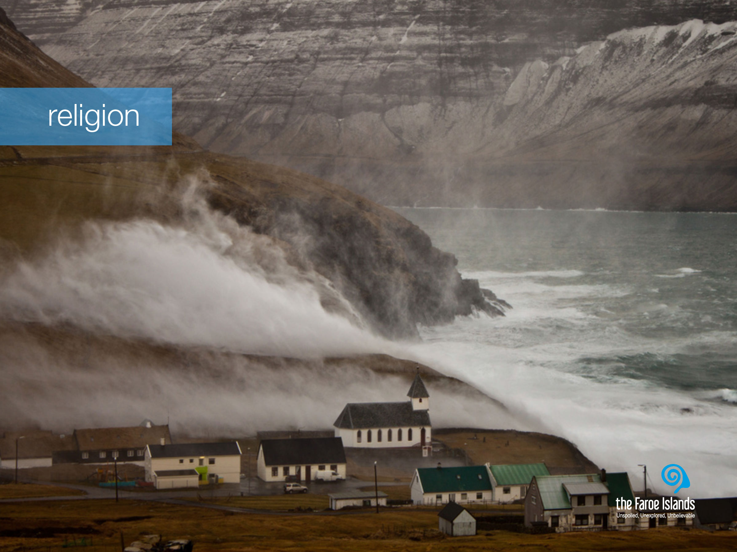
Notes:
The Faroese are predominantly religious, as is often the case with people in island communities.
Nature is present in the Faroe Islands and in the people, both in terms of its natural glory and its mighty powers. On the Faroe Islands, nature is the master. Its powers are enormous. And when the weather is wild and demanding, we truly feel how small we humans are and how grand and powerful nature is. In that sense we understand the need to believe in higher powers. When all the men in a village went out to sea to catch fish, the women and children had to believe that God would bring them back safe, and with a good catch. Unfortunately this was not always the case, and at such moments, those left behind sought comfort in their religion.

Slide 6
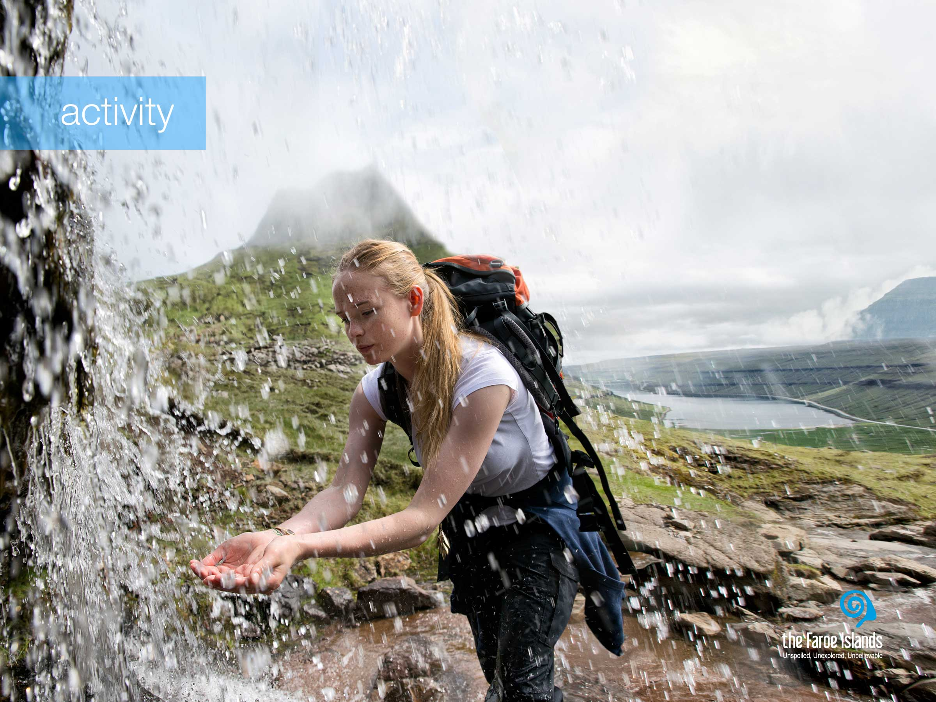
Notes:
The Faroese people are crazy about sports, both as a way of exercising and for leisure. This positive attitude towards keeping active has clear roots in the social and historical circumstances of the Faroe Islands. Before the introduction of modern infrastructure, people often had to walk long distances, hike up mountains, and row from island to island in order to get around. So physical activity is a natural extension of everyday life in the Faroe Islands, and it continues to be so.
Hiking is very popular both among Faroe Islanders and tourists, as it is a great way to get close to nature. Some people are great hikers and take hour-long hikes in the mountains, weekly. And the more difficult and dangerous the hike, the better. While others like to park their car by the road and take a shorter stroll – both types always offering beautiful scenery. Apart from the sheer enjoyment of a hiking trip in the hills and the mountains and the green grass, the clean air is something that makes the trip even more refreshing. Both the smaller water streams and the wild waterfalls consists of clean fresh water and you can safely drink just as much as you like.
In terms of organized sports, football is the most popular and widespread sport in the country. Though the official national sport is rowing, which has direct connections to the cultural heritage of the Faroe Islands. Other popular sports are handball, volleyball, swimming and gymnastics.

Slide 7
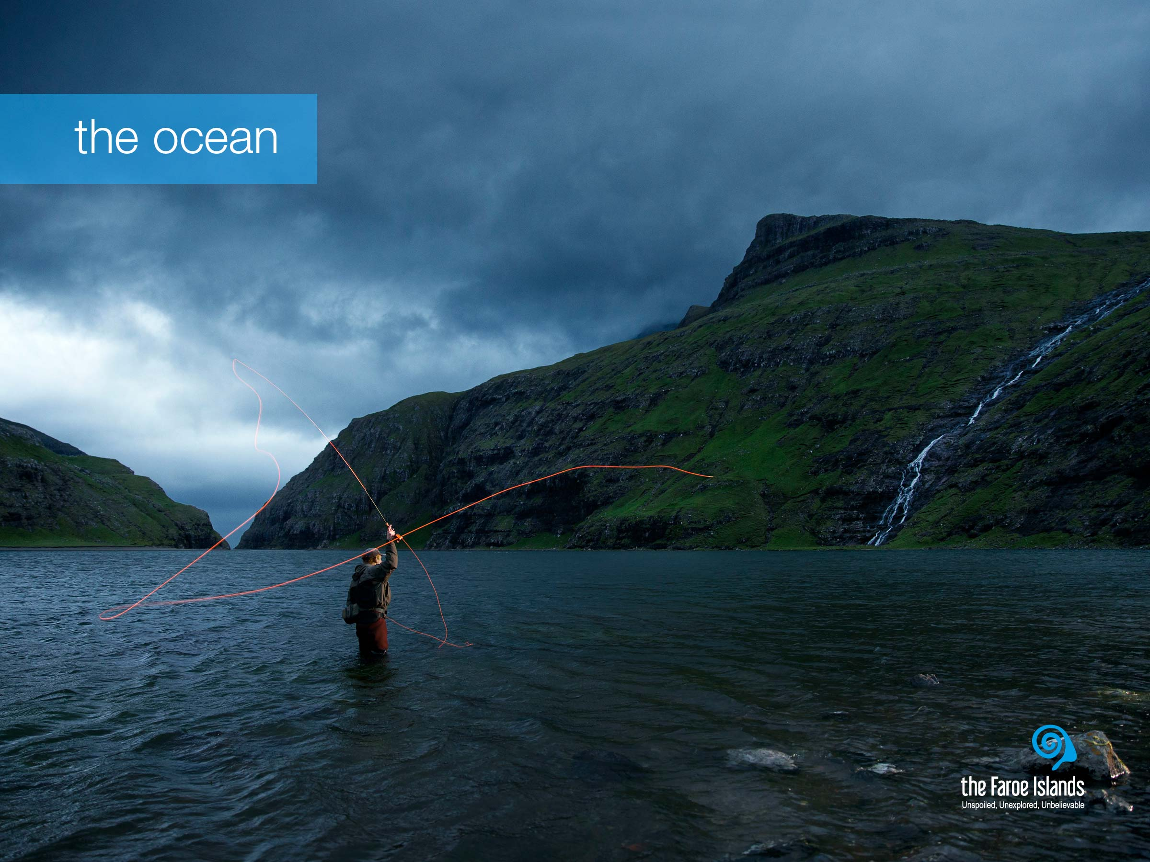
Notes:
The Faroe Islands are surrounded by the North Atlantic Ocean, and therefore a boat trip is always an adventure. Nature continues to surprise people during these trips - puffins skimming the waves, seals basking on cliffs, a school of whales or a flock of rare seabirds following the boat closely.
On a boat trip you may feel even closer to nature - and experience her unspoiled beauty. There is no guarantee of what you will see in advance, but you will have the experience of a lifetime. Amongst the many types of boat trips, you can choose from: fishing, bird watching or even try the unforgettable concerto grotto.
Fishing is how the Faroe islanders have survived the remoteness and harsh circumstances of the location – so fishing is at the very core of Faroese expertise. Fishery is not only an industry that employs many people, many Faroese families have their own boat with which they go out fishing when time and weather allows them to do so. And angling is also a favored pastime activity, hence Faroese cuisine is very much centered around fish.

Slide 8
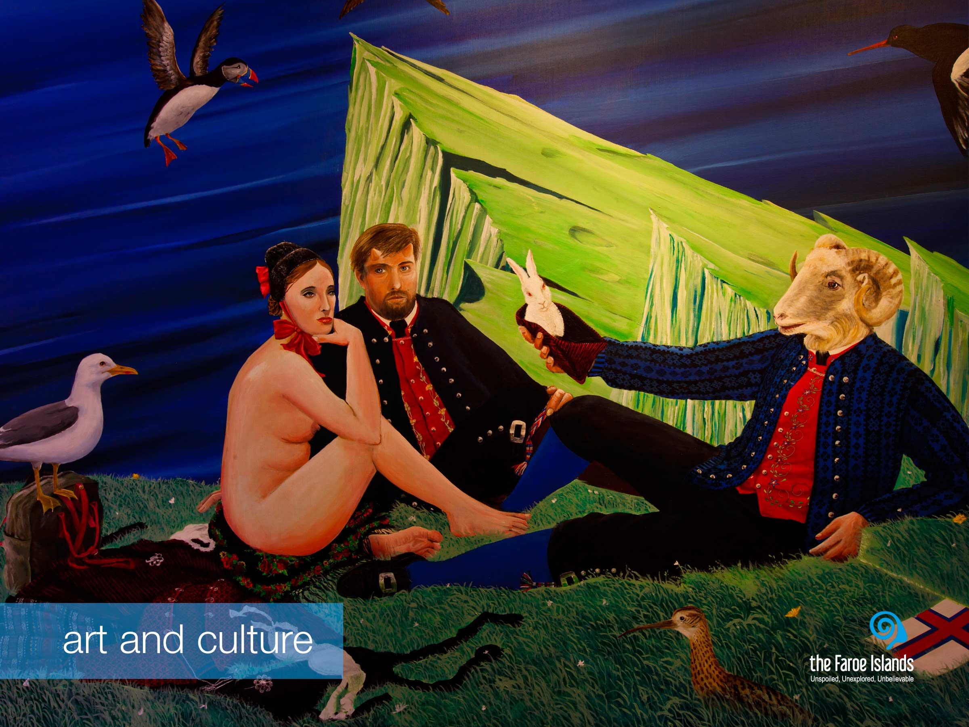
Notes:
It is often said that nature is a teacher and an inspiration to artists and creative souls in the Faroe Islands and that creativity and the cultivation of deep-rooted tradition are characteristic traits of Faroese society. The Faroese are well connected to the rest of the world and constantly embrace new trends while learning at the same time each day how better to share their unique creativity and culture with the rest of the world.
The Faroe Islands are a nation of poets and writers. The love of poetry and story-telling is deeply rooted in Faroese culture. Faroese literature is a literature of contrast between the old and the new, between tradition and innovation. Faroese literature is genuine Faroese and at the same time embedded in the literary history of Europe.
In the visual arts a lot has happened since the first Faroese painters painted the first landscape paintings to show the beauty of their country and demonstrate their love for the homeland. Countless new themes and motives have entered Faroese art since then. International styles have had their influence, and today an impressive number of artists work with pictorial art. But some things are still the same, though, and the landscape is still the dominant motif in Faroese art, just as the interplay between nature and mankind is still the most prevalent theme.
Deeply rooted in their long tradition of ballads and songs, the people of the Faroes simply cannot stop singing. Vocal traditions have been exceptionally rich and versatile, as there were no musical instruments of significance until the mid 1800s. The voice was the only music-making tool available, and as a result, singing is deeply anchored in the Faroese national identity. The Faroe Islands’ music scene is buzzing and artists and creators across all genres are delivering world class performances and recordings.

Slide 9
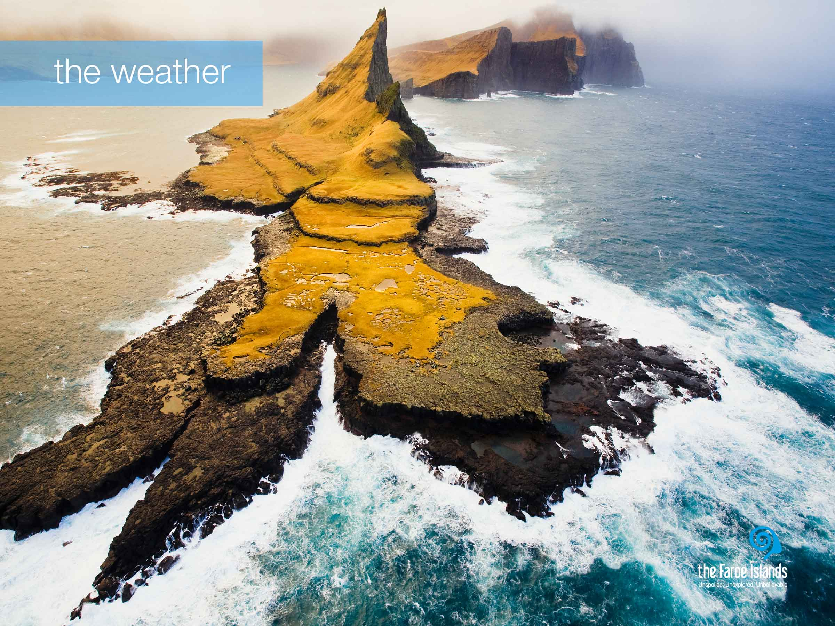
Notes:
Nature is present in the Faroe Islands and in the people, both in terms of its natural glory and its mighty powers. On the Faroe Islands, nature is the master. Its powers are enormous. And when the weather is wild and demanding, we truly feel how small we humans are and how grand and powerful nature is.
The climate on the Faroe Islands is very much influenced by its location in the warm Gulf Stream, which together with the remoteness of any source of warm airflows, ensures that winters are mild while summers are cool.

Slide 10
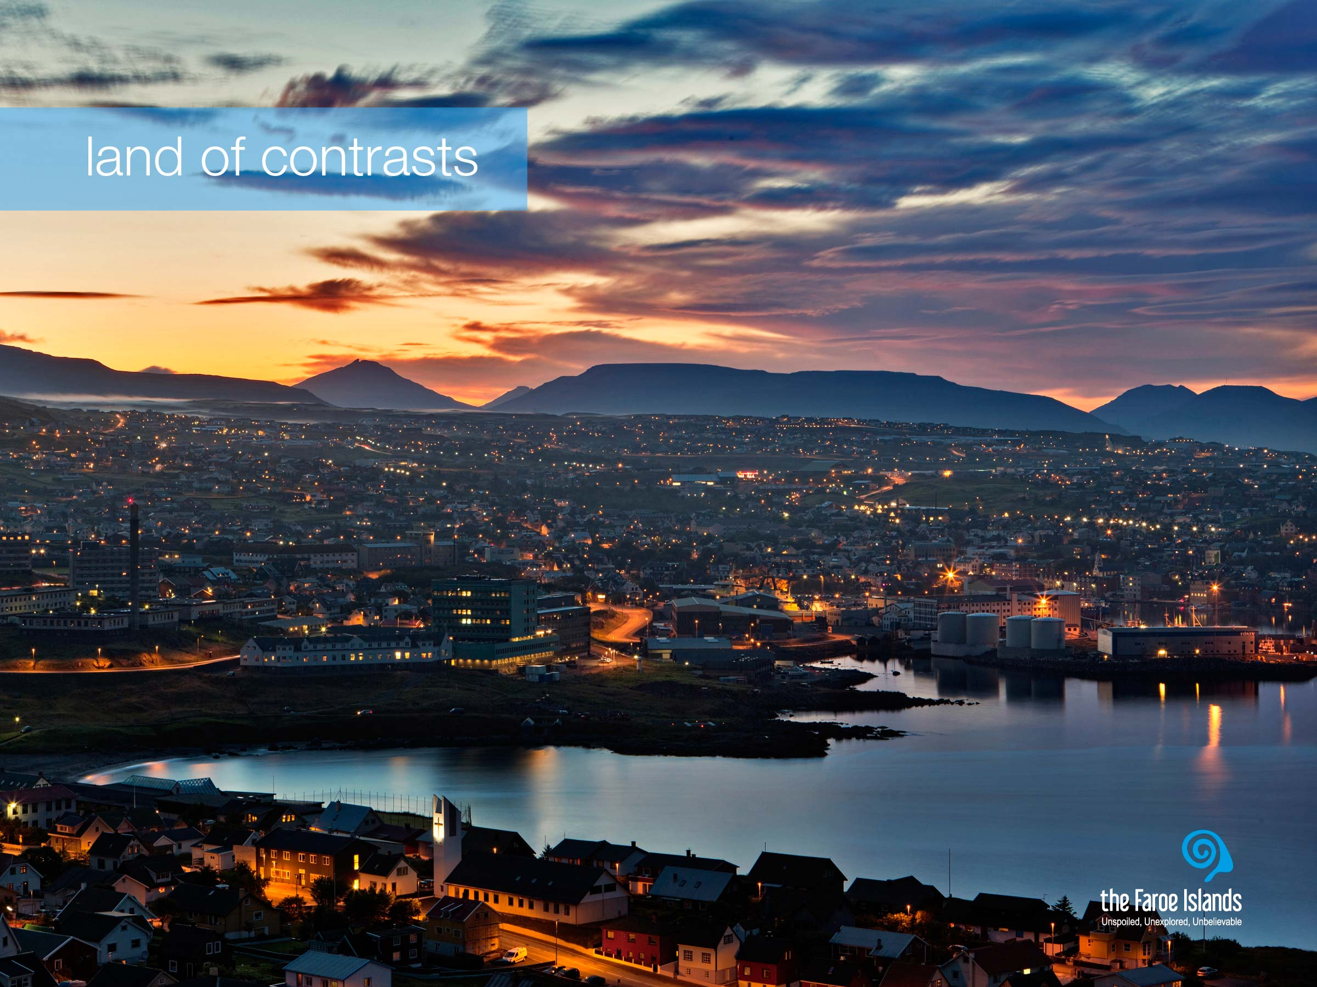
Notes:
The contrasts on the Faroe Islands are very dominant, and something which is natural to us but it is definitely something our guests notice very clearly when they visit the Faroe Islands. There is the tangible contrast between modern lifestyle and the very present traditions. But as a people, we are full of contrasts too. One moment we may be hierarchically differently placed in a company, but the next moment we are equals on the football pitch or when tending or slaughtering sheep. Somehow these contrasts also ensure that we are tolerant and open to new trends and norms. There is a curious co-existence of a highly modern society with old-fashioned traditions. We are not an ancient community, but modern with strong roots. The contrasts are also created by nature, because if it had not been so powerful, the good infrastructure would not have been created.
The capital Tórshavn is a great example. This peaceful, yet energetic capital has managed to meet the demands that any modern people has and is in many ways a micro cosmopolitan universe, it might be the smallest capital in the world but it still has top of the range restaurants and 5 star conference facilities.

