Slide 1
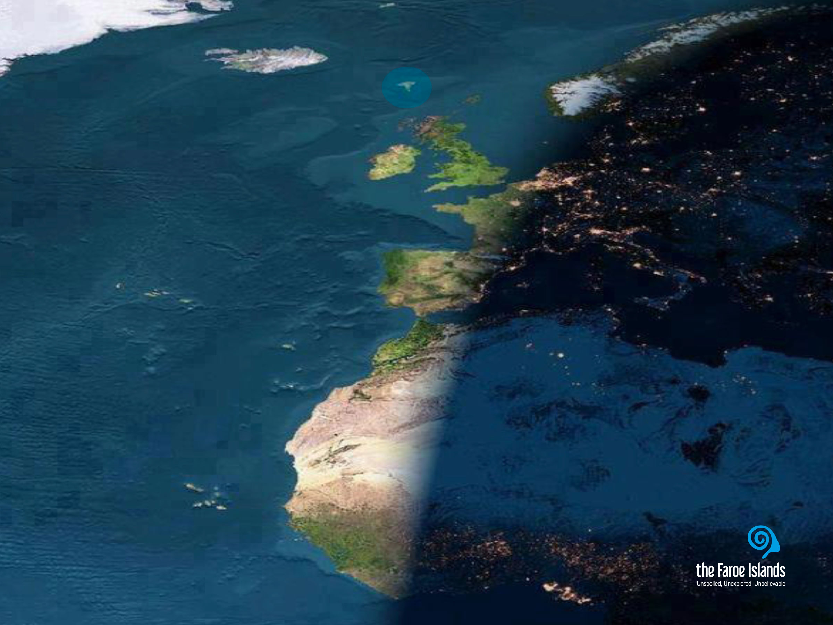
Notes:
Most people don’t seem to know that the Faroe Islands exist. And it is not strange that people do not know about the Faroe Islands. They are not even on most world maps. And if they are, they are marked by two or three small dots hardly visible to the naked eye.
This makes it difficult to imagine the versatility of what the Faroe Islands have to offer and what they are composed of.
Gævi gætur at Visit Faroe Islands eigur rættindi til allar myndirnar í framløgunum og at myndirnar bert kunnu brúkast í hesum líki í samband við framløgur um Føroyar.

Slide 2
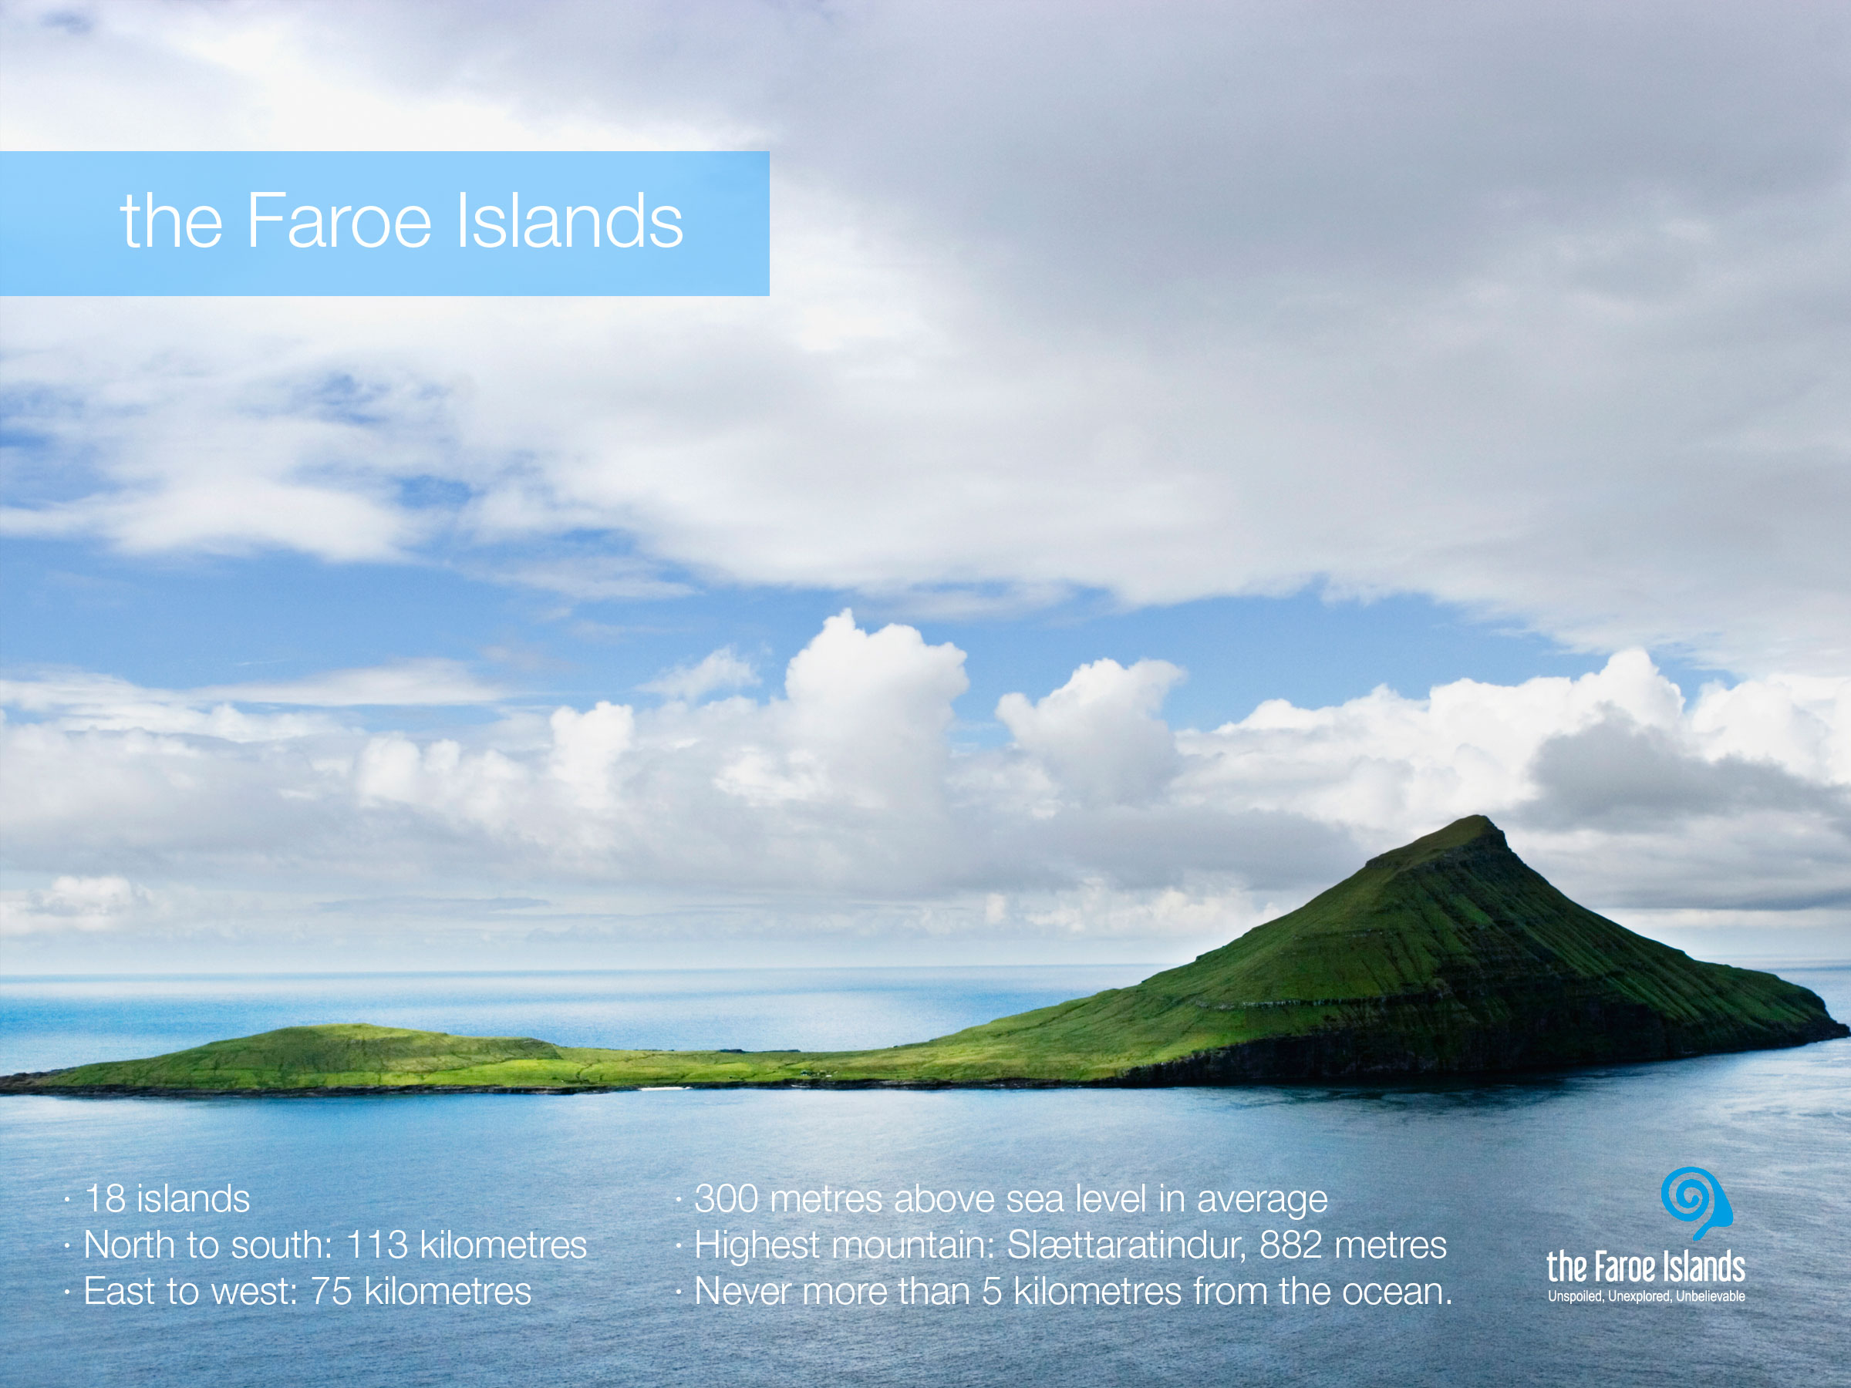
Notes:
The Faroe Islands are characterised by an incredibly fresh and clean air, a dramatic landscape with steep mountains, deep fjords, green grass and the lack of trees. The villages are small and scattered around 17 of the 18 islands. The islands differ both in size and character. In the north they seem more dramatic with higher mountains and tall cliffs, whereas they are greener and more velvety in south.
The island on the picture is Koltur. Koltur is one of the smallest of the islands. The island was uninhabited for many years, but today one family lives on the island. Among Faroe Islanders, Koltur is a popular place to visit for different reasons. Firstly it is a beautiful island, and a good place to hike for everyone, as it is not that steep, the highest top is 478 metres and most people can reach both tops without training or having special hiking skills. Secondly the old village has been restored, and therefore a good place to visit for historical reasons. Thirdly, because of the habitation, it is not so easy to visit the village as there is no regular ferry connection. So you either have to know the family on the island and visit them, or go on the arranged trips that are made, mainly in the summer season, to the island.
Facts:
· 18 islands
· Total area is 1,399 sq.km - total coast line is 1,289 kilometres
· The largest island is Streymoy (375.5 sq.km) with the capital, Tórshavn.
· The overall length of the archipelago north-south is 113 kilometres, and 75 kilometres east-west.
· The islands’ highest point "Slættaratindur" is 882 metres.
· On average the land is over 300 metres above sea level.
· At no time are you more than 5 kilometres (3 miles) from the ocean.

Slide 3
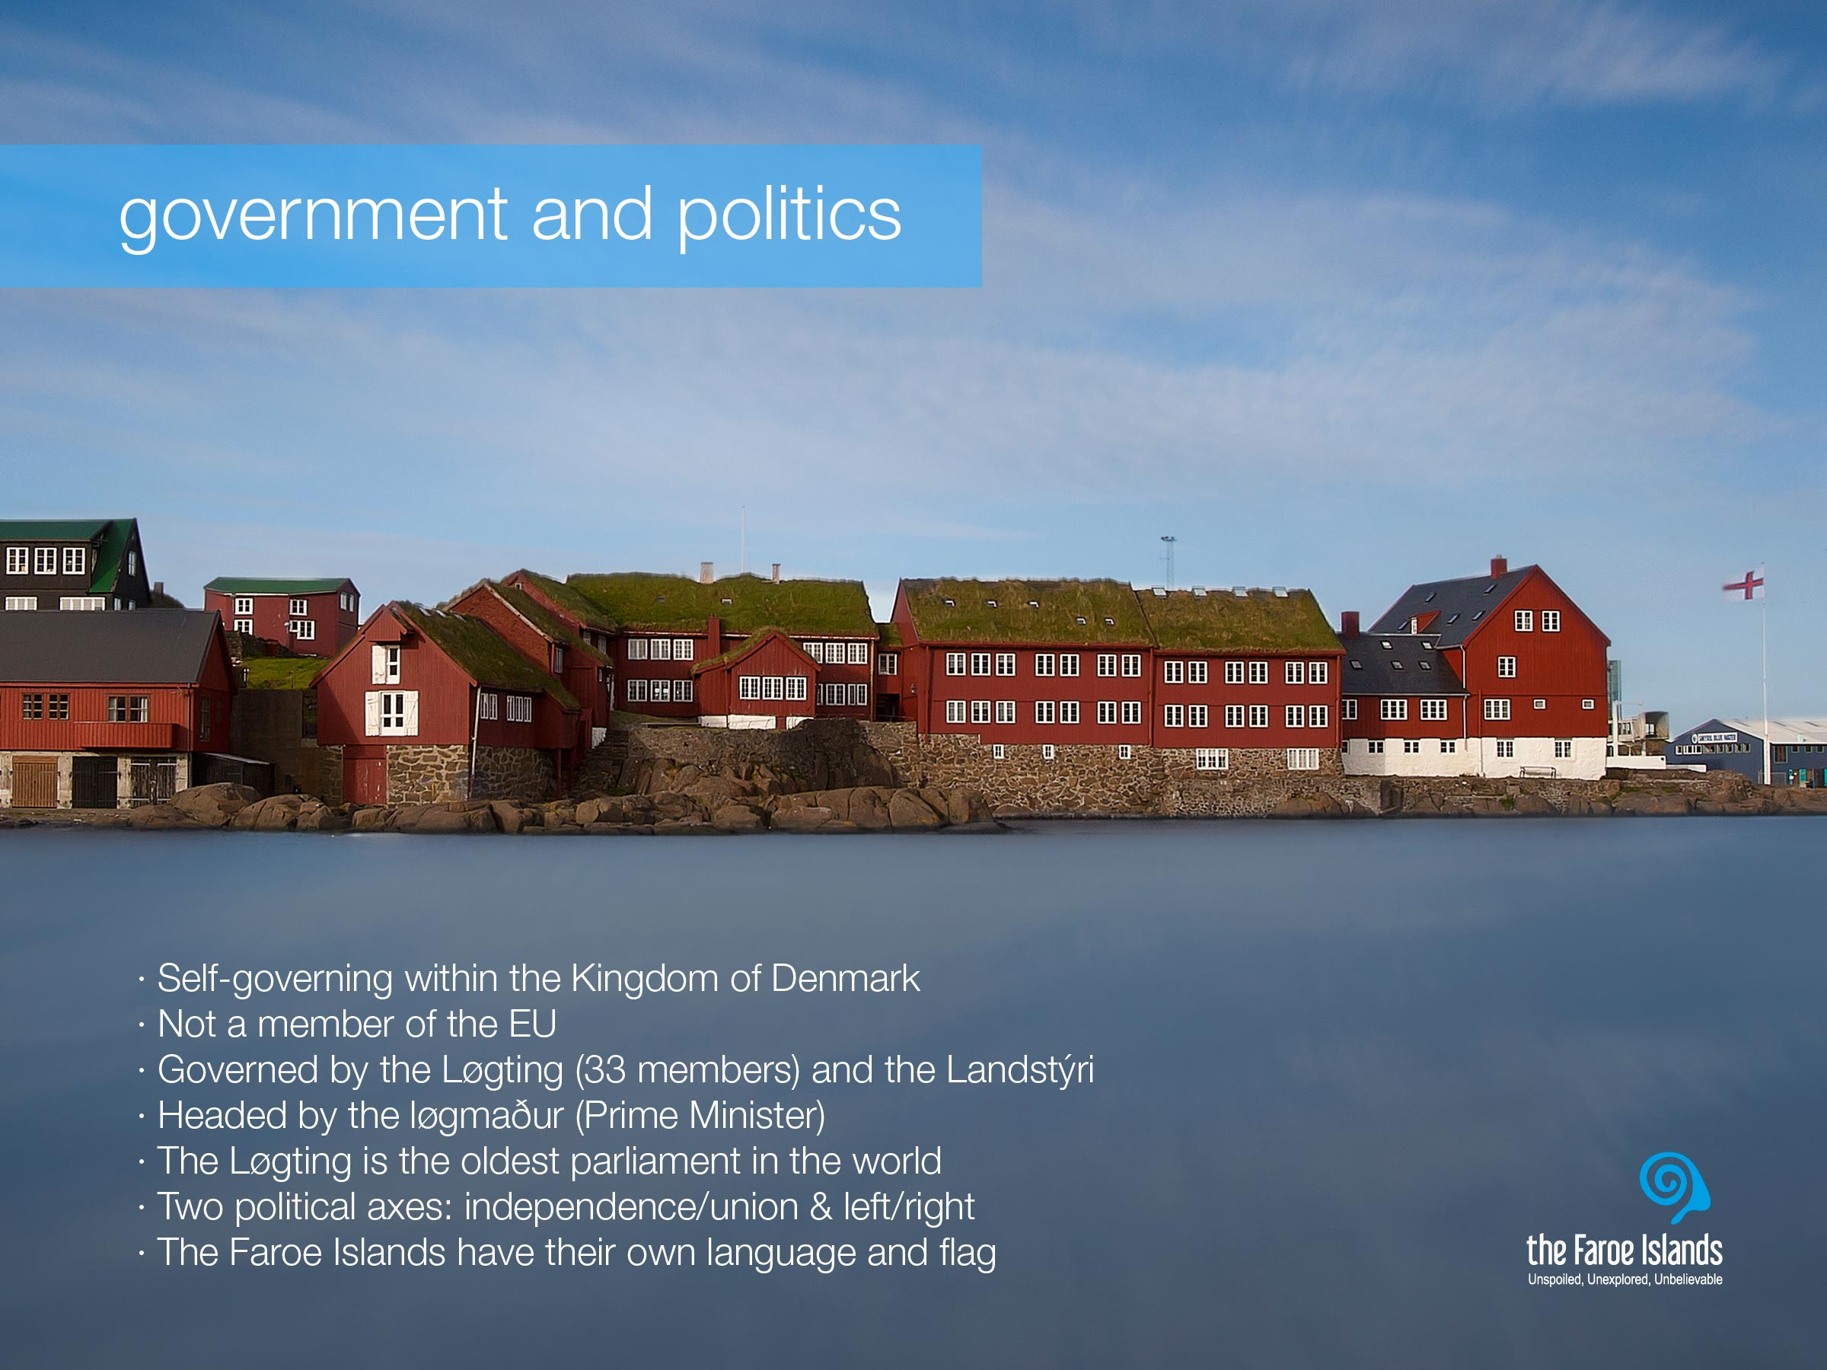
Notes:
The Faroe Islands are a self-governing nation under the external sovereignty of the Kingdom of Denmark. The Faroese political system is a variation of the Scandinavian type parliamentarian democracy, with its own democratically elected legislative assembly, the Løgting (parliament), and an executive government headed by the løgmaður (Prime Minister). The Løgting, which is the oldest parliament in the world.
With economic wealth the Faroese have developed a welfare society much along the lines of the typical Scandinavian welfare state model, e.g. with free education and health care for all.
Although The Faroe Islands are part of the Kingdom of Denmark, and share both currency and Queen with the Danes and the people of Greenland, the degree of Faroese autonomy can be illustrated by the fact that the Faroe Islands are not members of the EU, nor EFTA (and thereby not of the EEA either).
And let there be no doubt, the Faroe Islanders consider themselves Faroese and not Danes and are proud of their own language, flag, culture and people.

Slide 4
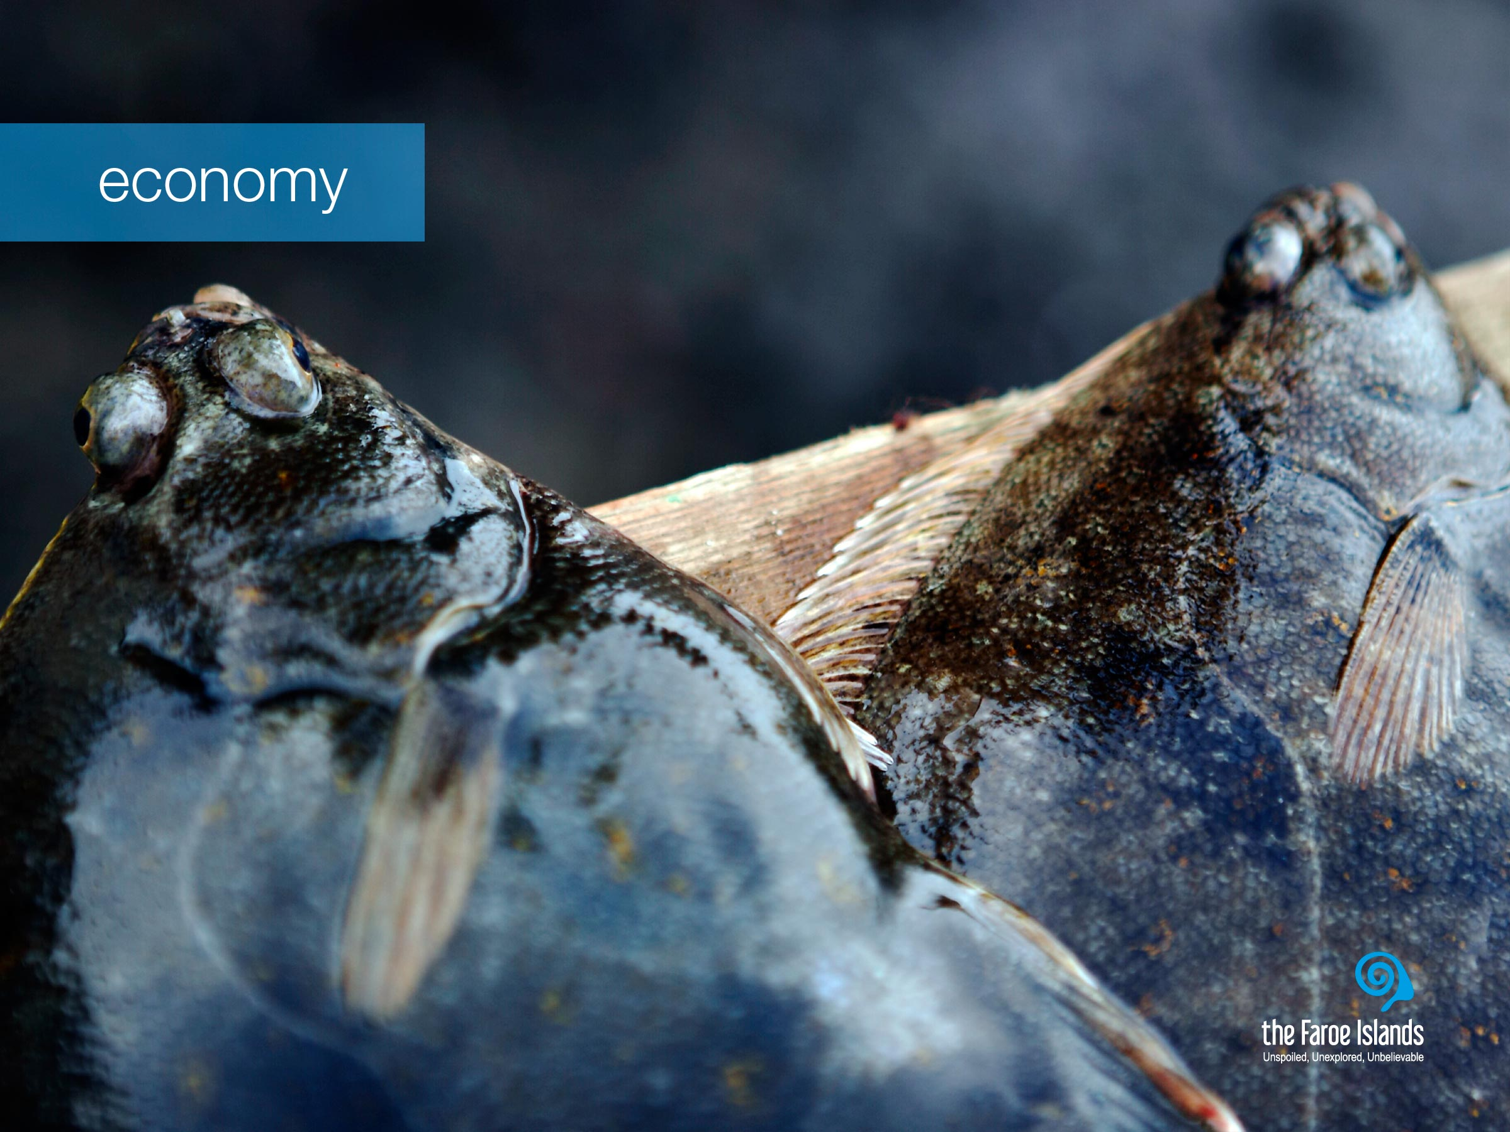
Notes:
Life on the islands hasn’t always been easy. With a firm grip on the realities of island life in the middle of the ocean, they see the North Atlantic as a bread basket and bridge, not a barrier. The sustainable utilisation of the natural resources was the only means of life, both for fishing and aquaculture, and with nature’s mood swings, this challenged life on the Faroe Islands.
The Faroese economy is highly dependant on fisheries and aquaculture as the production and export of fish products constitute 95 per cent of the total income of exported goods.
Other important and promising industries include financial services, petroleum related businesses, shipping and offshore service, manufacturing (esp. servicing the maritime industries), civil aviation, IT and telecoms, tourism and creative industries. Some are already well established, while others – e.g. some creative industries – are up and coming.

Slide 5
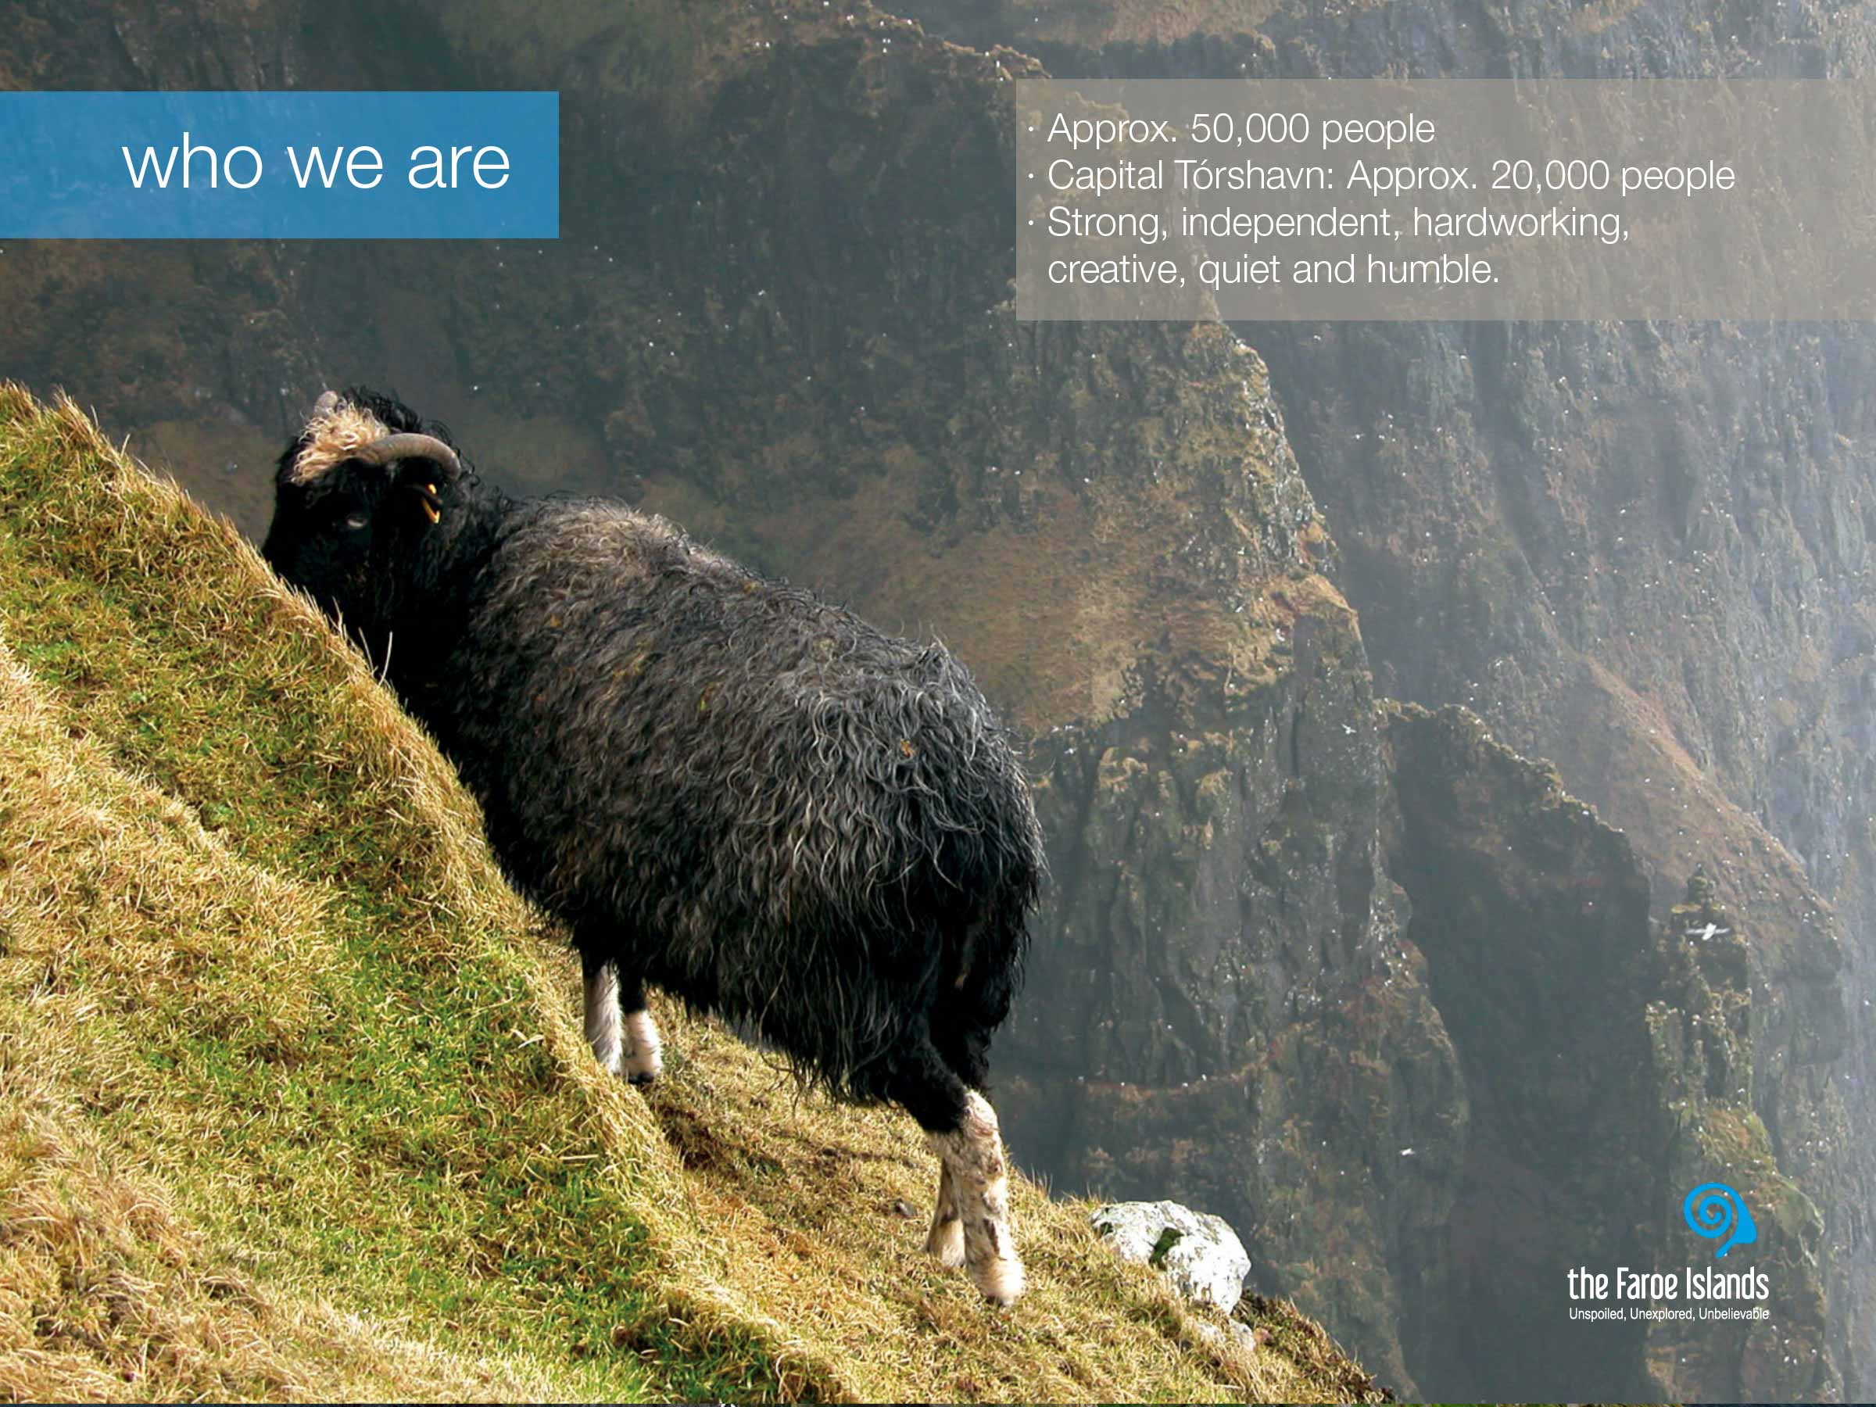
Notes:
The population of the Faroe Islands is approximately 49.000. Twice outnumbered by the sheep and not to mention the 2 million birds.
The Faroese settlement pattern is characterized by a large number of densely populated villages of varying size. There are in all about 100 towns and villages, with Tórshavn the capital, as the largest town where about 40% of the population lives.
The sometimes harsh living conditions, history and nature, has had big impact on the Faroe Islanders, and made them both patient and adaptable to change. Other than that, the Faroese are often characterized as being strong, independent, hardworking and creative people. And although they do have a strong belief in their own abilities, they can come across as being quiet and humble. We are a close-knit community, and close to our heritage. There is little distance between high and low and our different varieties as individuals is visible.
Active participation in all aspects of local community life characterizes the Faroe Islands. This contributes to social cohesion and a strong sense of local identity together with the great sense of national identity. For whatever political view, unionist or wanting independence from Denmark, pride in being from the Faroe Islands is as recognizable as the color of your eyes. The Faroese identity is very strong, for example there are probably not that many places in the world where young people think it is cool to wear their national dress on national holidays, but in the Faroe Islands they do while living a life that is just as globalised as the rest of the modern world.

Slide 6
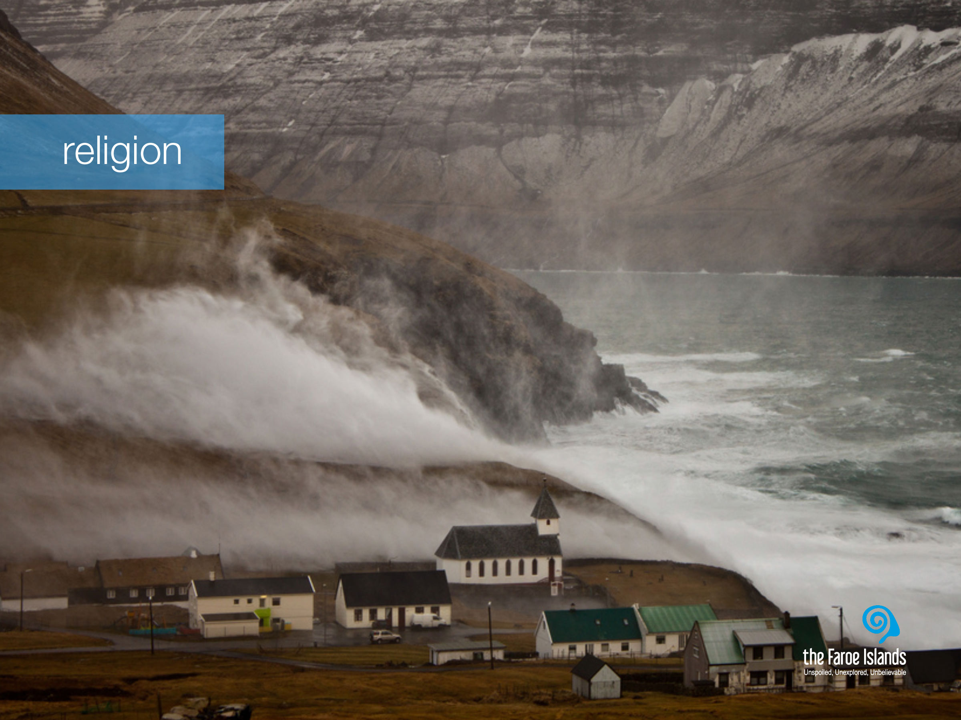
Notes:
The Faroese are predominantly religious, as is often the case with people in island communities.
Nature is present in the Faroe Islands and in the people, both in terms of its natural glory and its mighty powers. On the Faroe Islands, nature is the master. Its powers are enormous. And when the weather is wild and demanding, we truly feel how small we humans are and how grand and powerful nature is. In that sense we understand the need to believe in higher powers. When all the men in a village went out to sea to catch fish, the women and children had to believe that God would bring them back safe, and with a good catch. Unfortunately this was not always the case, and at such moments, the widows sought comfort in their religion.
This is why every village on the Faroe Islands has either a church, a house of prayer or both, and quite often more than just one or two. The churches are all visible from sea, so that the returning fisherman would see the church first and know that they were home safe.

Slide 7
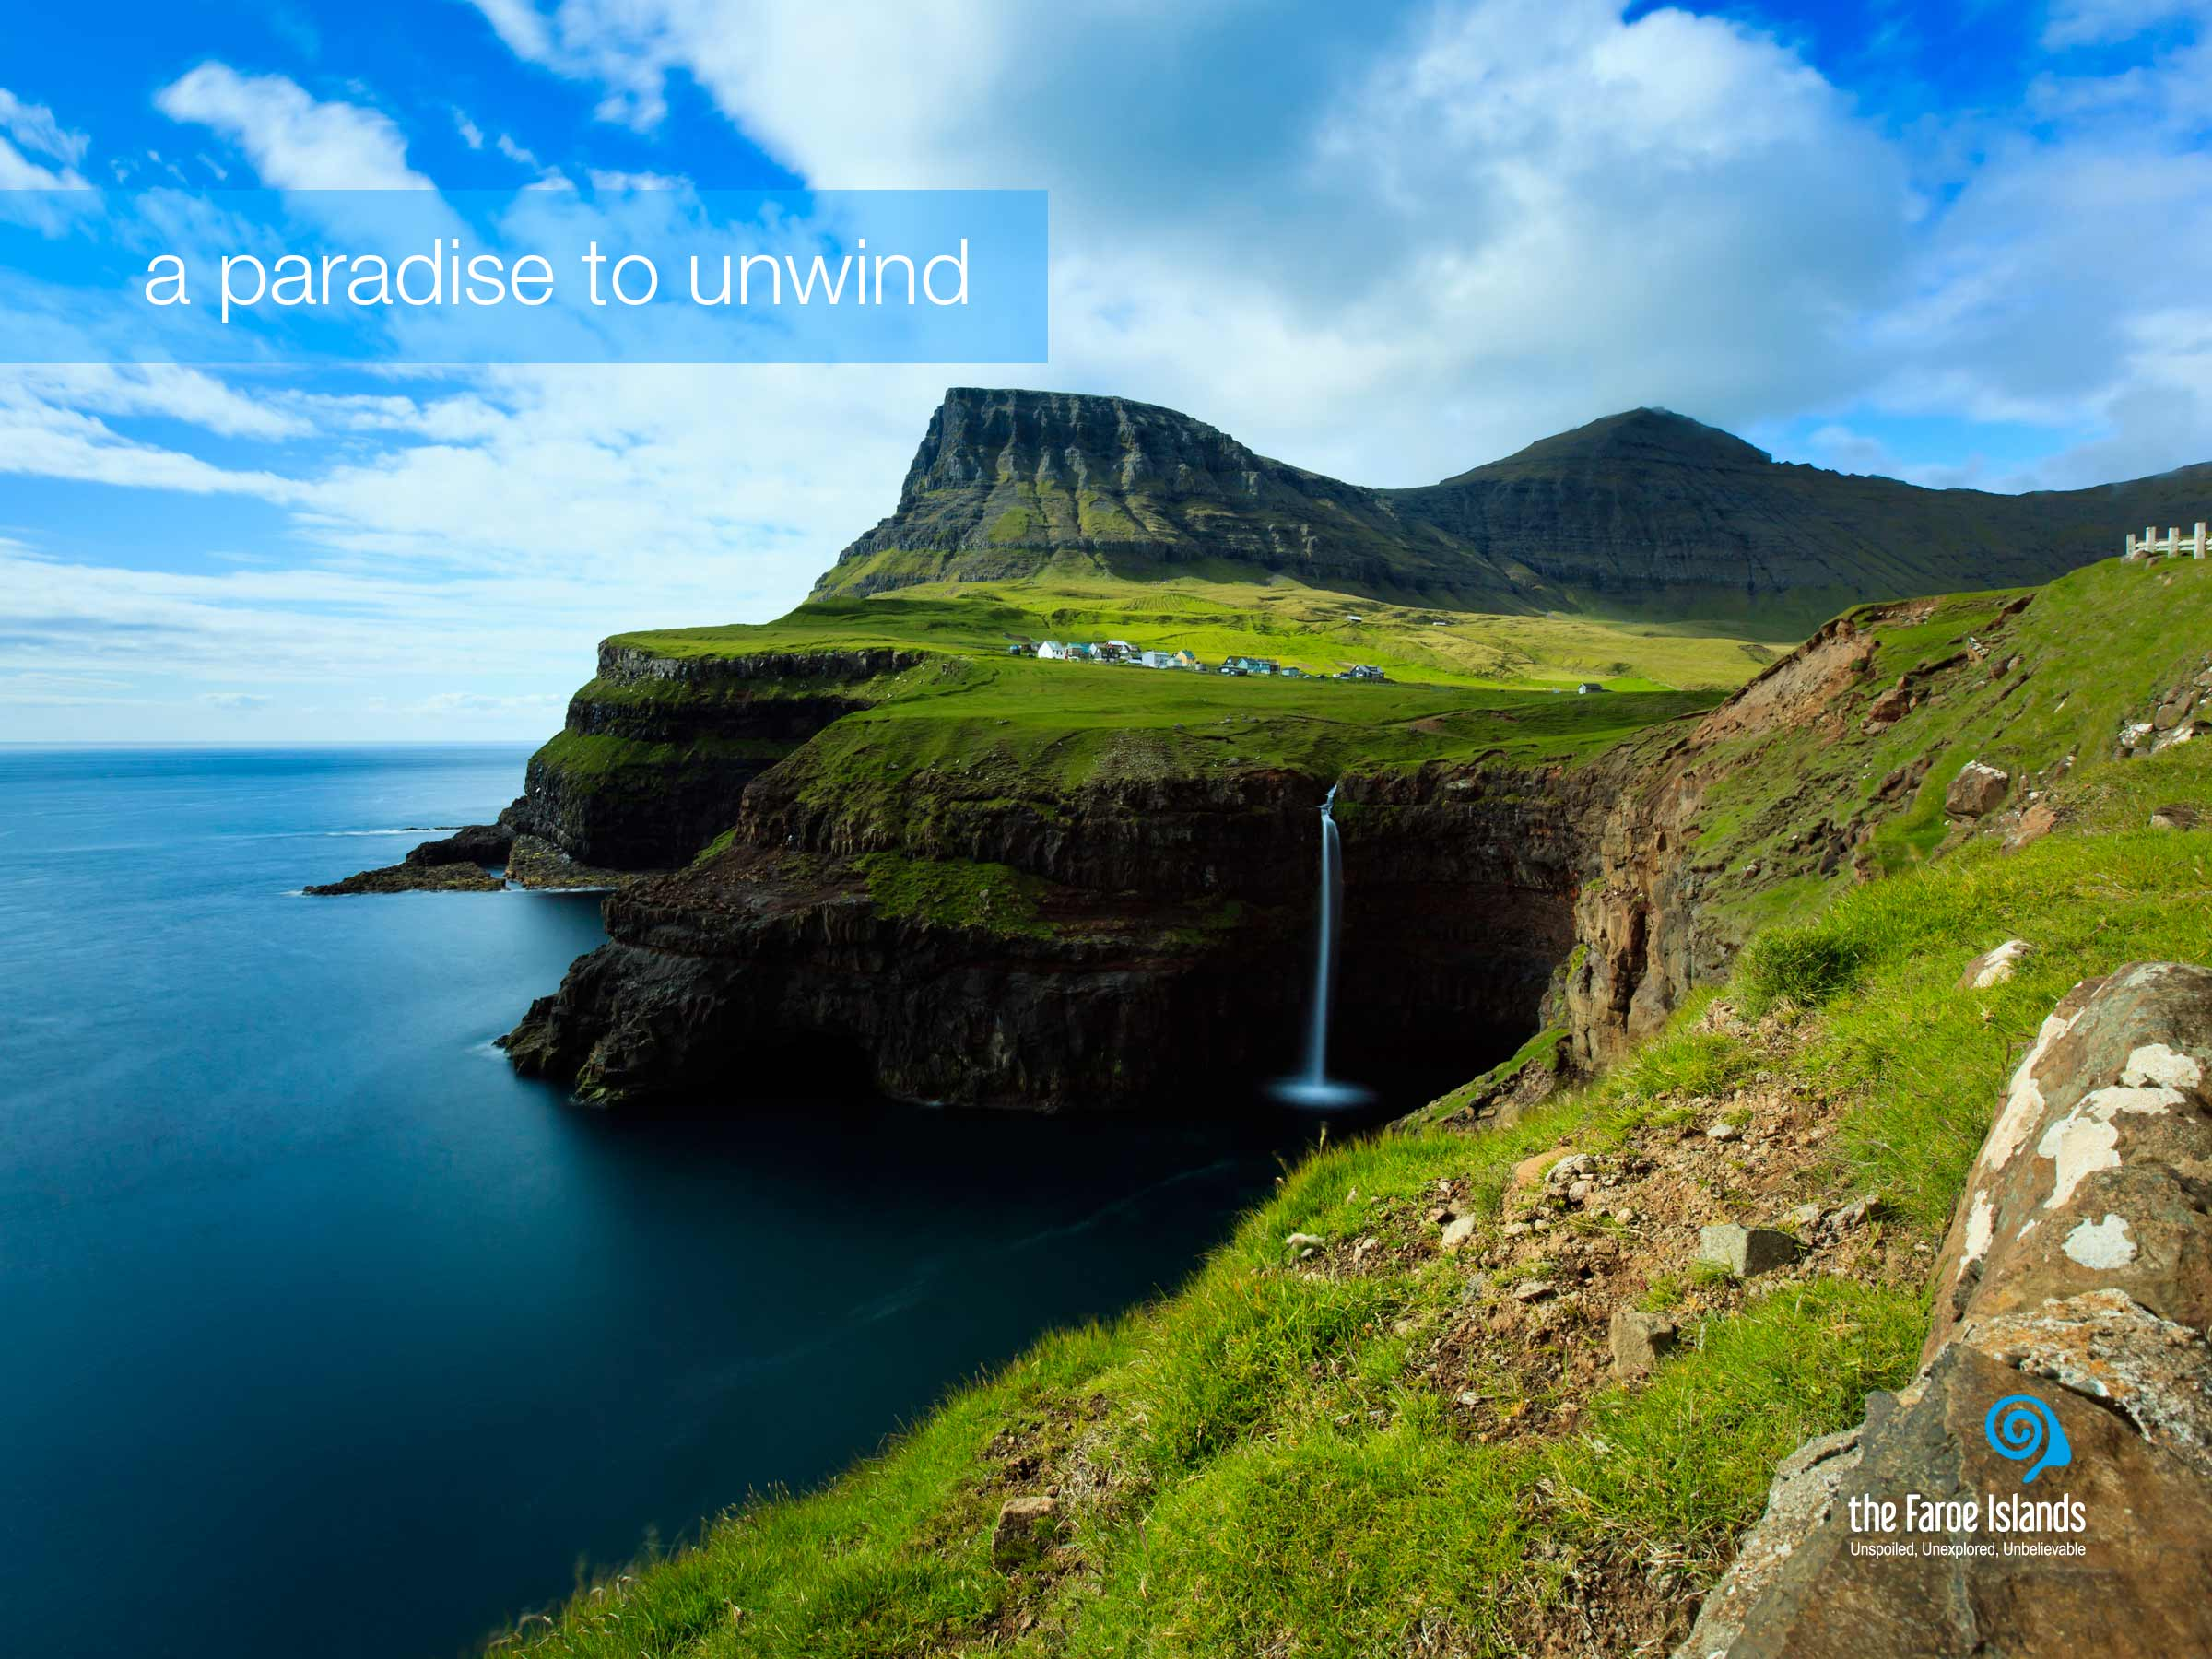
Notes:
During Worls War II, a guest on the Faroe Islands famously named it “the land of maybe.” This was because nature ruled on the Faroe islands and if the weather prohibited you to travel from village to village, you had to accept that – or at least travel at a slower pace – hence maybe was a much used word at that time. Today, the circumstances on the Faroe Islands are not the same. The infrastructure, both on land and sea, and the technology have made life on the islands a lot easier, as with the rest of the world. But the maybe word, in Faroese kanska, has proven difficult to get rid of.
Life on the Faroe Islands is less stressful. The Faroese people live closely in and with nature, something guests recognize the second they set foot on land, whether they arrive by ferry or plane. Absorbing reality, as it is in the Faroe Islands, almost forces you to look within yourself to discover who you really are.
A few years ago the American travel magazine National Geographic Traveler summoned over 500 travel experts to participate in a survey to find the best island community in the world. The survey was based on integrity of place and on what makes a destination unique. 111 different islands were rated and the Faroe Islands topped the list as the number one island destination in the world. National Geographic Traveler say that the Faroe Islands are Authentic, unspoiled and likely to remain so. When the National Geographic Traveler voted the Faroe Islands the best islands destination in the world, it was because the islands are such an uncut gem away from the mainstream of international tourism.

Slide 8
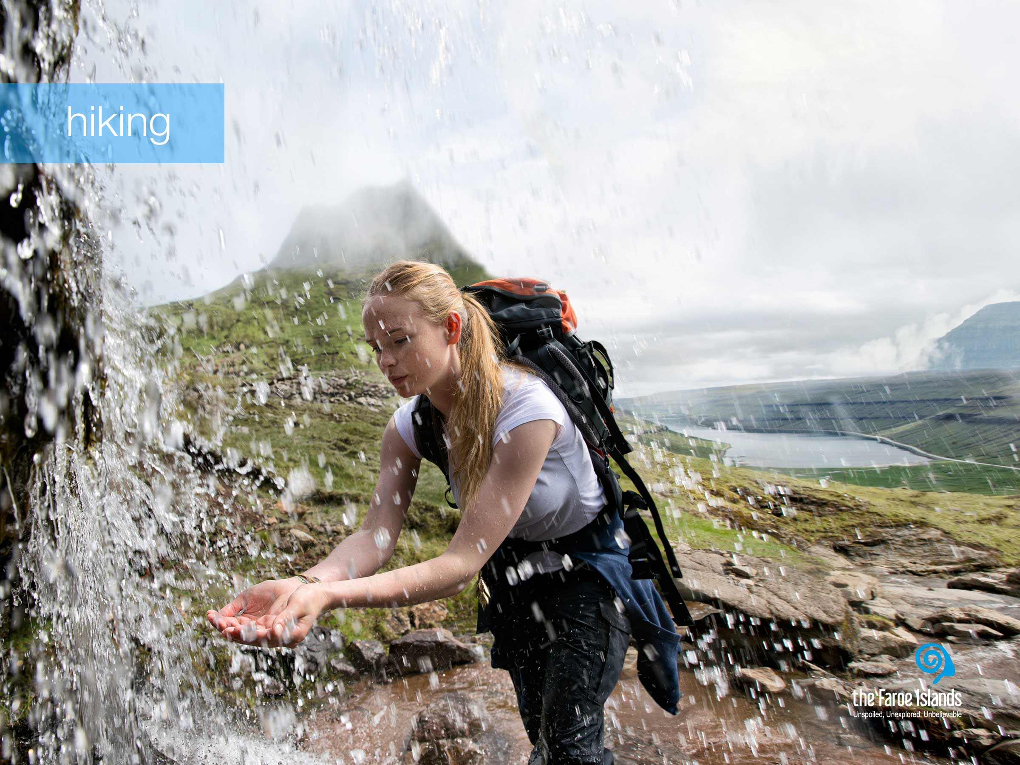
Notes:
Today the infrastructure on the Faroe islands is very good, and nothing hinders you to go from one place to another in no time. Not only are there very good roads, but almost as many tunnels as there are islands, and even subsea tunnels. Therefore it can be difficult to imagine how life was in the past, when the islanders had to hike from village to village in order to get to school, work, visit family or go to the shop.
Hiking is very popular both among Faroe Islanders and tourists, as it is a great way to get close to nature. Some people are great hikers and take hour-long hikes in the mountain, weekly. And the more difficult and dangerous the hike, the better. While others like to park their car by the road and take a shorter stroll or hike in the mountains.
Apart from the sheer enjoyment of a hiking trip in the hills and the mountains and the green grass, the clean air is something that makes the hiking trip even more refreshing. Both the smaller water streams and the wild waterfalls consists of clean fresh water and you can safely drink just as much as you like.
As it is possible to get quite close to the birds either by boat along and under the majestic bird cliffs or just by walking in nature, the Faroe Islands are a quite popular destination for bird lovers and photographers who like to get a close frame of these colorful birds. The most photographed must be the colorful Puffin, with its clumsiness and sad expression and also our national bird, the Oystercatcher or Tjaldur as we say in Faroese.

Slide 9
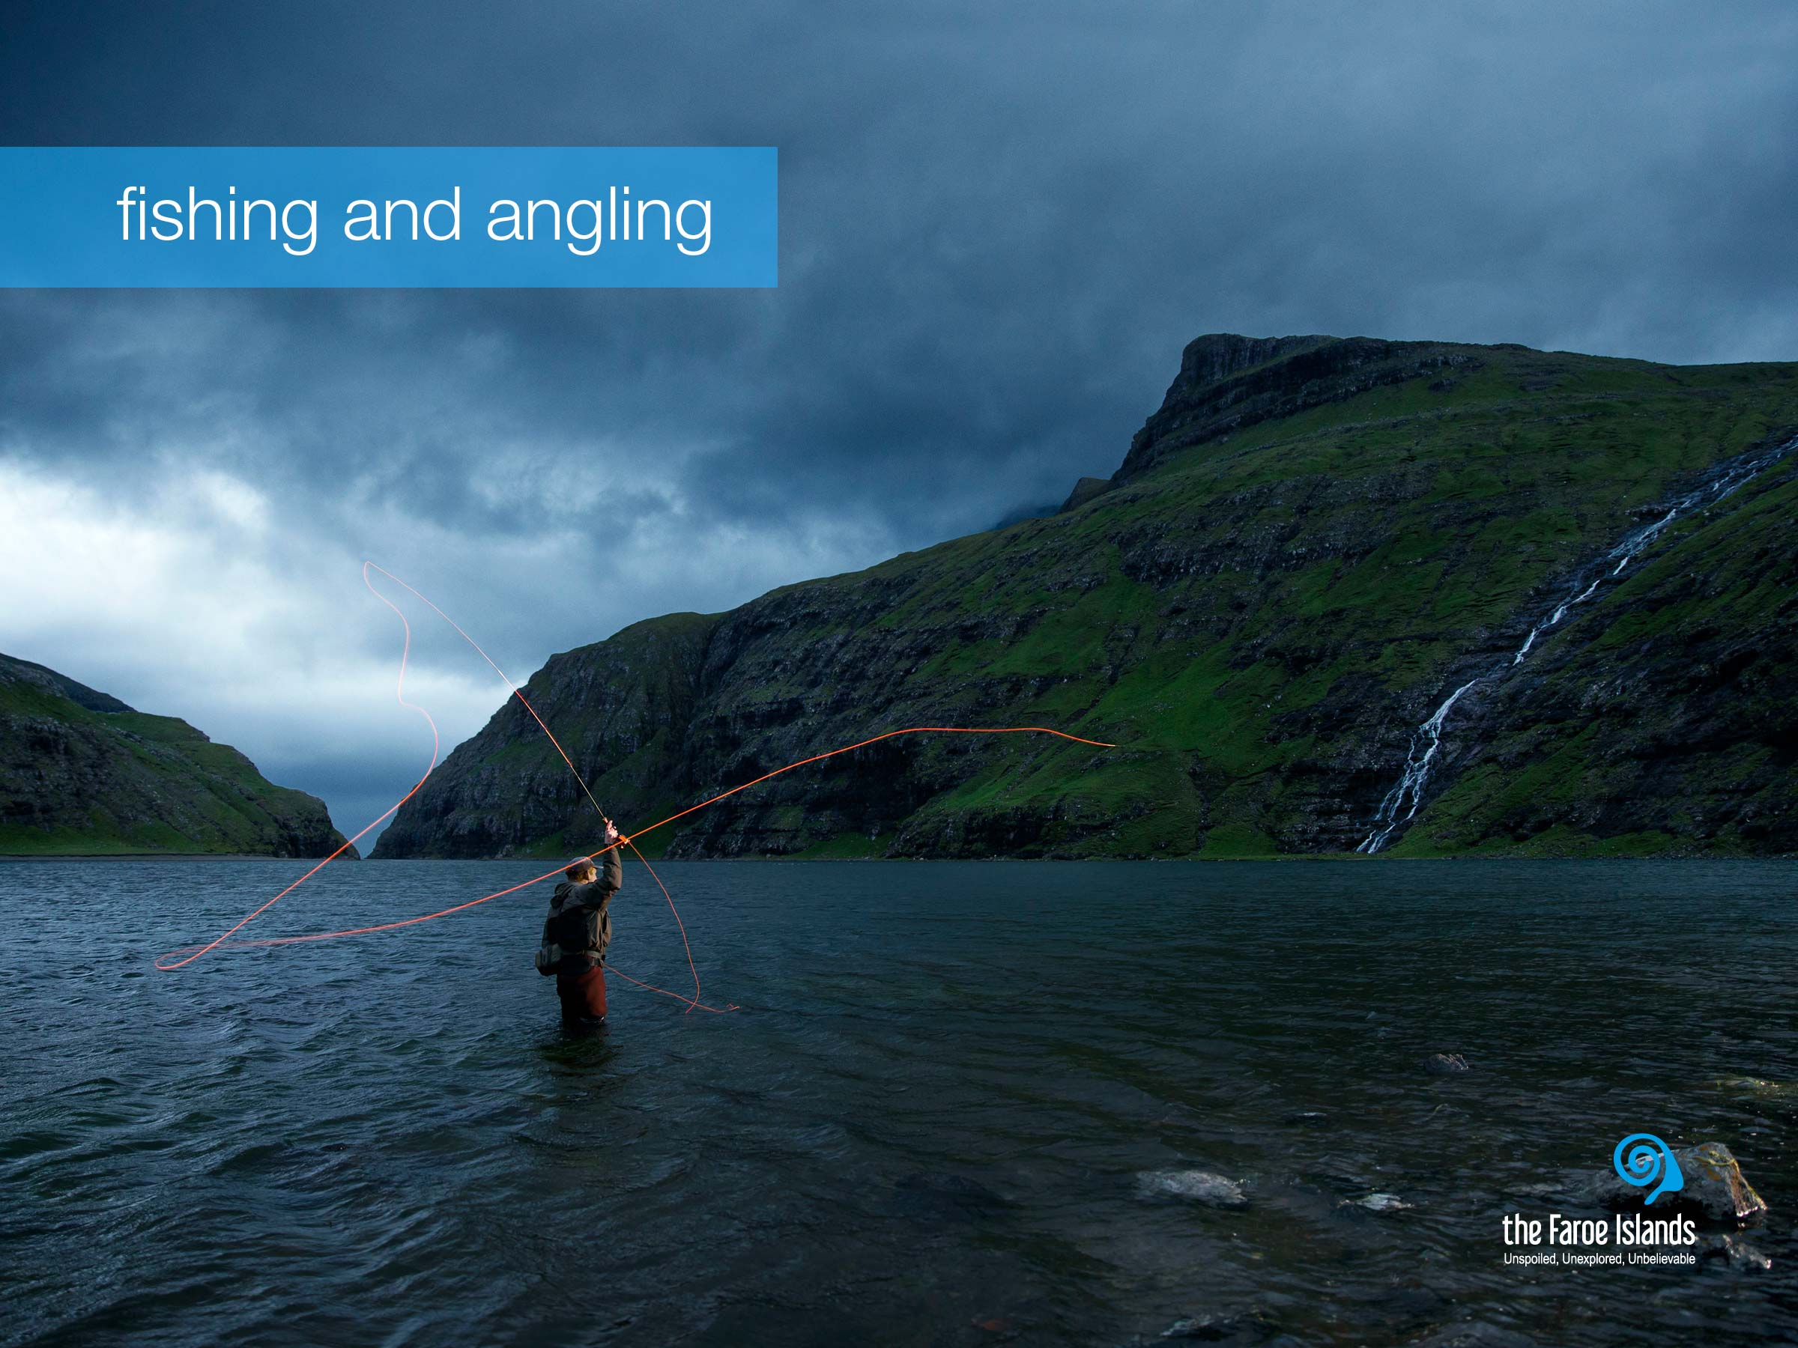
Notes:
The Faroe Islands are surrounded by the North Atlantic Ocean, and therefore a boat trip is always an adventure. Nature continues to surprise people during these trips - puffins skimming the waves, seals basking on cliffs, a school of whales or a flock of rare seabirds following the boat closely.
On a boat trip you may feel even closer to nature - and experience her unspoiled beauty. There is no guarantee of what you will see in advance, but you will have the experience of a lifetime. Amongst the many types of boat trips, you can choose from: fishing, bird watching or even try the unforgettable concerto grotto.
Fishing is how the Faroe islanders have survived the remoteness and harsh circumstances of the location – so fishing is at the very core of Faroese expertise. Fishery is not only an industry that employs many people, many Faroese families have their own boat with which they go out fishing when time and weather allows them to do so. And angling is also a favored pastime activity, hence Faroese cuisine is very much centered around fish.

Slide 10

Notes:
The Faroe Islands are a nation of poets and writers. The love of poetry and story-telling is deeply rooted in Faroese culture. Faroese literature is a literature of contrast between the old and the new, between tradition and innovation. Faroese literature is genuine Faroese and at the same time embedded in the literary history of Europe.
It is often said that nature is a teacher and an inspiration to artists and creative souls in the Faroe Islands and that creativity and the cultivation of deep-rooted tradition are characteristic traits of Faroese society. The Faroese are well connected to the rest of the world and constantly embrace new trends while learning at the same time each day how better to share their unique creativity and culture with the rest of the world.
Deeply rooted in their long tradition of ballads and songs, the people of the Faroes simply cannot stop singing. Vocal traditions have been exceptionally rich and versatile, as there were no musical instruments of significance until the mid 1800s. The voice was the only music-making tool available, and as a result, singing is deeply anchored in the Faroese national identity. The Faroe Islands’ music scene is buzzing and artists and creators across all genres are delivering world class performances and recordings.
Today the creative vibe is found everywhere in events and in creative hubs for art, crafts and design where musicians, fashion designers, writers and artists and producers of handicrafts make artefacts and goods for consumption that are both locally inspired and touch on themes and trends that are meaningful in a global context.

Slide 11
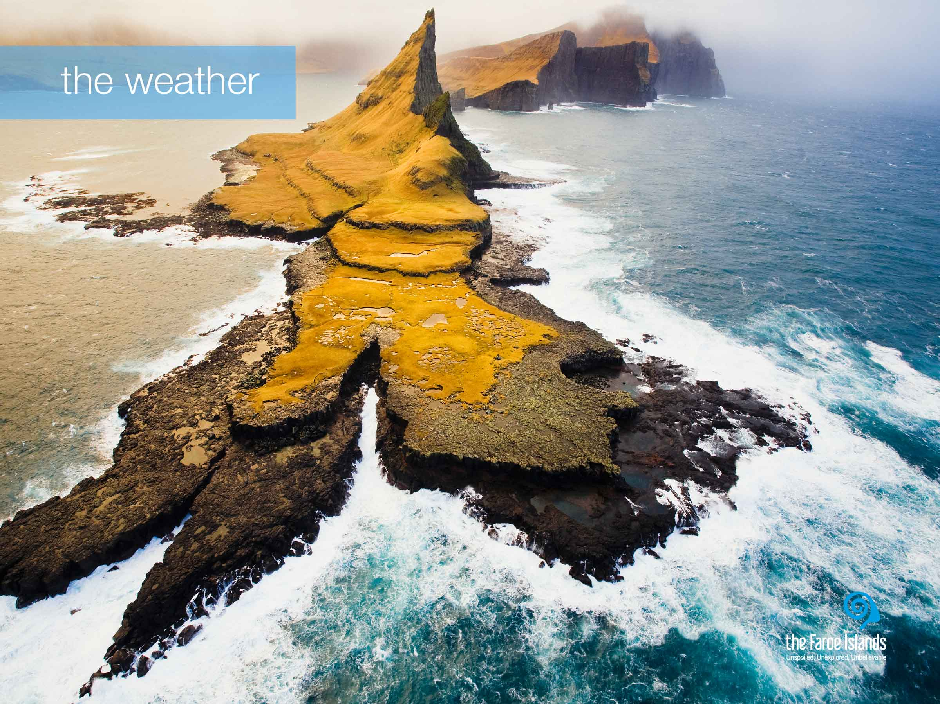
Notes:
The climate on the Faroe Islands is very much influenced by its location in the warm Gulf Stream, which together with the remoteness of any source of warm airflows, ensures that winters are mild while summers are cool. The average temperature in the warmest months is 13°C resulting is mild summer days and during the winter the average temperature is 3°C. So the temperature here is not very changeable over the year compared to most other countries. The Faroe Islands are windy, cloudy and cool throughout the year.
One of the many charms with the Faroese climate is the constantly changing weather. One of the most common feedbacks from tourists is the uniqueness of experiencing all four seasons in the same day. And even though the Faroe Islands are small, there is a big chance that the weather is different at the other end of the country or even the next village. During summer, we enjoy long days and light nights. In the middle of the summer the sun hardly sets and the longest day is 19½ hours long. In contrast, the winter days are somewhat different, and December has only few hours of true daylight.

Slide 12
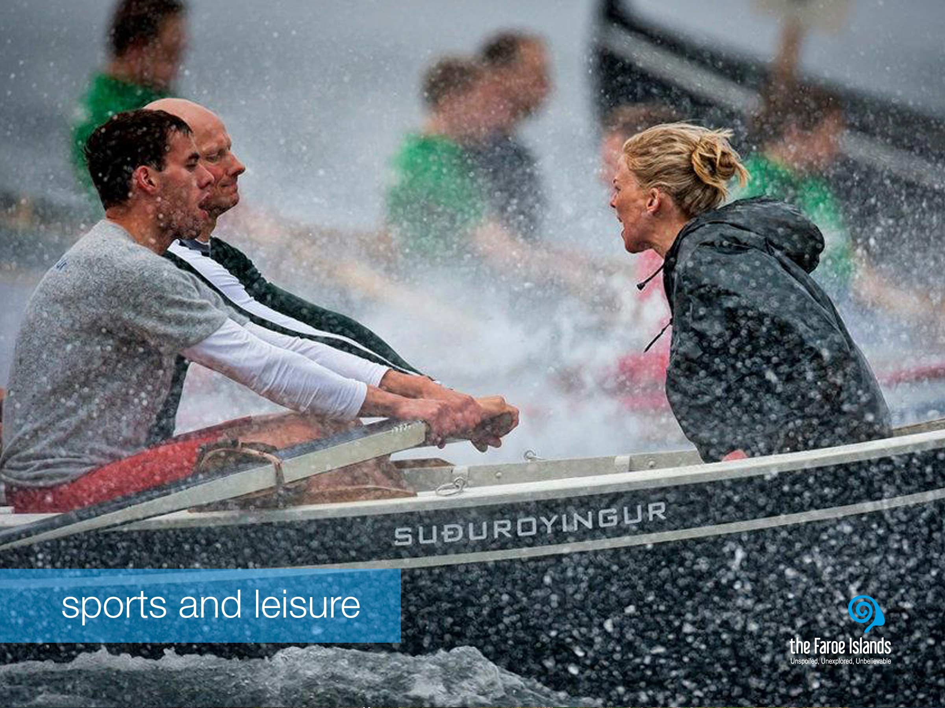
Notes:
The Faroese people are crazy about sports, both as a way of exercising and for leisure. This positive attitude towards keeping active has clear roots in the social and historical circumstances of the Faroe Islands. Before the introduction of modern infrastructure, people often had to walk long distances, hike up mountains, and row from island to island in order to get around. So physical activity is a natural extension of everyday life in the Faroe Islands, and it continues to be so.
The best known Faroese sports team is the men's national football team. But currently, the most accomplished Faroese athlete is the European Championship runner-up and Olympic swimmer Pál Joensen, who has caught the world's attention, and his people’s great pride with his impressive competitive achievements.
Football is the most popular and widespread sport in the country. Though the official national sport is rowing, which has direct connections to the cultural heritage of the Faroe Islands. Other popular sports are handball, volleyball, swimming and gymnastics.

Slide 13
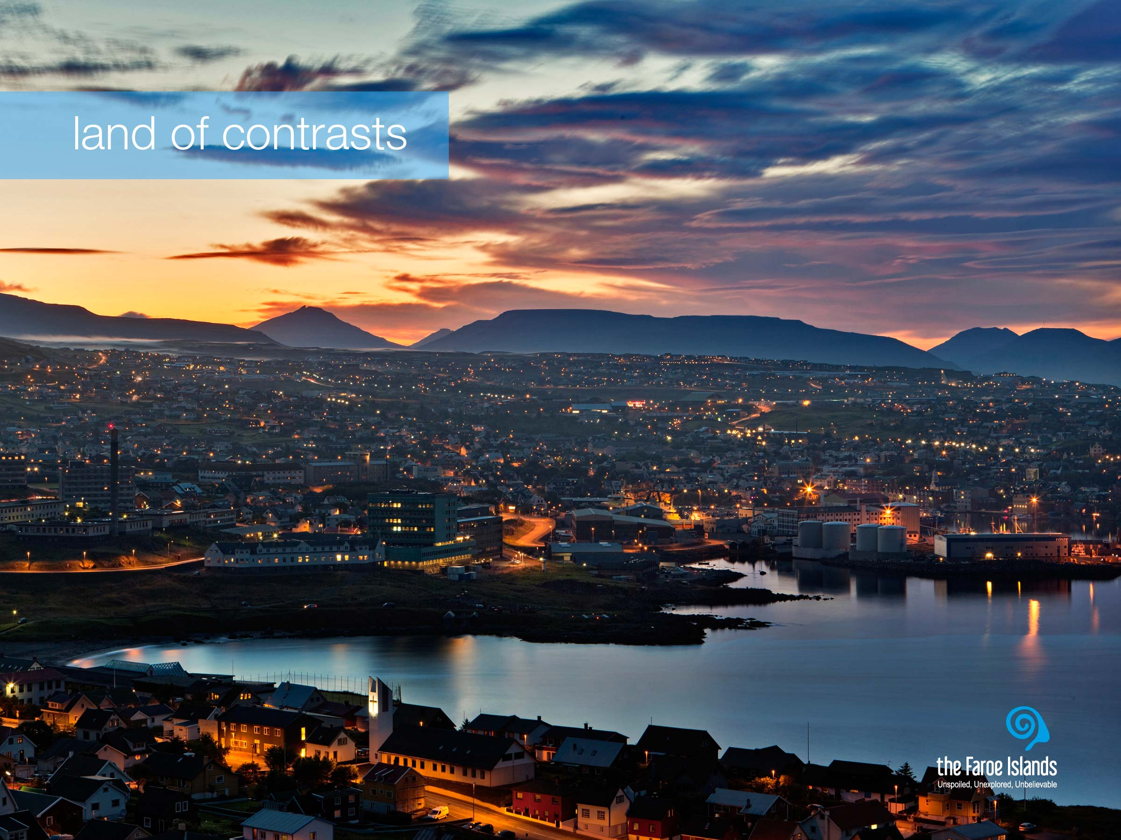
Notes:
The contrasts on the Faroe Islands are very dominant, and something we as a people think of as natural, but definitely something tourists notice very clearly when they visit the Faroe Islands. There is the tangible contrast between modern lifestyle and the very present traditions. But as a people, we are full of contrasts too. One moment we may be hierarchically differently placed in a company, but the next we are equals on the football pitch or when tending or slaughtering sheep. Somehow these contrasts also ensure that we are tolerant and open to new trends and norms. There is a curious co-existence of a highly modern society with old-fashioned traditions. We are not an ancient community, but modern with strong roots. The contrasts are also created by nature, because if it had not been so powerful, the good infrastructure would not have been created.
The capital Tórshavn is a great example. For a city, with just about 20.000 inhabitants, it is surprising, how modern it is. This peaceful, yet energetic capital has managed to meet the demands that any modern people demand.

Slide 14
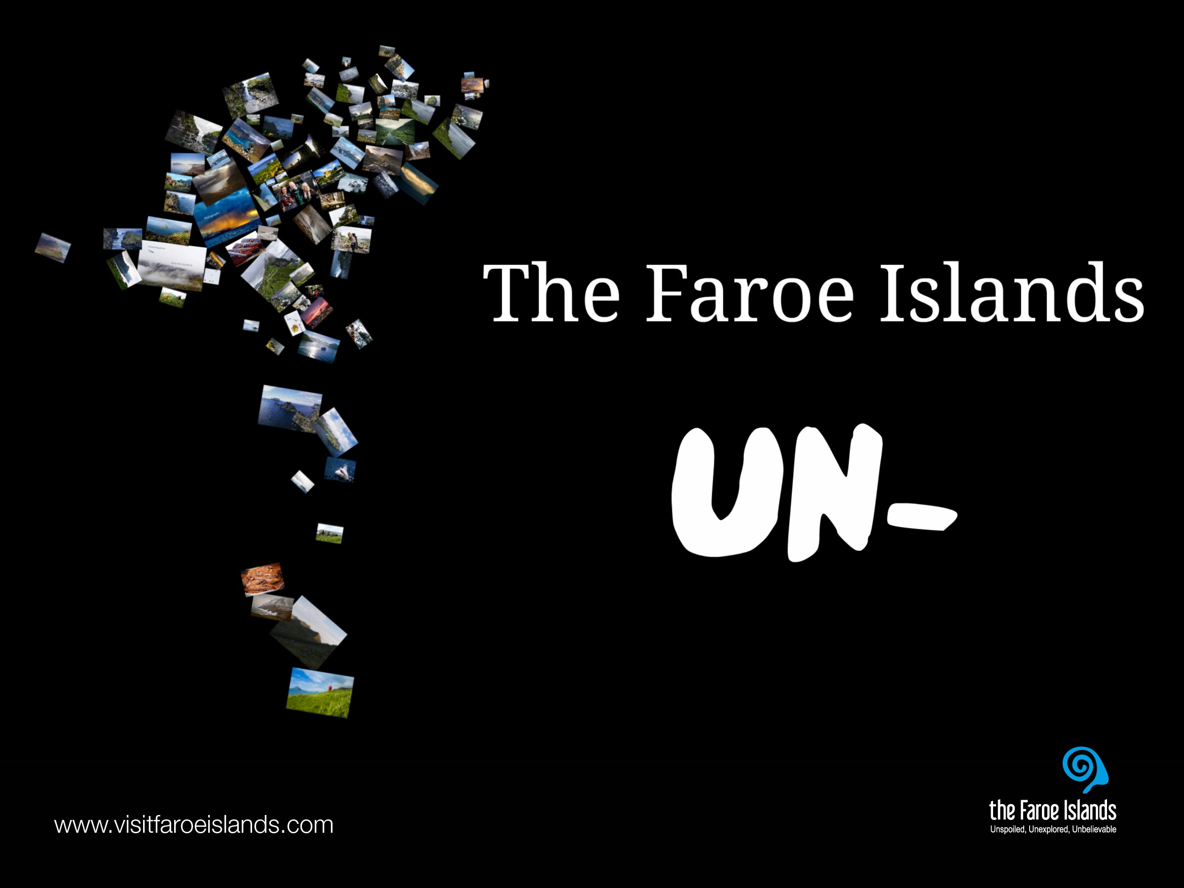
Notes:
The un – destination
When you take a look at all the descriptions of the Faroe Islands that tourists have made, you notice a pattern. Unspoiled, unexploited, unpolluted, unexplored... Many of the words used to describe the Faroe Islands are so-called un-words. Perhaps ordinary descriptive words just aren't adequate. Or perhaps this hidden, treeless land of contrasts, evokes such unique emotions in its visitors, that the best way to describe it is by setting it apart from the rest, by applying the inherent meaning of the small, yet powerful prefix, un.
For more information on the Faroe Islands, visit: www.visitfaroeislands.com and www.faroeislands.fo

