Slide 1
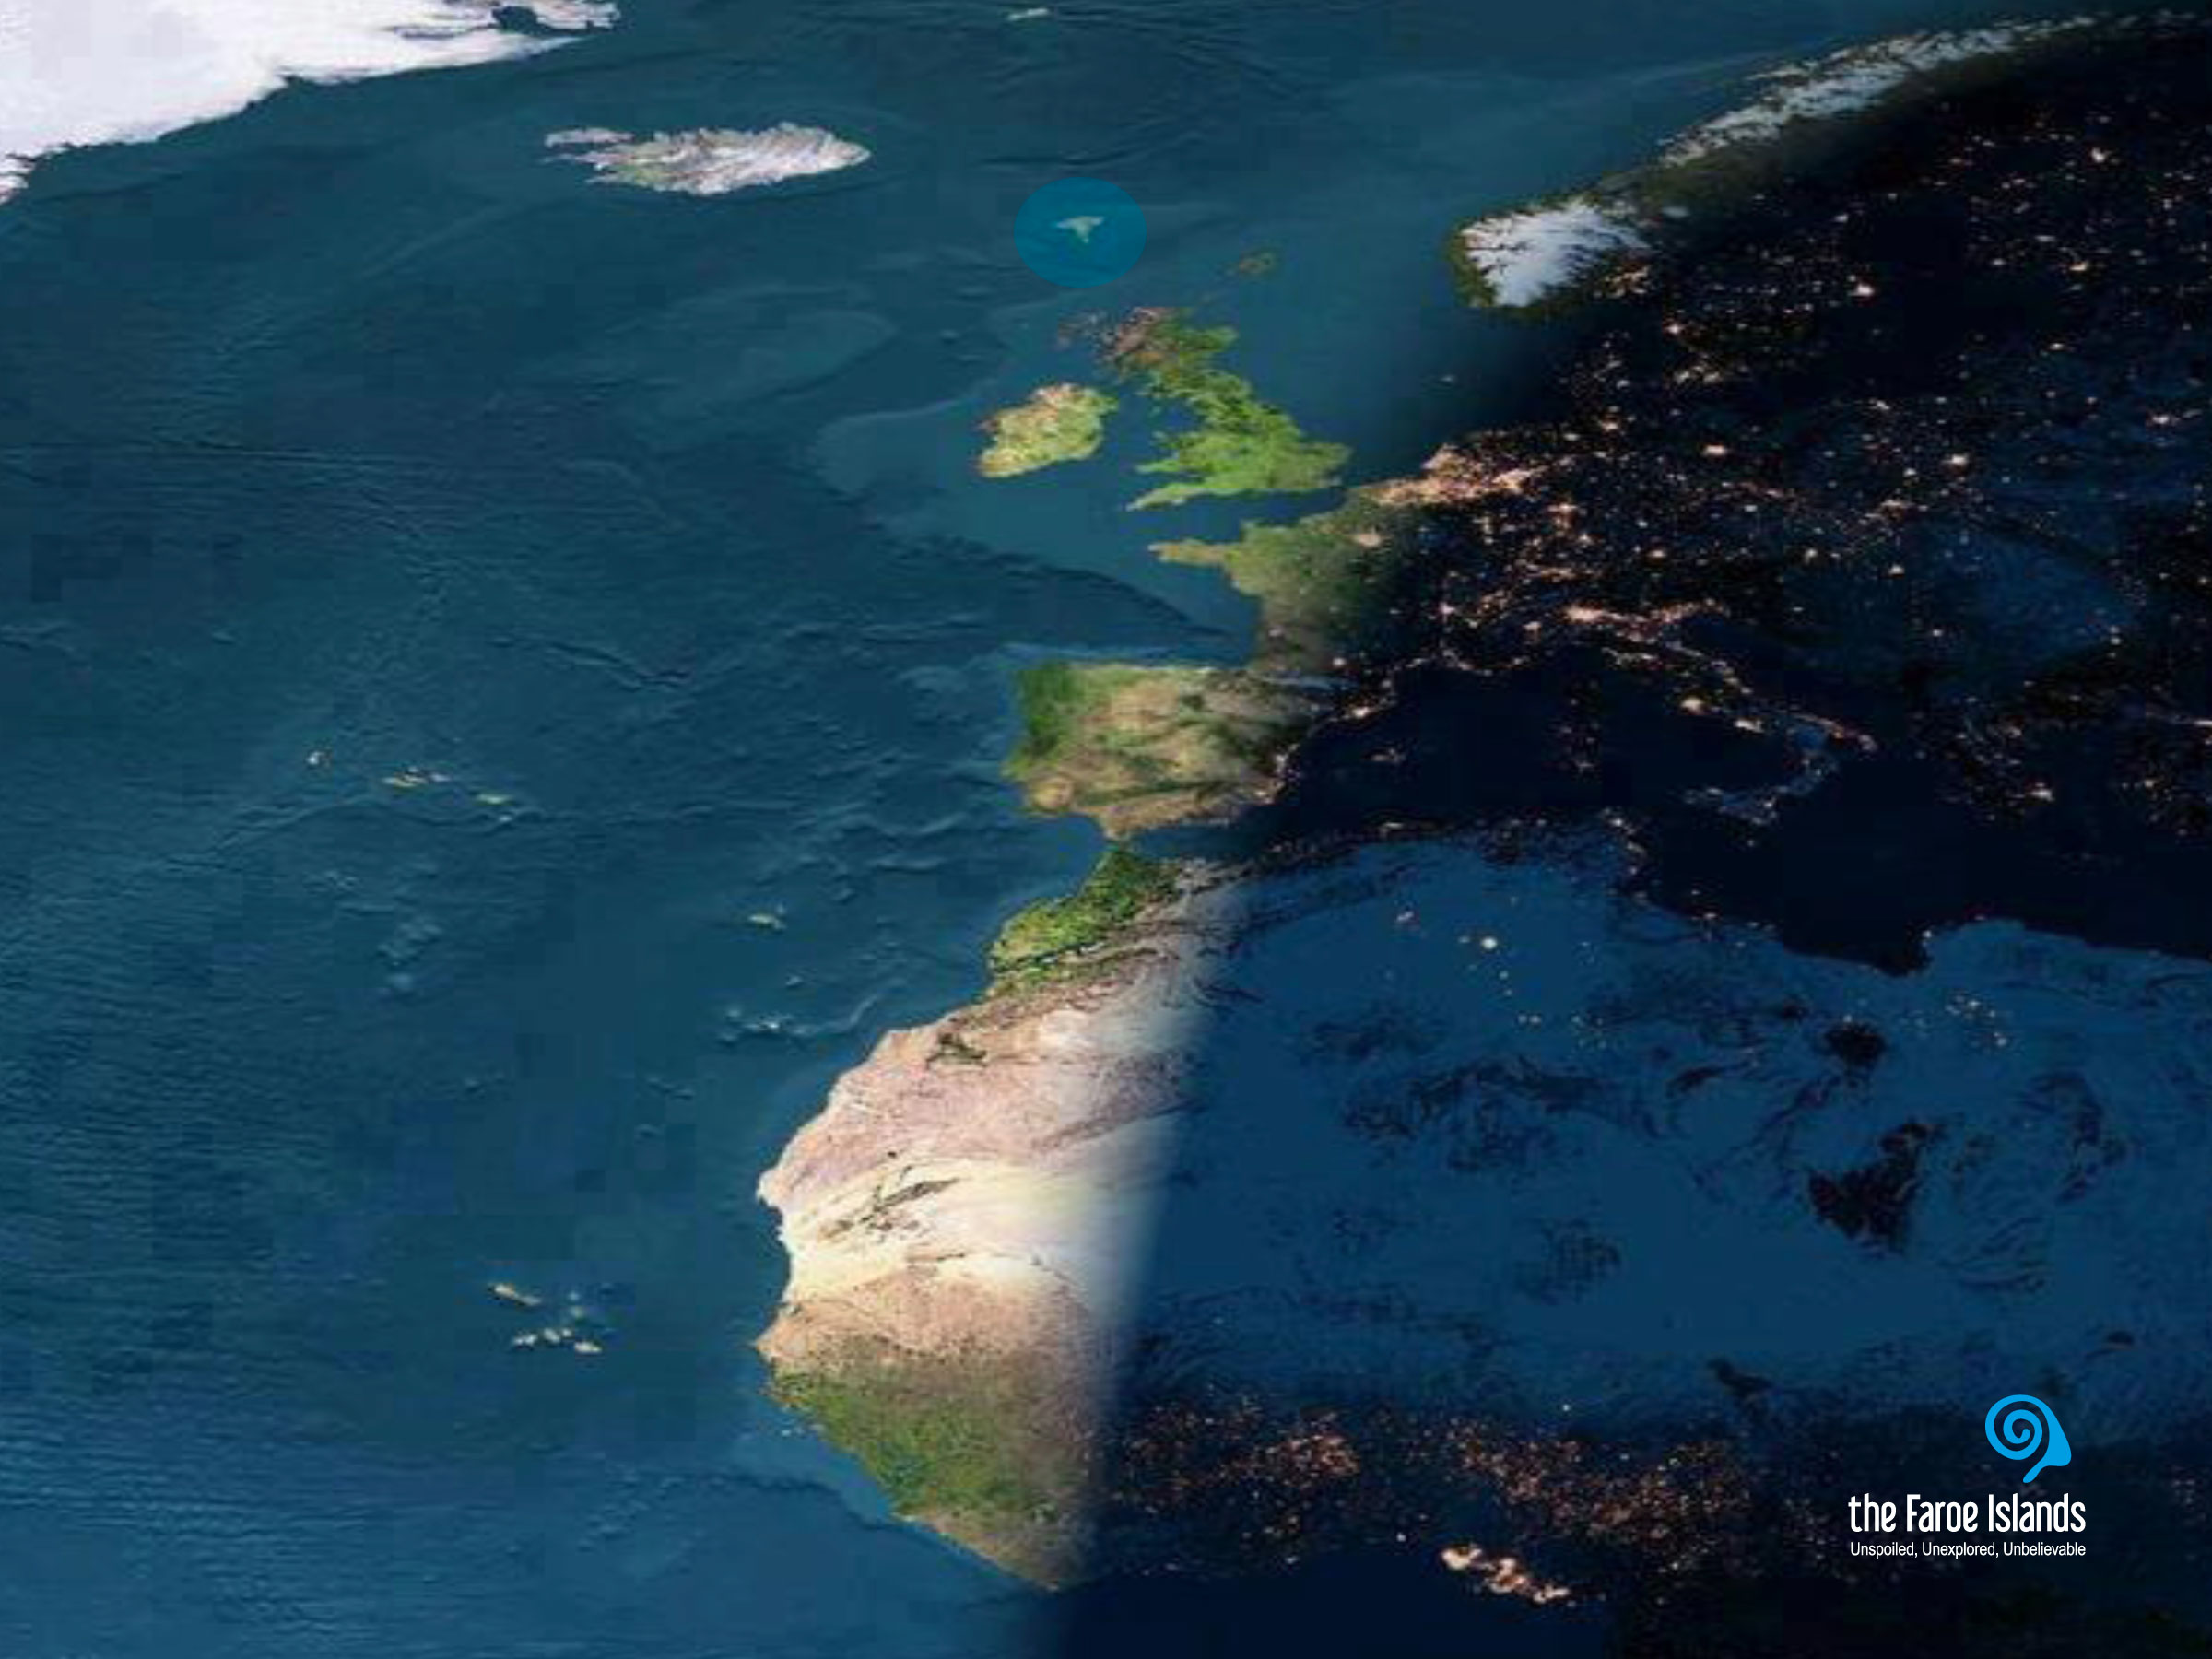
Notes:
Most people don’t seem to know that the Faroe Islands exist. And it is not strange that people do not know about the Faroe Islands. They are not even on most world maps. And if they are, they are marked by two or three small dots hardly visible to the naked eye.
This makes it difficult to imagine the versatility of what the Faroe Islands have to offer and what they are composed of.
Gævi gætur at Visit Faroe Islands eigur rættindi til allar myndirnar í framløgunum og at myndirnar bert kunnu brúkast í hesum líki í samband við framløgur um Føroyar.

Slide 2
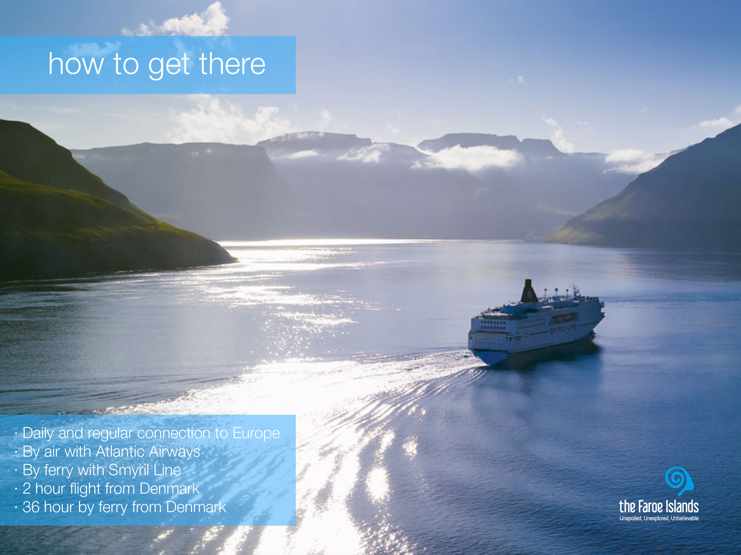
Notes:
Getting to the Faroe Islands is easy. Despite the seemingly remote location of the Faroe Islands, they are much closer than you might think. It’s just a two to three hour flight from continental Europe. The national airline, Atlantic Airways, operates flights from Iceland, Norway and Denmark to the Faroese airport Vágar. There are several daily flights from Copenhagen airport.
You could also choose to take the scenic route, arriving by ferry. Smyril Line gives you a glimpse of how the Vikings might have felt when sailing into the dramatic seascape of this archipelago. You can board the ferry Norrøna both in Iceland and Denmark.

Slide 3
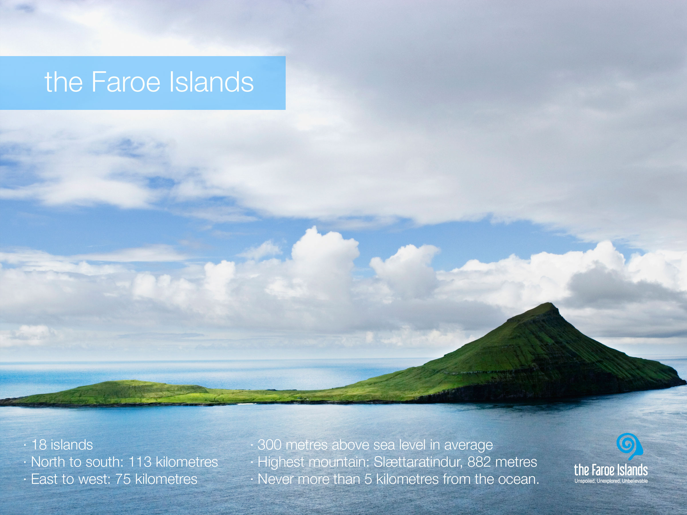
Notes:
The Faroe Islands are characterised by an incredibly fresh and clean air, a dramatic landscape with steep mountains, deep fjords, green grass and the lack of trees. The villages are small and scattered around 17 of the 18 islands. The islands differ both in size and character. In the north they seem more dramatic with higher mountains and tall cliffs, whereas they are greener and more velvety in south. On the Faroe Islands, most people own their own houses, and therefore you will not see big, grey apartment blocks, instead the houses are colourful and often, especially with the old houses, you will find that houses have grass on the roofs. There is a rich bird life on the islands, and there are twice as many sheep as there are people.
The island on the picture is Koltur. Koltur is one of the smallest of the islands. The island was uninhabited for many years, but today one family lives on the island. Among Faroe Islanders, Koltur is a popular place to visit for different reasons. Firstly it is a beautiful island, and a good place to hike for everyone, as it is not that steep, the highest top is 478 metres and most people can reach both tops without training or having special hiking skills. Secondly the old village has been restored, and therefore a good place to visit for historical reasons. Thirdly, because of the habitation, it is not so easy to visit the village as there is no regular ferry connection. So you either have to know the family on the island and visit them, or go on the arranged trips that are made, mainly in the summer season, to the island.
Facts:
· 18 islands
· Total area is 1,399 sq.km - total coast line is 1,289 kilometres
· The largest island is Streymoy (375.5 sq.km) with the capital, Tórshavn.
· The overall length of the archipelago north-south is 113 kilometres, and 75 kilometres east-west.
· The islands’ highest point "Slættaratindur" is 882 metres.
· On average the land is over 300 metres above sea level.
· At no time are you more than 5 kilometres (3 miles) from the ocean.

Slide 4
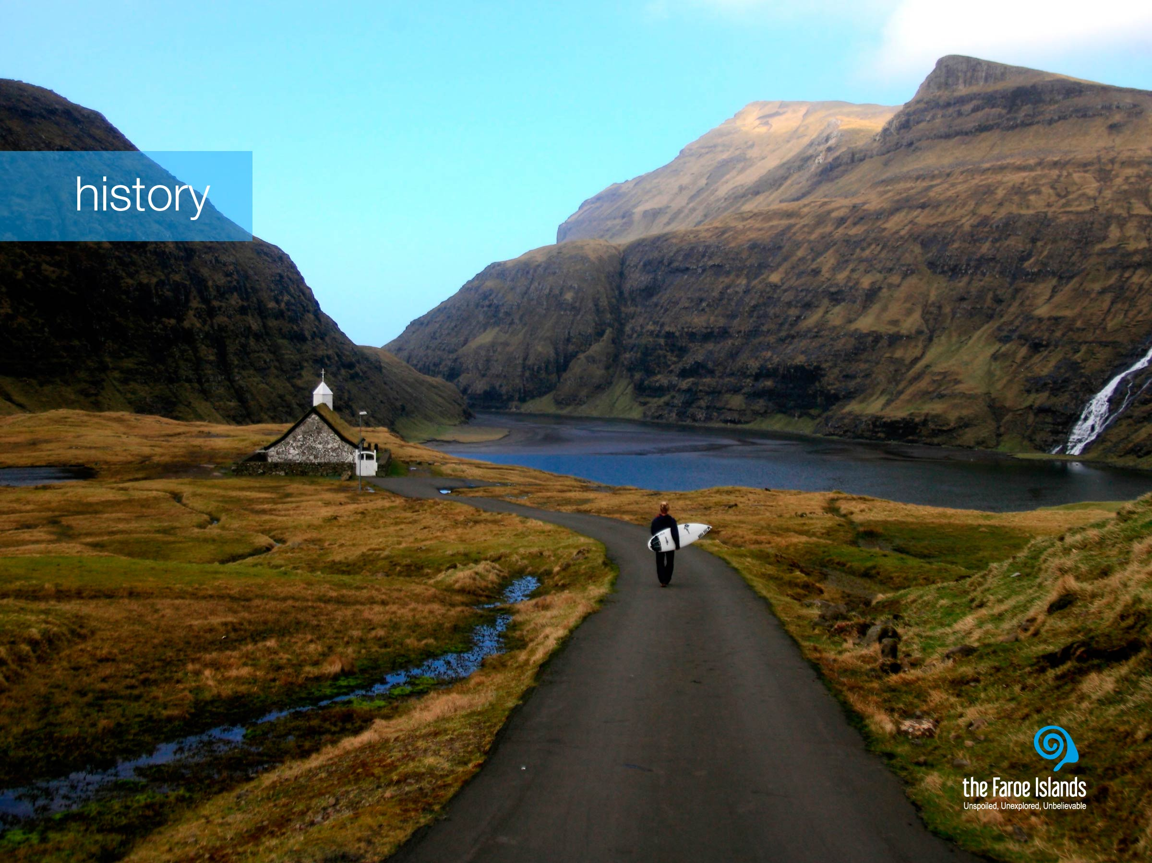
Notes:
The name Føroyar derives from old Norse and means Sheep Islands, a name given by the Viking age settlers arriving from Norway in the 9th century.
The language of the Faroe Islands is Faroese. It is a Nordic language, which derives from the language of the Norsemen who settled the islands.
Life on the islands hasn’t always been easy. Over the centuries the Faroe Islanders have learnt to understand and respect the forces and fluctuations of the stormy seas around them and to make the most of their valuable resources. With a firm grip on the realities of island life in the middle of the ocean, they see the North Atlantic as a bread basket and bridge, not a barrier. The sustainable utilisation of the natural resources was the only means of life, both for fishing and aquaculture, and with nature’s mood swings, this challenged life on the Faroe Islands.
For hundreds of years, Faroe Islanders have taken part in physically demanding activities such as walking in the mountains and rowing open oar boats. Fishing was originally a means of survival, and the traditional Faroese chain dance also served a variety of purposes. In addition to being a joyful physical activity that helped people keep warm and happy during the cold, dark winters, the dance also provided people with an opportunity to come together and tell stories about things that mattered, love, hate, war, past and present through the singing of the old ballads 'kvæðir’.

Slide 5
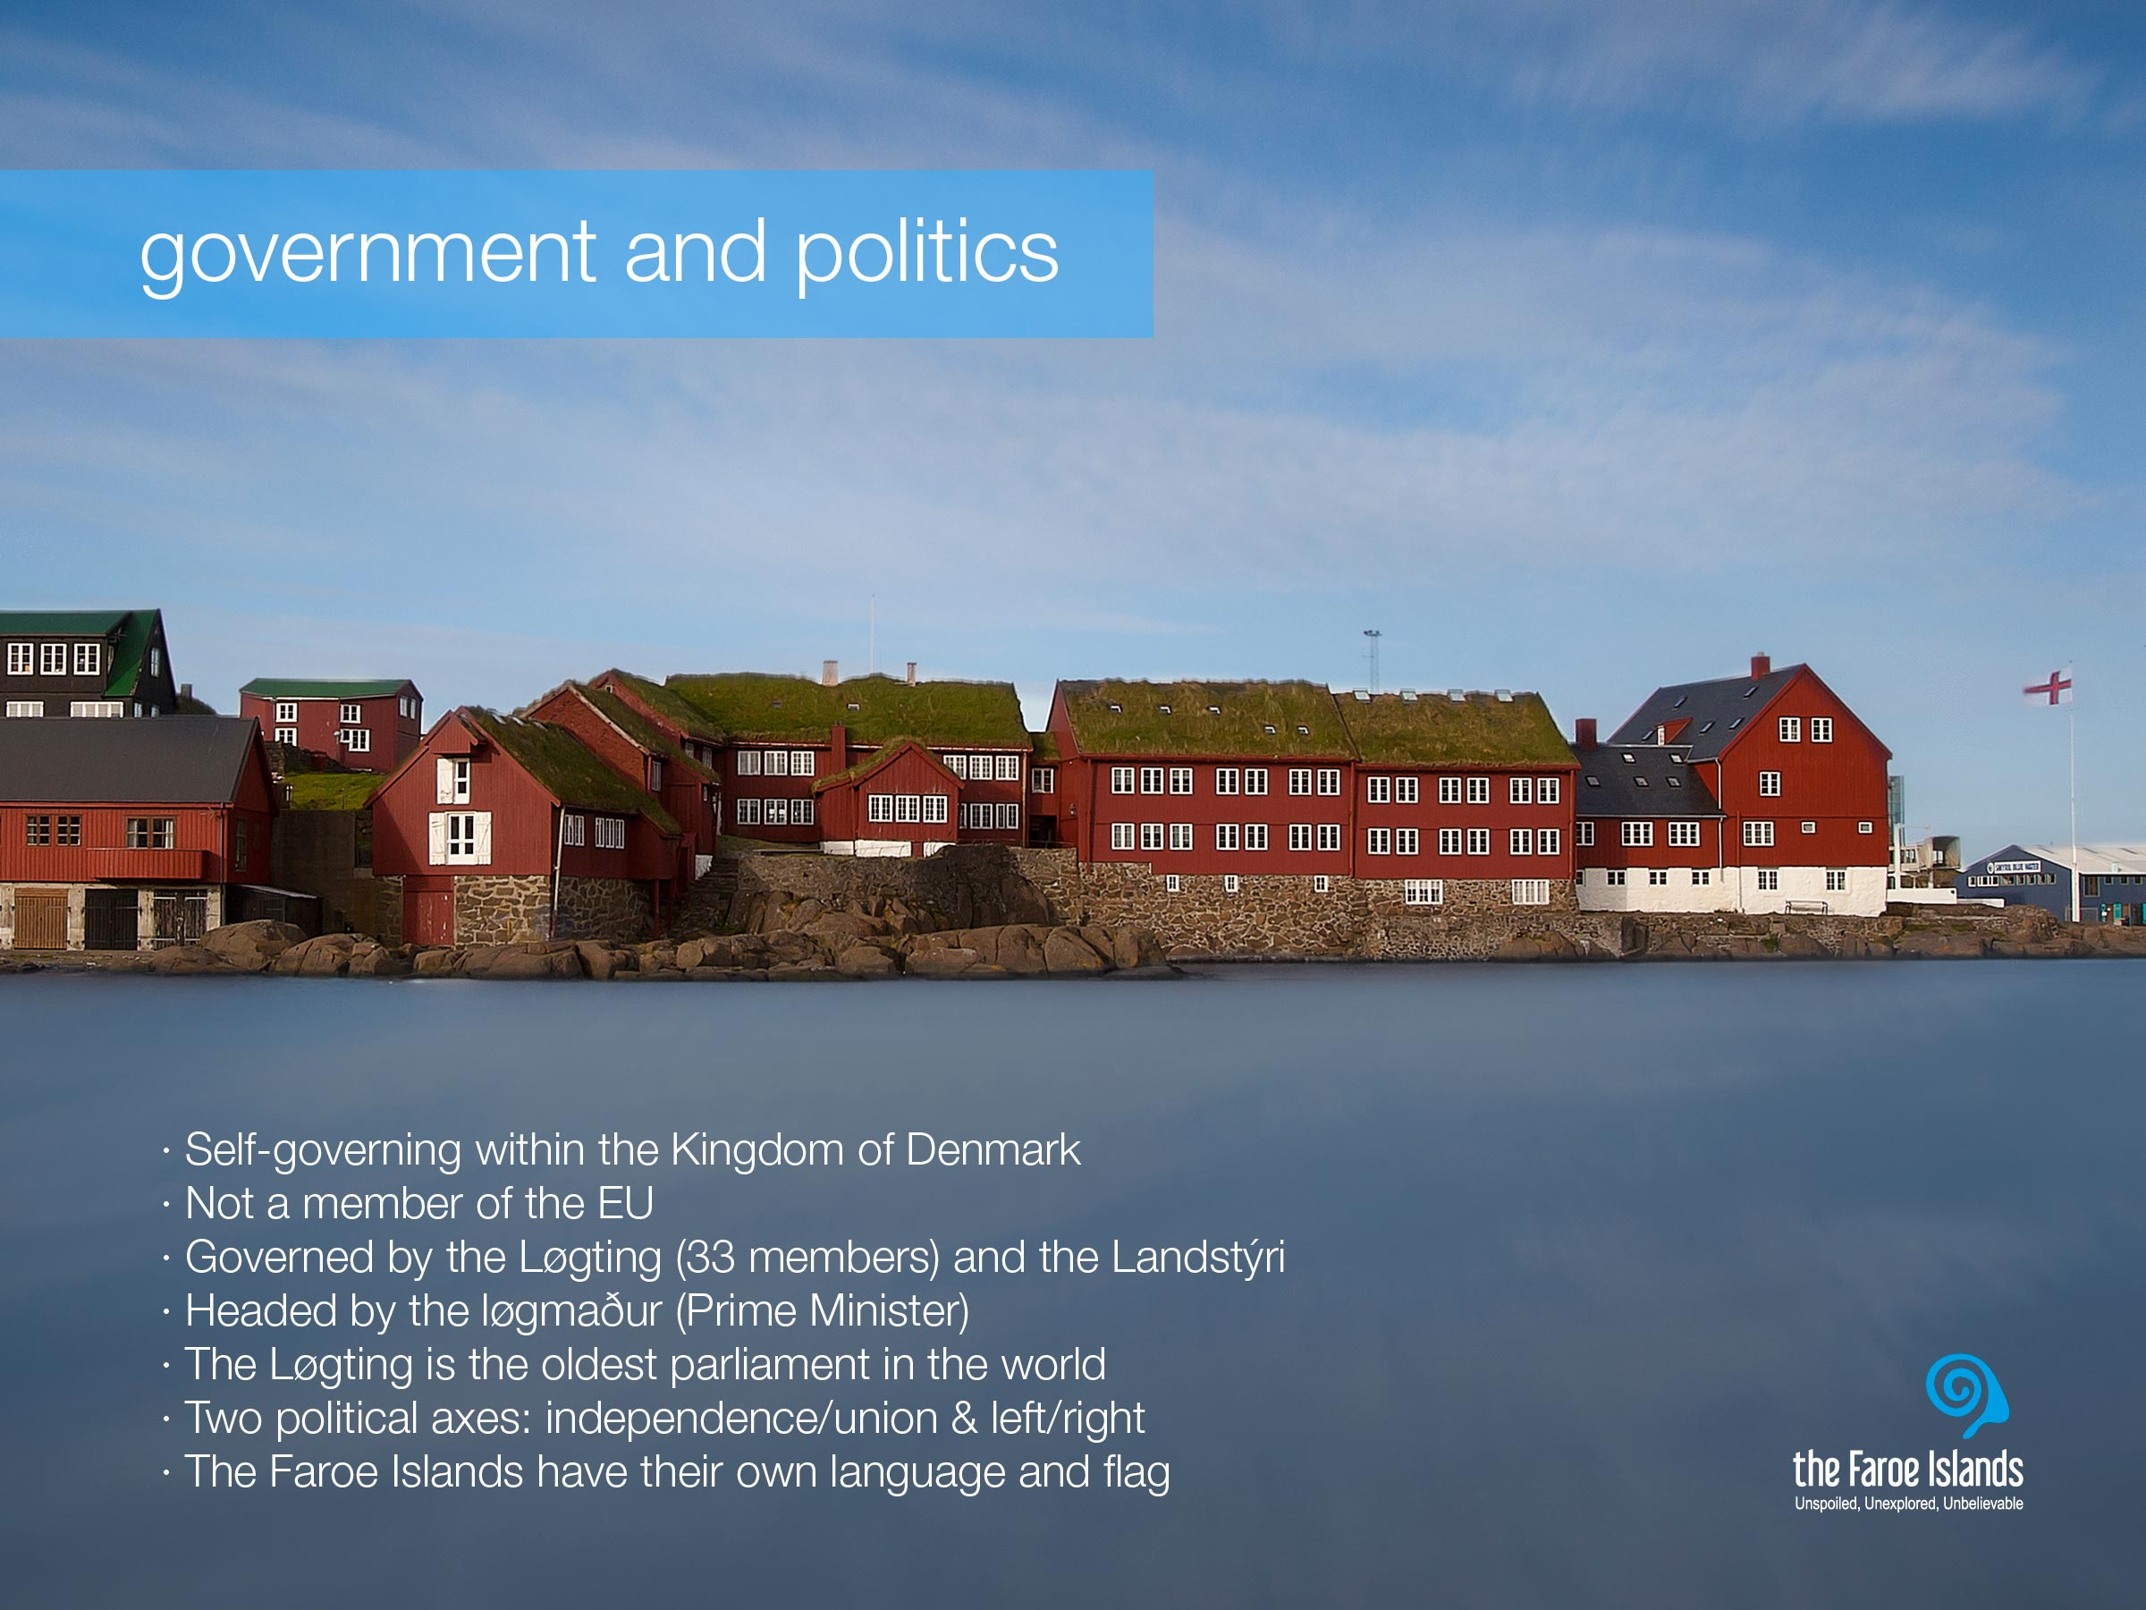
Notes:
The Faroe Islands are a self-governing nation under the external sovereignty of the Kingdom of Denmark. They have exclusive competence to legislate and govern independently in a wide range of areas. The Faroese political system is a variation of the Scandinavian type parliamentarian democracy, with its own democratically elected legislative assembly, the Løgting (parliament), and an executive government headed by the løgmaður (Prime Minister).
The Løgting, which is the oldest parliament in the world, has 33 members elected for a period of four years. A distinctive feature as regards Faroese politics is the fact that there are two axes, one concerning the independence question, the other is the classic socio-economic left-right divide.
Although The Faroe Islands are part of the Kingdom of Denmark, and share both currency and Queen with the Danes and the people of Greenland, the degree of Faroese autonomy can be illustrated by the fact that the Faroe Islands are not members of the EU, nor EFTA (and thereby not of the EEA either).
And let there be no doubt, the Faroe Islanders consider themselves Faroese and not Danes and are proud of their own language, flag, culture and people.
With economic wealth the Faroese have developed a welfare society much along the lines of the typical Scandinavian welfare state model, e.g. with free education and health care for all.

Slide 6
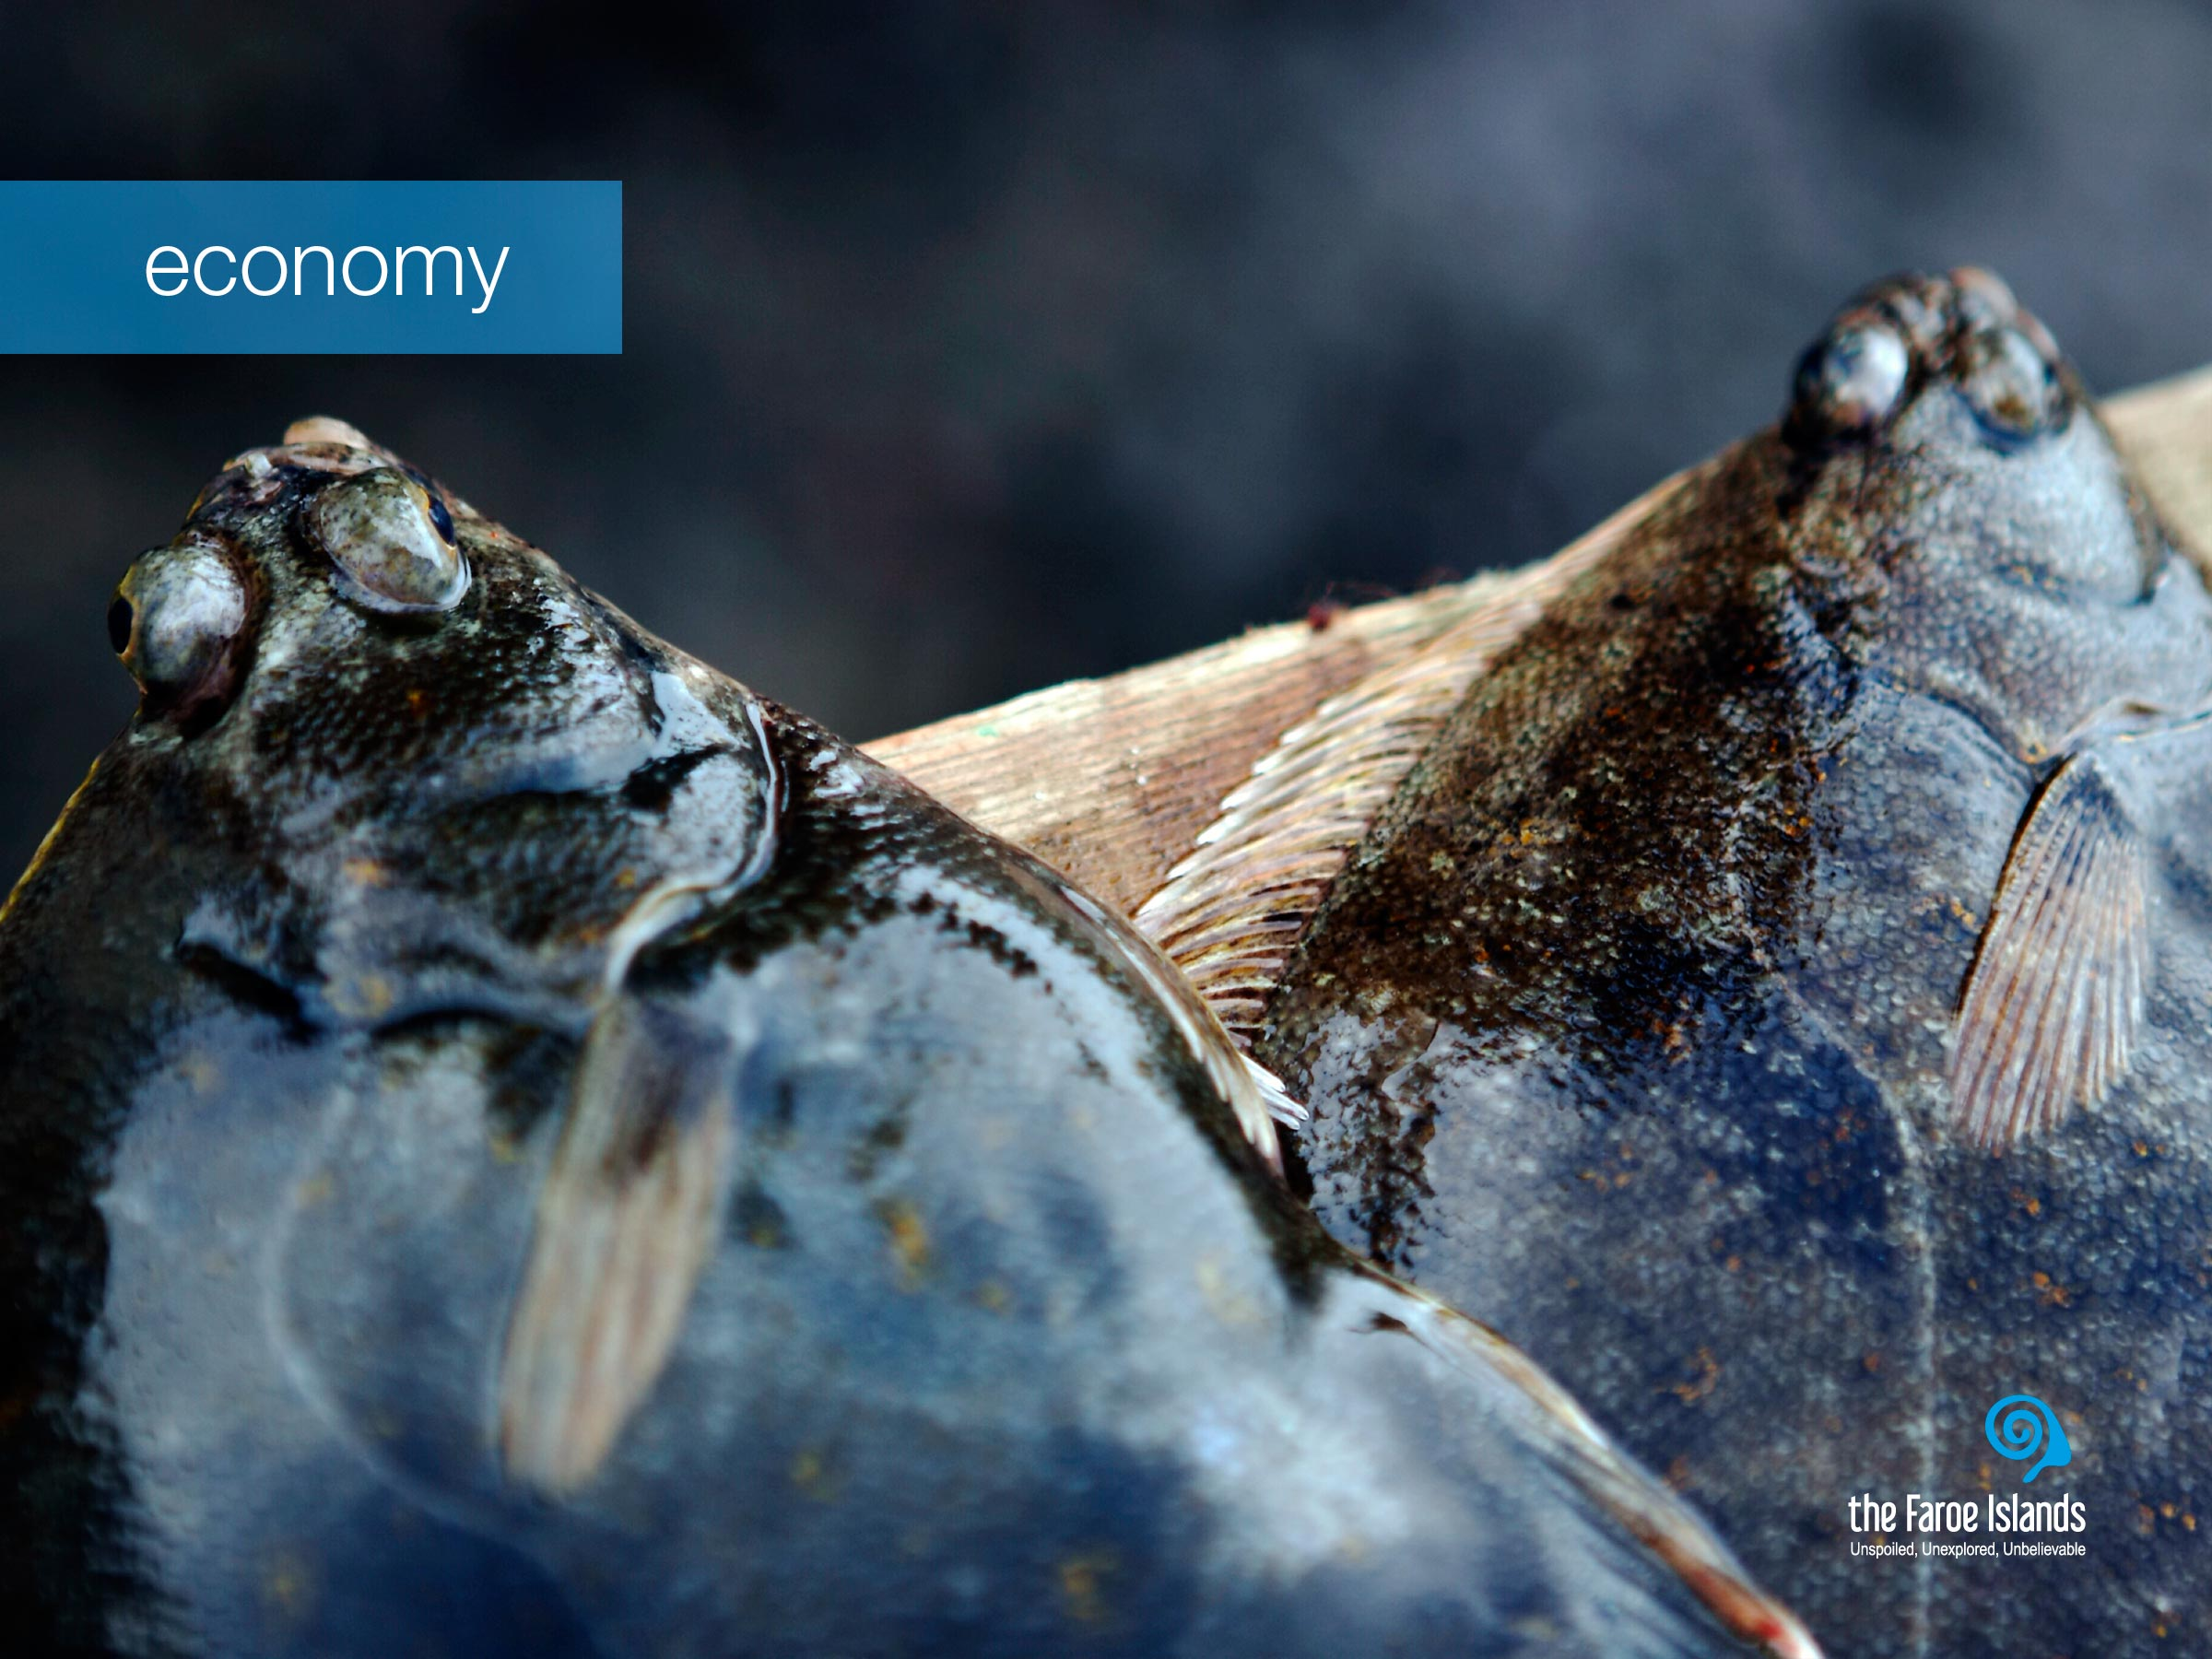
Notes:
The Faroese economy is highly dependant on fisheries and aquaculture as the production and export of fish products constitute 95 per cent of the total income of exported goods.
Other important and promising industries include financial services, petroleum related businesses, shipping and offshore service, manufacturing (esp. servicing the maritime industries), civil aviation, IT and telecoms, tourism and creative industries. Some are already well established, while others – e.g. some creative industries – are up and coming.

Slide 7
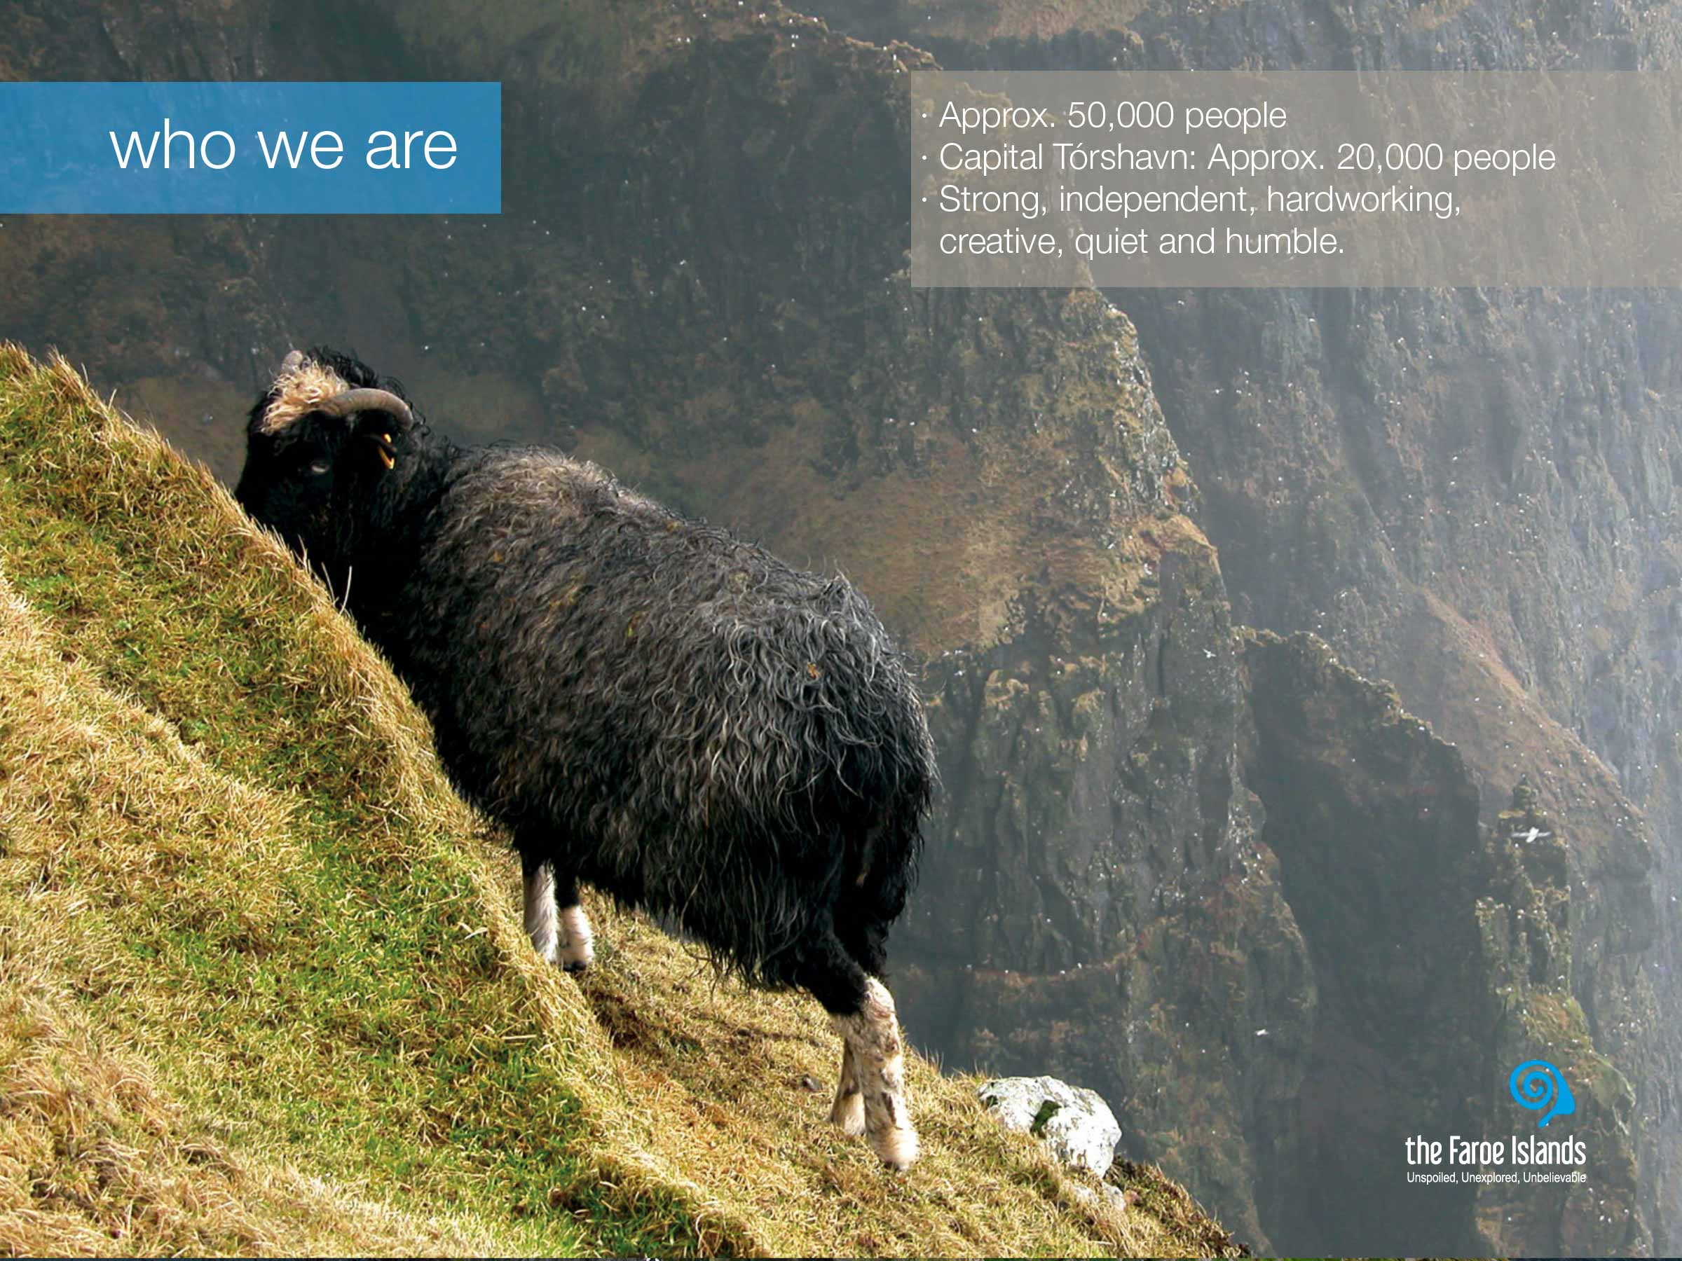
Notes:
The population of the Faroe Islands is approximately 49.000. Twice outnumbered by the sheep and not to mention the 2 million birds.
The Faroese settlement pattern is characterized by a large number of densely populated villages of varying size. There are in all about 100 towns and villages, with Tórshavn the capital, as the largest town where about 40% of the population lives.
The sometimes harsh living conditions, history and nature, has had big impact on the Faroe Islanders, and made them both patient and adaptable to change. Other than that, the Faroese are often characterized as being strong, independent, hardworking and creative people. And although they do have a strong belief in their own abilities, they can come across as being quiet and humble. We are a close-knit community, and close to our heritage. There is little distance between high and low and our different varieties as individuals is visible.
Active participation in all aspects of local community life characterizes the Faroe Islands. This contributes to social cohesion and a strong sense of local identity together with the great sense of national identity. For whatever political view, unionist or wanting independence from Denmark, pride in being from the Faroe Islands is as recognizable as the color of your eyes. The Faroese identity is very strong, for example there are probably not that many places in the world where young people think it is cool to wear their national dress on national holidays, but in the Faroe Islands they do while living a life that is just as globalised as the rest of the modern world.

Slide 8
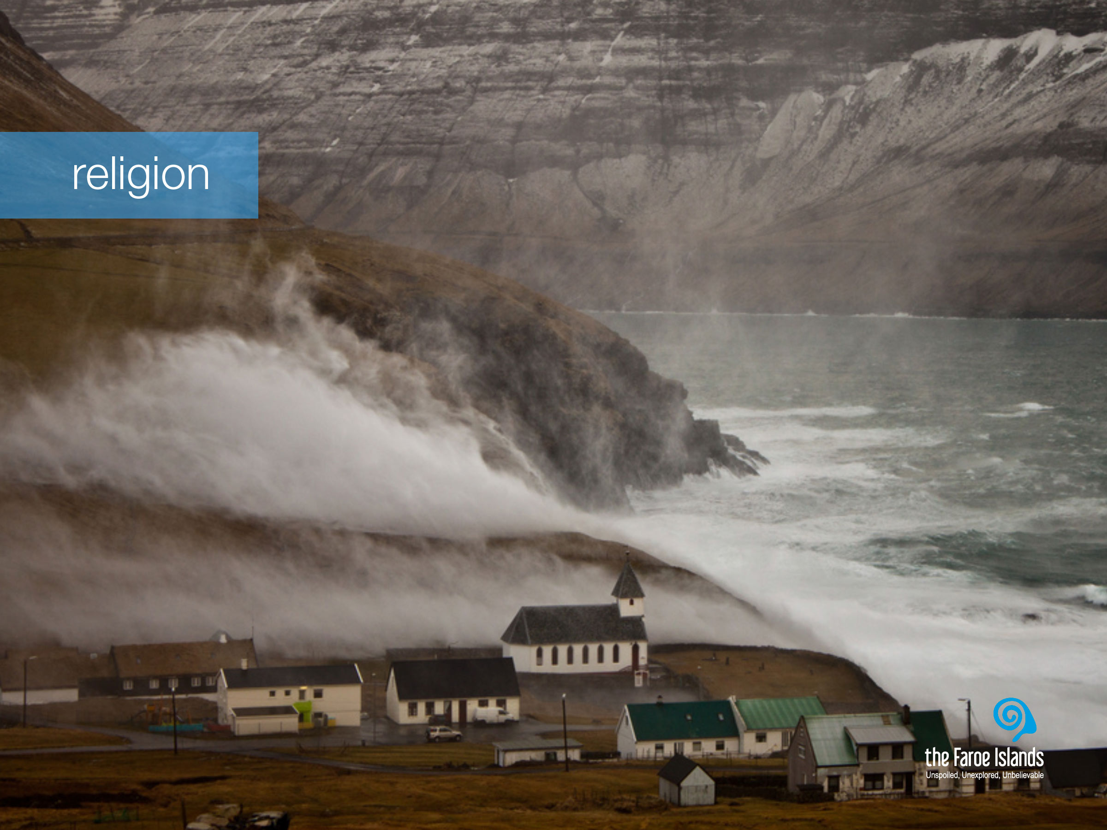
Notes:
The Faroese are predominantly religious, as is often the case with people in island communities.
Nature is present in the Faroe Islands and in the people, both in terms of its natural glory and its mighty powers. On the Faroe Islands, nature is the master. Its powers are enormous. And when the weather is wild and demanding, we truly feel how small we humans are and how grand and powerful nature is. In that sense we understand the need to believe in higher powers. When all the men in a village went out to sea to catch fish, the women and children had to believe that God would bring them back safe, and with a good catch. Unfortunately this was not always the case, and at such moments, the widows sought comfort in their religion.
This is why every village on the Faroe Islands has either a church, a house of prayer or both, and quite often more than just one or two. The churches are all visible from sea, so that the returning fisherman would see the church first and know that they were home safe.
Facts:
· 85% belong to the Faroese Evangelical Lutheran Church
· 13% belong to the Plymouth Brethren
· There are in total 62 churches on the Faroe Islands

Slide 9
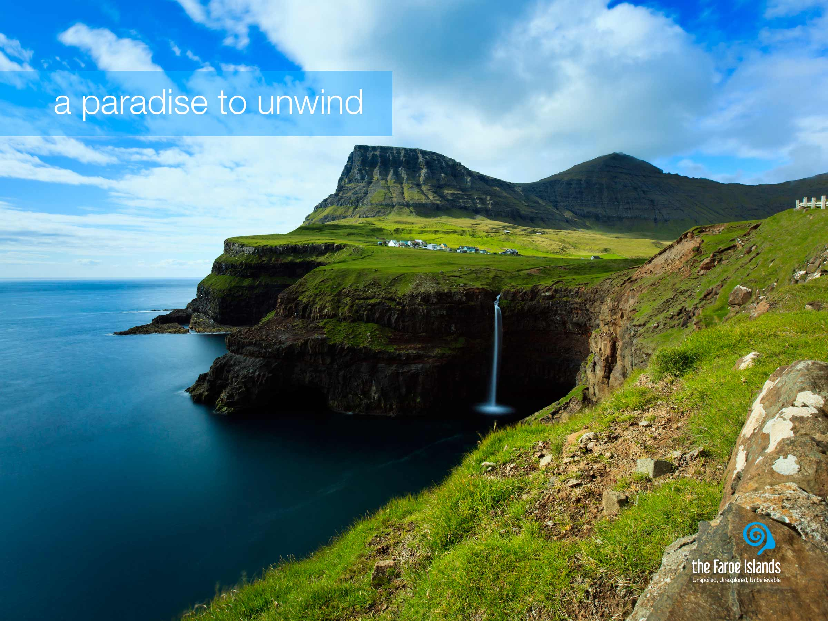
Notes:
During Worls War II, a guest on the Faroe Islands famously named it “the land of maybe.” This was because nature ruled on the Faroe islands and if the weather prohibited you to travel from village to village, you had to accept that – or at least travel at a slower pace – hence maybe was a much used word at that time. Today, the circumstances on the Faroe Islands are not the same. The infrastructure, both on land and sea, and the technology have made life on the islands a lot easier, as with the rest of the world. But the maybe word, in Faroese kanska, has proven difficult to get rid of.
Life on the Faroe Islands is less stressful. The Faroese people live closely in and with nature, something guests recognize the second they set foot on land, whether they arrive by ferry or plane. Absorbing reality, as it is in the Faroe Islands, almost forces you to look within yourself to discover who you really are.
A few years ago the American travel magazine National Geographic Traveler summoned over 500 travel experts to participate in a survey to find the best island community in the world. The survey was based on integrity of place and on what makes a destination unique. 111 different islands were rated and the Faroe Islands topped the list as the number one island destination in the world. National Geographic Traveler say that the Faroe Islands are Authentic, unspoiled and likely to remain so. When the National Geographic Traveler voted the Faroe Islands the best islands destination in the world, it was because the islands are such an uncut gem away from the mainstream of international tourism.

Slide 10
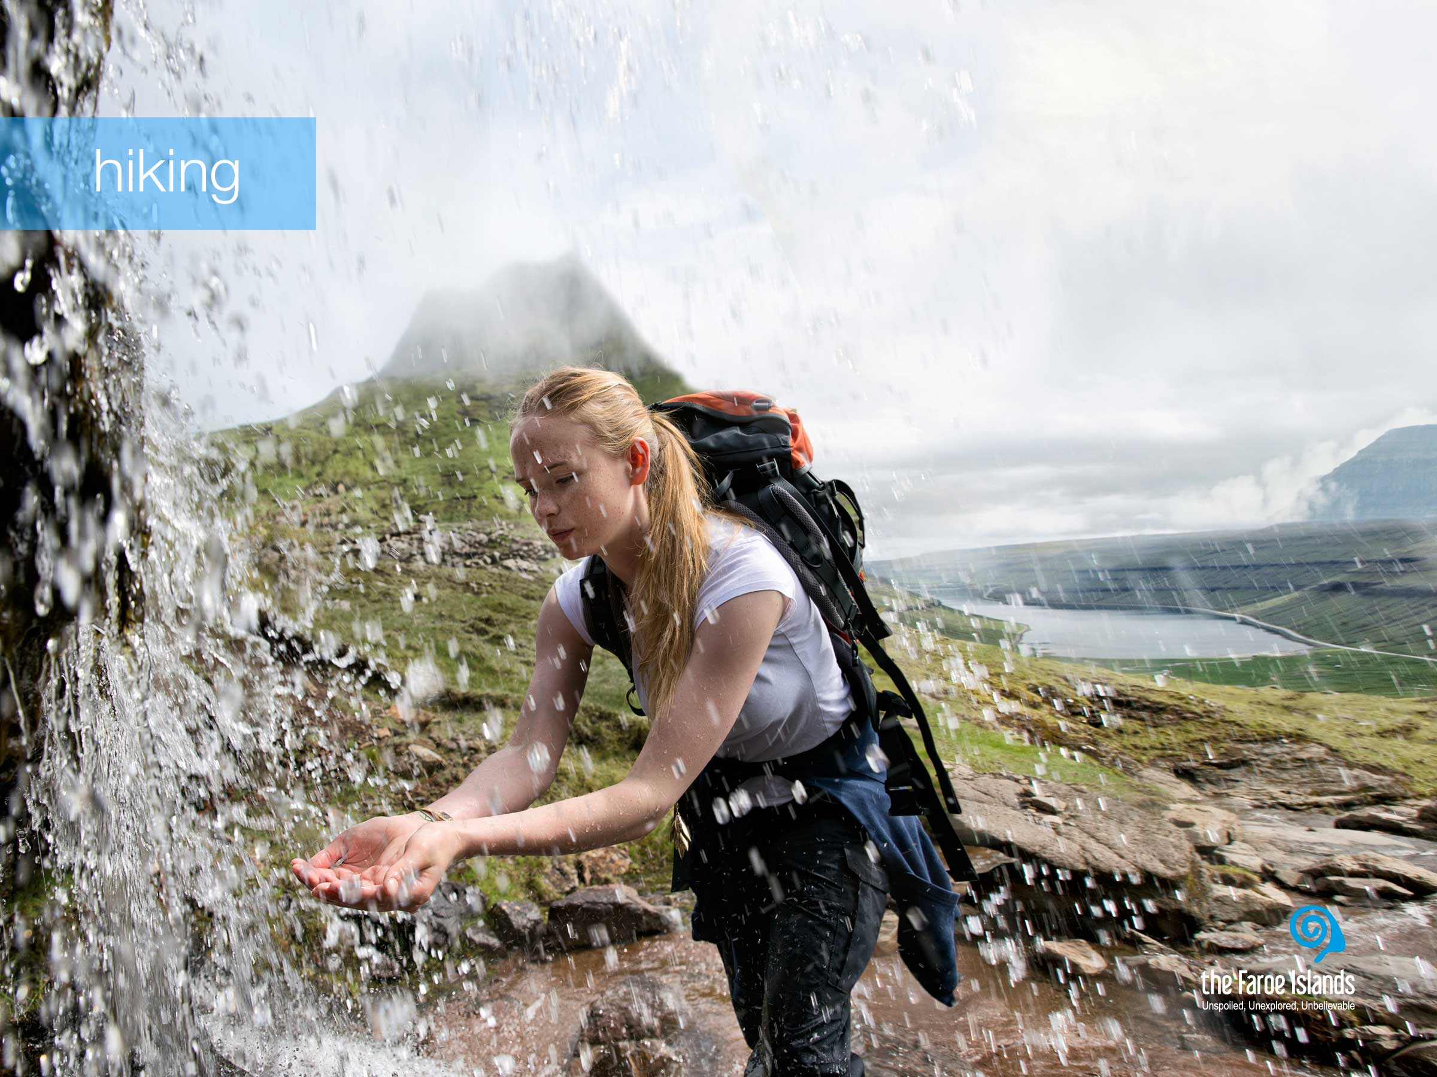
Notes:
Today the infrastructure on the Faroe islands is very good, and nothing hinders you to go from one place to another in no time. Not only are there very good roads, but almost as many tunnels as there are islands, and even subsea tunnels. Therefore it can be difficult to imagine how life was in the past, when the islanders had to hike from village to village in order to get to school, work, visit family or go to the shop.
Hiking is very popular both among Faroe Islanders and tourists, as it is a great way to get close to nature. Some people are great hikers and take hour-long hikes in the mountain, weekly. And the more difficult and dangerous the hike, the better. While others like to park their car by the road and take a shorter stroll or hike in the mountains. Climbing up on the top of a mountain on a beautiful sunny day is an exceptional feeling that you never get tired of. It might be a bit hard to reach the top but the green grass all around you, the bird song, the ever present sheep, and the magnificent view when you reach your goal, are great rewards. Both in solitude and with good friends.
Apart from the sheer enjoyment of a hiking trip in the hills and the mountains and the green grass, the clean air is something that makes the hiking trip even more refreshing. Both the smaller water streams and the wild waterfalls consists of clean fresh water and you can safely drink just as much as you like.

Slide 11
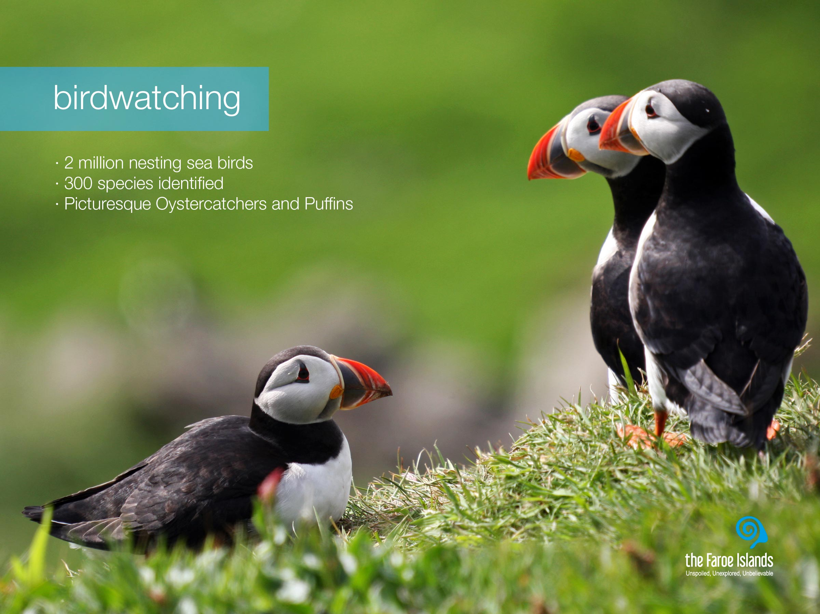
Notes:
The cold Arctic currents that merge with the warm Gulf Stream in the waters off the Faroe Islands result in a particularly rich food environment for nesting seabirds. During the long days of summer, the cliffs on the Northern and Western coasts shelter Guillemots, Razorbills and Kittiwakes, whilst Puffins breed on the grassy tops of the cliffs.
As it is possible to get quite close to the birds either by boat along and under the majestic bird cliffs or just by walking in nature, the Faroe Islands are a quite popular destination for bird lovers and photographers who like to get a close frame of these colorful birds. The most photographed must be the colorful Puffin, with its clumsiness and sad expression and also our national bird, the Oystercatcher or Tjaldur as we say in Faroese.
Facts:
· Approximately 300 species of birds have been identified on the Faroe Islands.
· Of these, 40 species are common breeding birds and about 40 are rare or irregular visitors.
· There are an estimated two million pairs of breeding seabirds of several species.

Slide 12
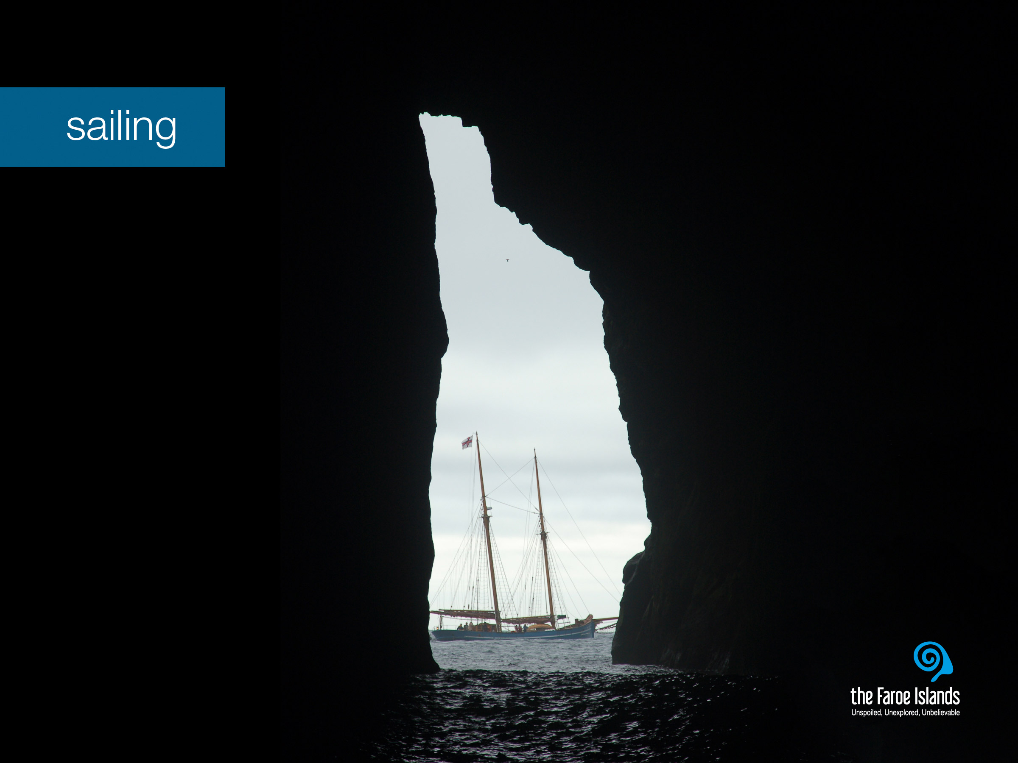
Notes:
The Faroe Islands are surrounded by the North Atlantic Ocean, and therefore a boat trip is always an adventure. Nature continues to surprise people during these trips - puffins skimming the waves, seals basking on cliffs, a school of whales or a flock of rare seabirds following the boat closely.
On a boat trip you may feel even closer to nature - and experience her unspoiled beauty. There is no guarantee of what you will see in advance, but you will have the experience of a lifetime. Amongst the many types of boat trips, you can choose from: fishing, bird watching or even try the unforgettable concerto grotto.

Slide 13
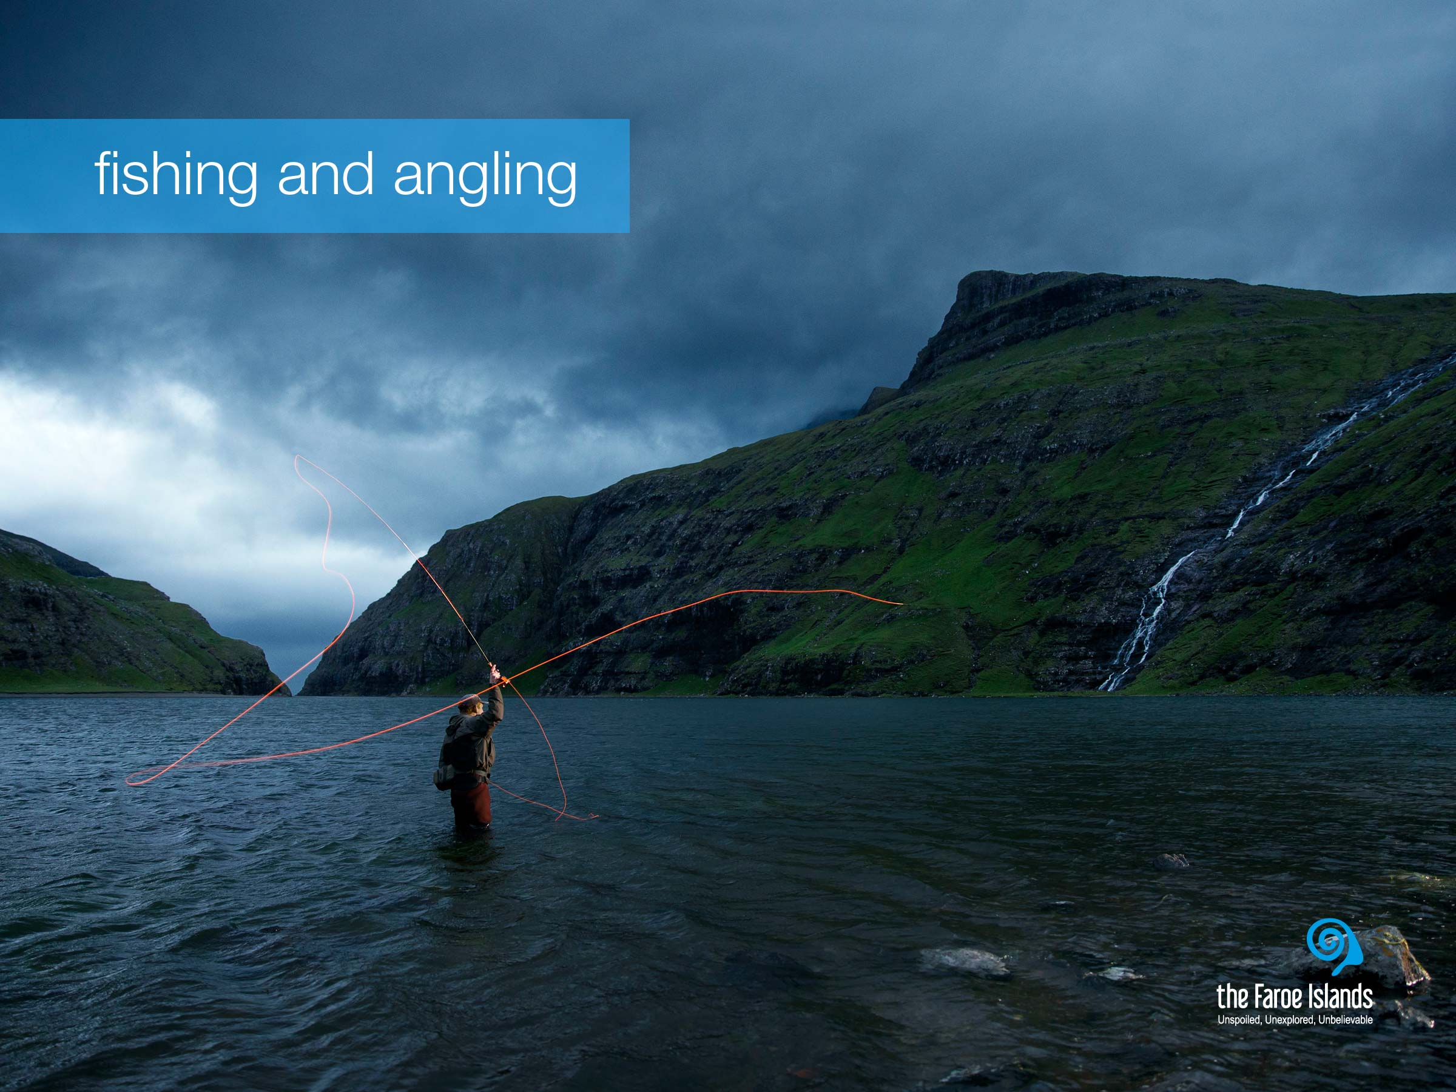
Notes:
Fishing is how the Faroe islanders have survived the remoteness and harsh circumstances of the location – so fishing is at the very core of Faroese expertise. For centuries, when long time passed without a foreign boat in sight, the islands could not rely on imported goods for survival. Therefore, living off what the land and sea provided was a matter of life or death. Consequently, fishery is the very essence of the Faroe Islands.
Fishery is not only an industry that employs many people, many Faroese families have their own boat with which they go out fishing when time and weather allows them to do so. And angling is also a favored pastime activity, hence Faroese cuisine is very much centered around fish.

Slide 14
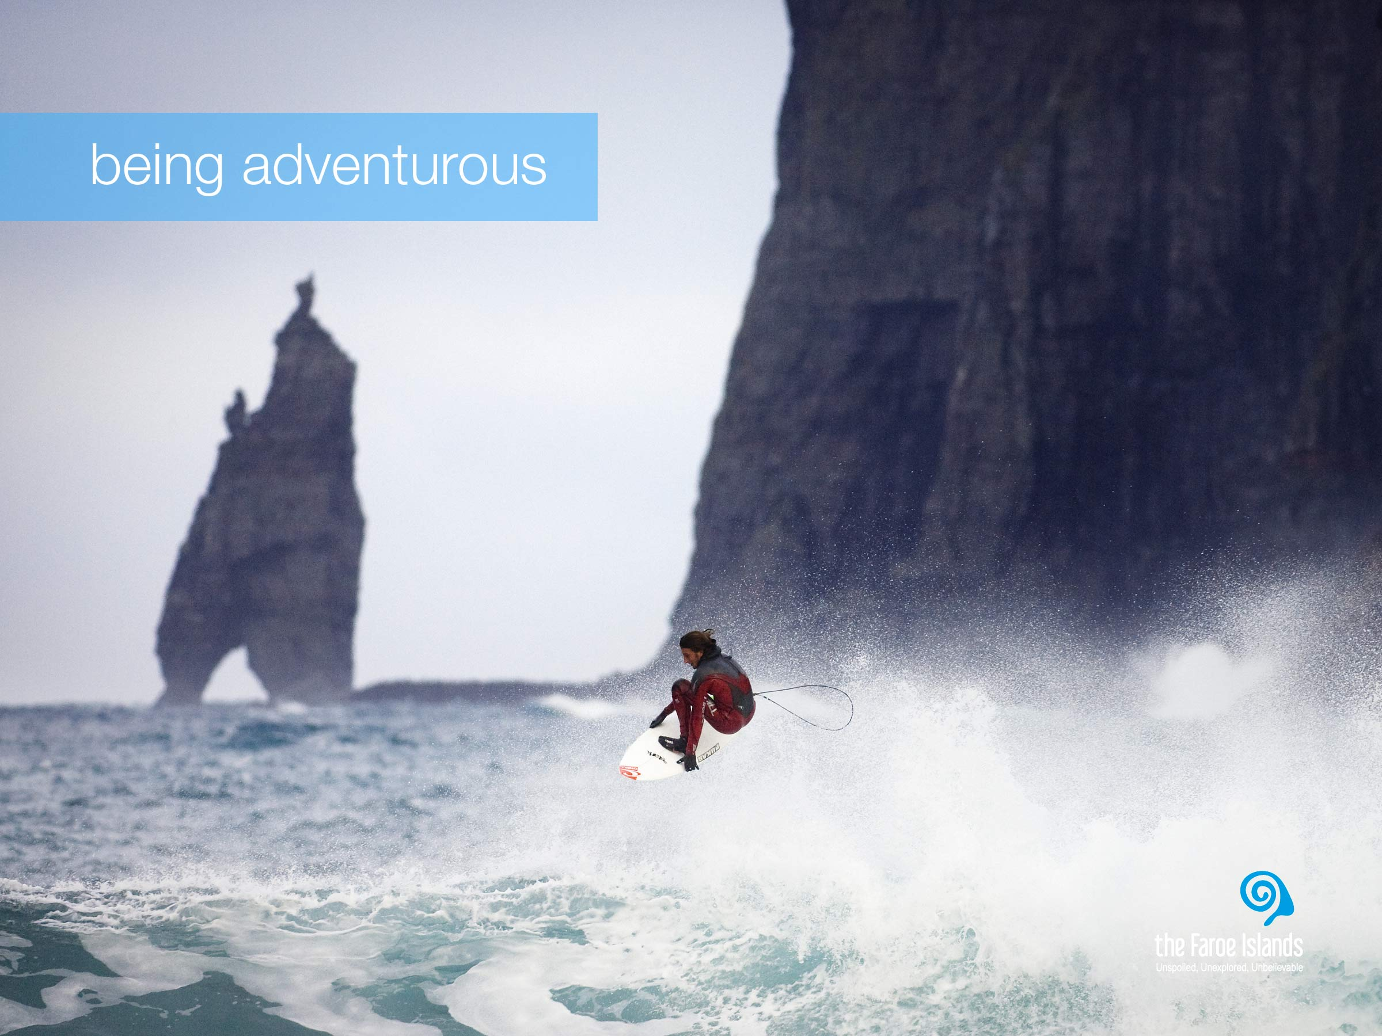
Notes:
The pure and wild nature of the Faroe Islands is very inspiring and you can imagine that the islanders go a little crazy once in a while. The younger generation do tempt fate more than the older generations. However, in the past, people tempted fate in their way of life because they had to travel between villages on foot or in small boats, or had to go out to meet the dangers of the open sea in order to feed their family.
Today Faroe Islanders are more likely to sail the North Atlantic waves in a high speed boat, or head out to experience a unique grotto concert by schooner than they used to. And extreme hiking, rock climbing, rappelling, diving, and jumping out from high cliffs into the ocean is becoming more and more popular although not common. So even though, as the picture shows, surfing is possible and does look very tempting, not many Faroe Islanders surf today. However, it is very likely, that also this sport will be less of an unique sight in the near future.

Slide 15
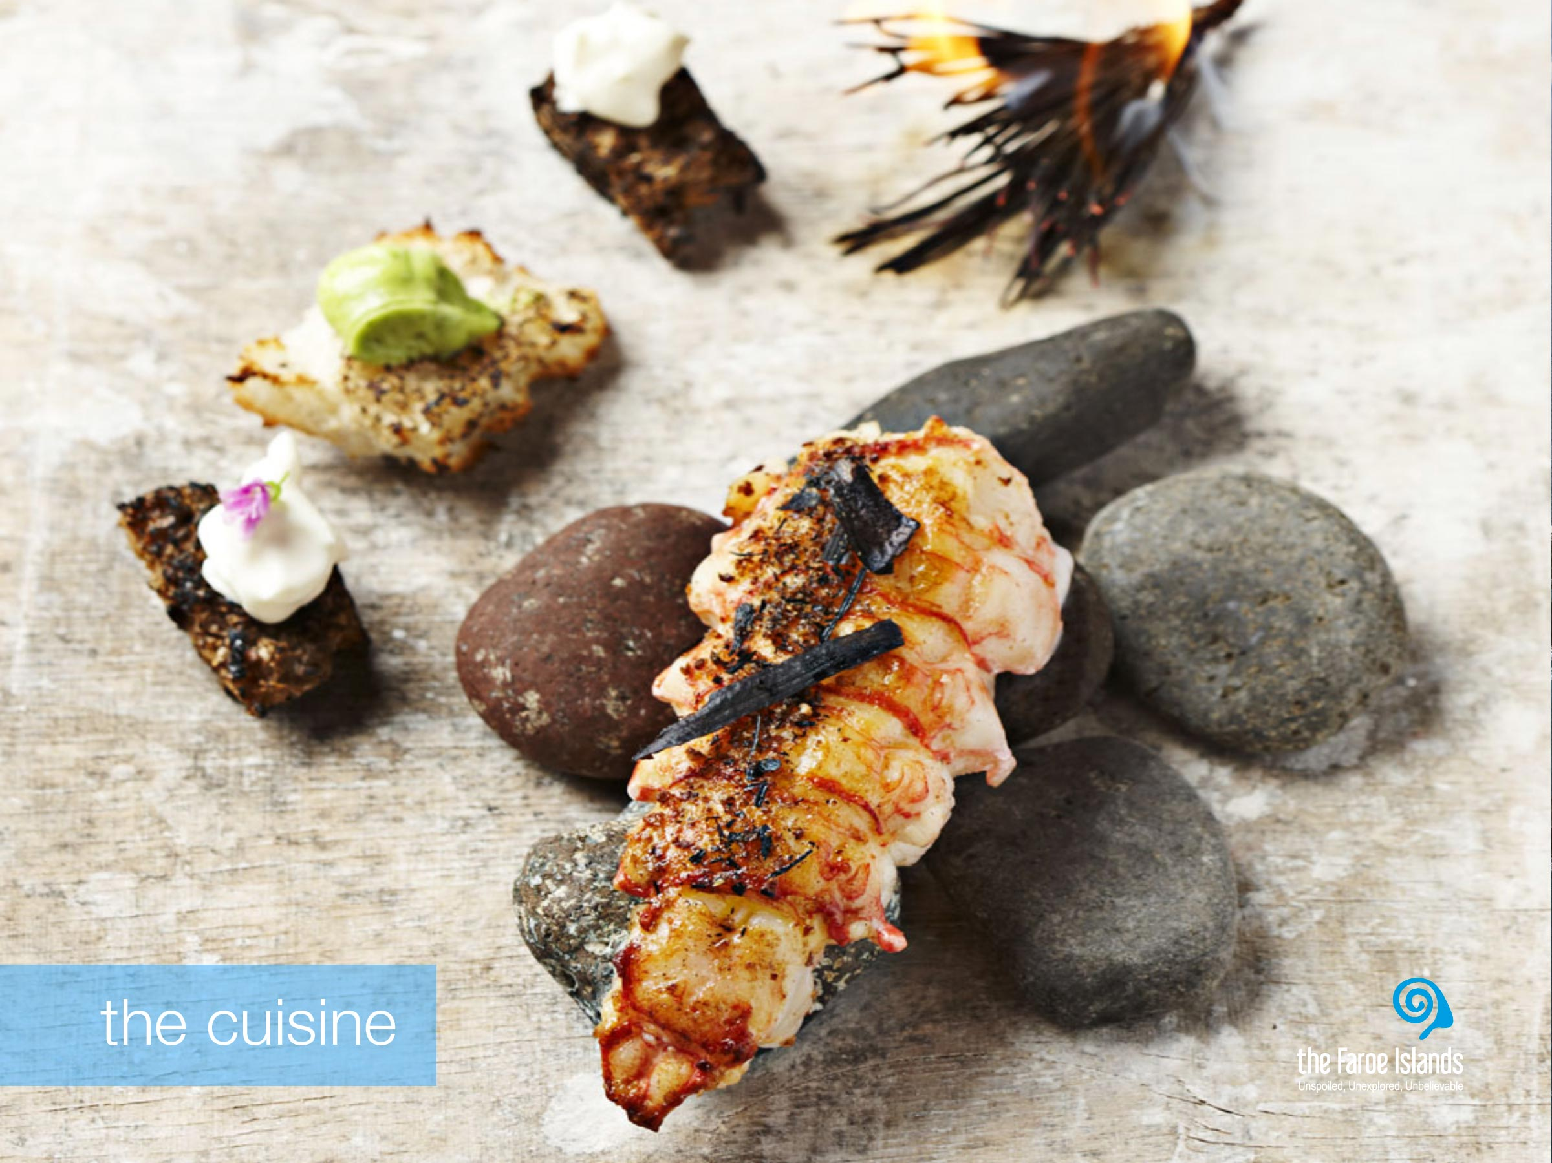
Notes:
Today, traditional Faroese food is to a large extent, an authentic expression of the necessity of a past to utilise every part of every fish caught, every animal slaughtered and every bird netted. Whether people went out fishing or took to the bird cliffs with fowler’s nets, they found ways to put every part of their catch to good use and to store as much as possible for hard times.
Ræst is both the Faroese way of drying fish and meat and the unique flavour produced by this process. Ræst is the first step in drying food and today it is the Faroese contribution to the international culinary scene. This unmistakable flavour is the cornerstone of the Faroese kitchen, the combination of natural phenomena peculiar to the Faroes and the skill of many generations.
The Faroese cuisine has not been something that the Faroese people have thought of as an attraction, but with the new focus on the Nordic cuisine, the Faroese cuisine has come to life. Faroese chefs are getting recognition all around the world, and on the Faroe Islands you’ll find excellent restaurants that serve food based on local produce like fish, lamb, birds, seafood and herbs. Even gastro tourists will have a wide variety to choose from, and the famous restaurant Koks, which is currently listed as one of Denmark’s 5 best restaurants, is a must try experience.

Slide 16
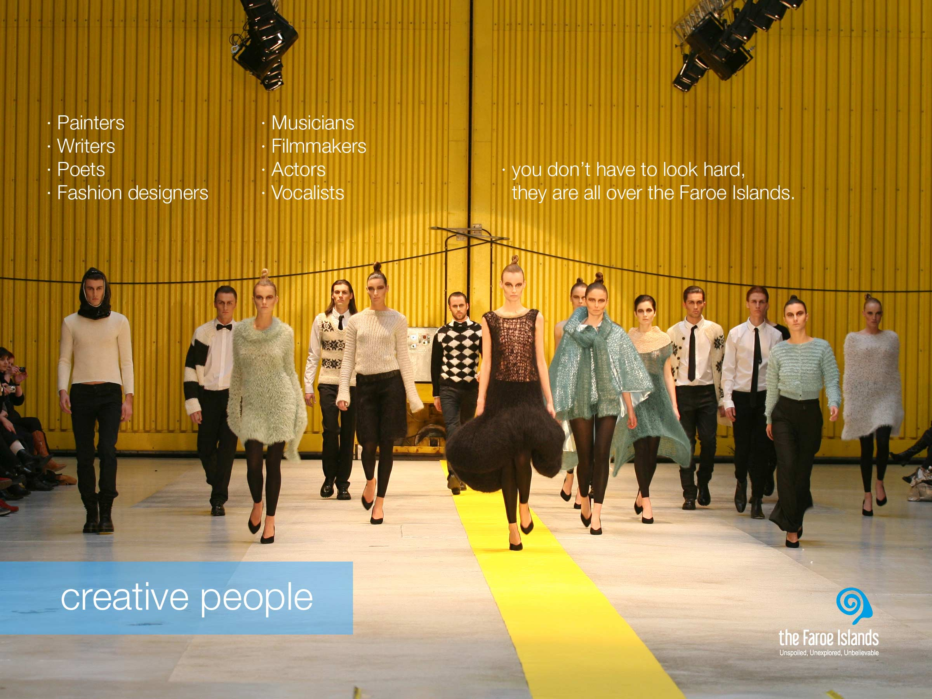
Notes:
It is often said that nature is a teacher and an inspiration to artists and creative souls in the Faroe Islands and that creativity and the cultivation of deep-rooted tradition are characteristic traits of Faroese society. The Faroese are well connected to the rest of the world and constantly embrace new trends while learning at the same time each day how better to share their unique creativity and culture with the rest of the world.
Deeply rooted in their long tradition of ballads and songs, the people of the Faroes simply cannot stop singing. Vocal traditions have been exceptionally rich and versatile, as there were no musical instruments of significance until the mid 1800s. The voice was the only music-making tool available, and as a result, singing is deeply anchored in the Faroese national identity. The Faroe Islands’ music scene is buzzing and artists and creators across all genres are delivering world class performances and recordings.
Today the creative vibe is found everywhere in events and in creative hubs for art, crafts and design where musicians, fashion designers, writers and artists and producers of handicrafts make artefacts and goods for consumption that are both locally inspired and touch on themes and trends that are meaningful in a global context.
In fashion and design, Faroese brands have in recent years emerged and have started to make their mark on the international fashion scene. Most of them have one thing in common: knitting. The frontrunner in Faroese knitted fashion is undoubtedly the label Guðrun & Guðrun, and the picture is taken at one of their fashion shows.

Slide 17
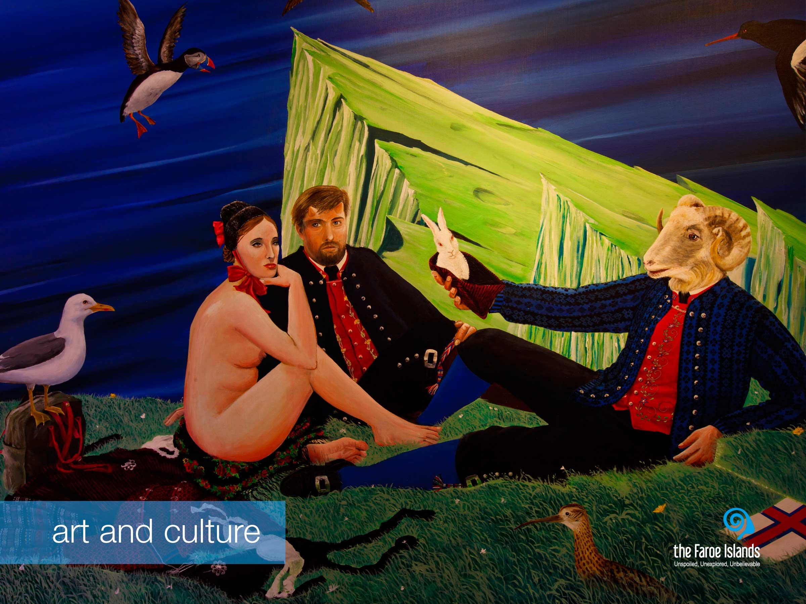
Notes:
The Faroe Islands are a nation of poets and writers. The love of poetry and story-telling is deeply rooted in Faroese culture. Faroese literature is a literature of contrast between the old and the new, between tradition and innovation. Faroese literature is genuine Faroese and at the same time embedded in the literary history of Europe.
One of the most unique cultural features is the chain dance, which was originally a mediaeval ring dance. Today, we call it the Faroese chain dance, and rightly so as it has only managed to survive in the Faroe Islands. The rhythm is quite quirky and the ballads about kings and heroes may have several hundred verses. The captain leads the singing and everybody joins in on the chorus. The symbolic significance of the chain dance is the full circle of people from all walks of life who hold each others’ hands and meet face-to-face while sharing a moment of true common ground.
In the visual arts a lot has happened since the first Faroese painters painted the first landscape paintings to show the beauty of their country and demonstrate their love for the homeland. Countless new themes and motives have entered Faroese art since then. International styles have had their influence, and today an impressive number of artists work with pictorial art.
Some things are still the same, though, and the landscape is still the dominant motif in Faroese art, just as the interplay between nature and mankind is still the most prevalent theme.

Slide 18
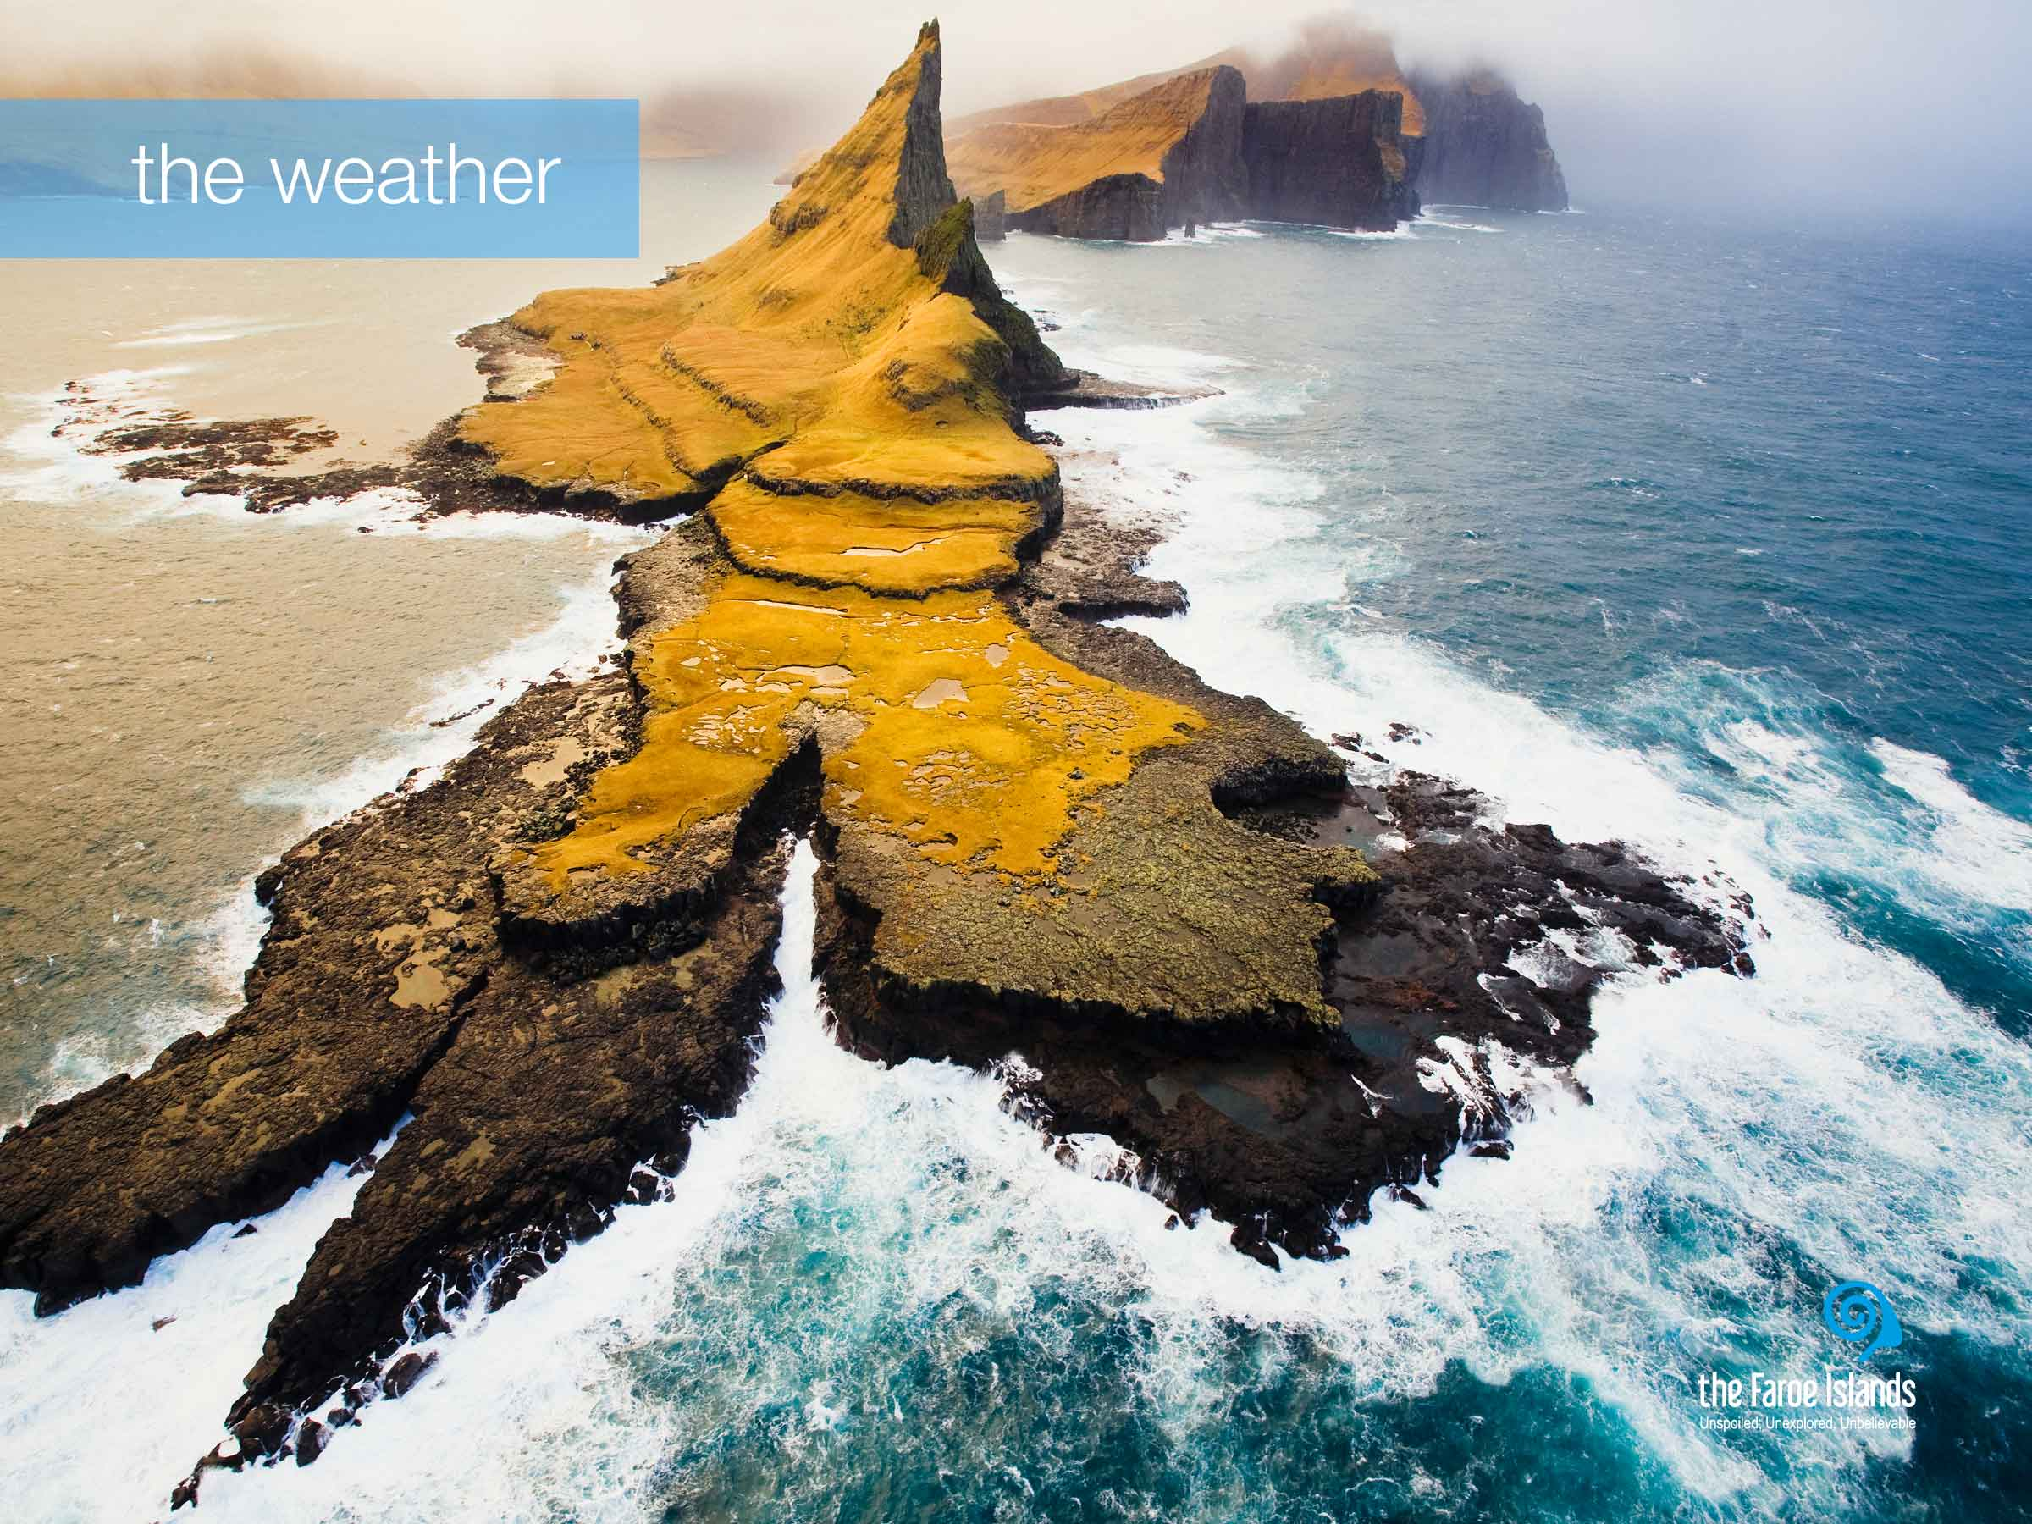
Notes:
The climate on the Faroe Islands is very much influenced by its location in the warm Gulf Stream, which together with the remoteness of any source of warm airflows, ensures that winters are mild while summers are cool. The average temperature in the warmest months is 13°C resulting is mild summer days and during the winter the average temperature is 3°C. So the temperature here is not very changeable over the year compared to most other countries. The Faroe Islands are windy, cloudy and cool throughout the year.
One of the many charms with the Faroese climate is the constantly changing weather. One of the most common feedbacks from tourists is the uniqueness of experiencing all four seasons in the same day. And even though the Faroe Islands are small, there is a big chance that the weather is different at the other end of the country or even the next village. During summer, you are wise to ask, if the sun is out on another island or village if it is foggy where you live, as it is very likely to be bright sun in one place and thick fog in another.
During summer, we enjoy long days and light nights. In the middle of the summer the sun hardly sets and the longest day is 19½ hours long. In contrast, the winter days are somewhat different, and December has only few hours of true daylight. This does have an influence on the way we spend our days. During the long days and light nights of the summer, people spend much of their time outside, and use the light to their advantage. It is not unusual to see children playing outside until midnight during the summer. We are more declined to spend winter evenings and nights inside, whether it is in our own homes or at different cultural venues.

Slide 19
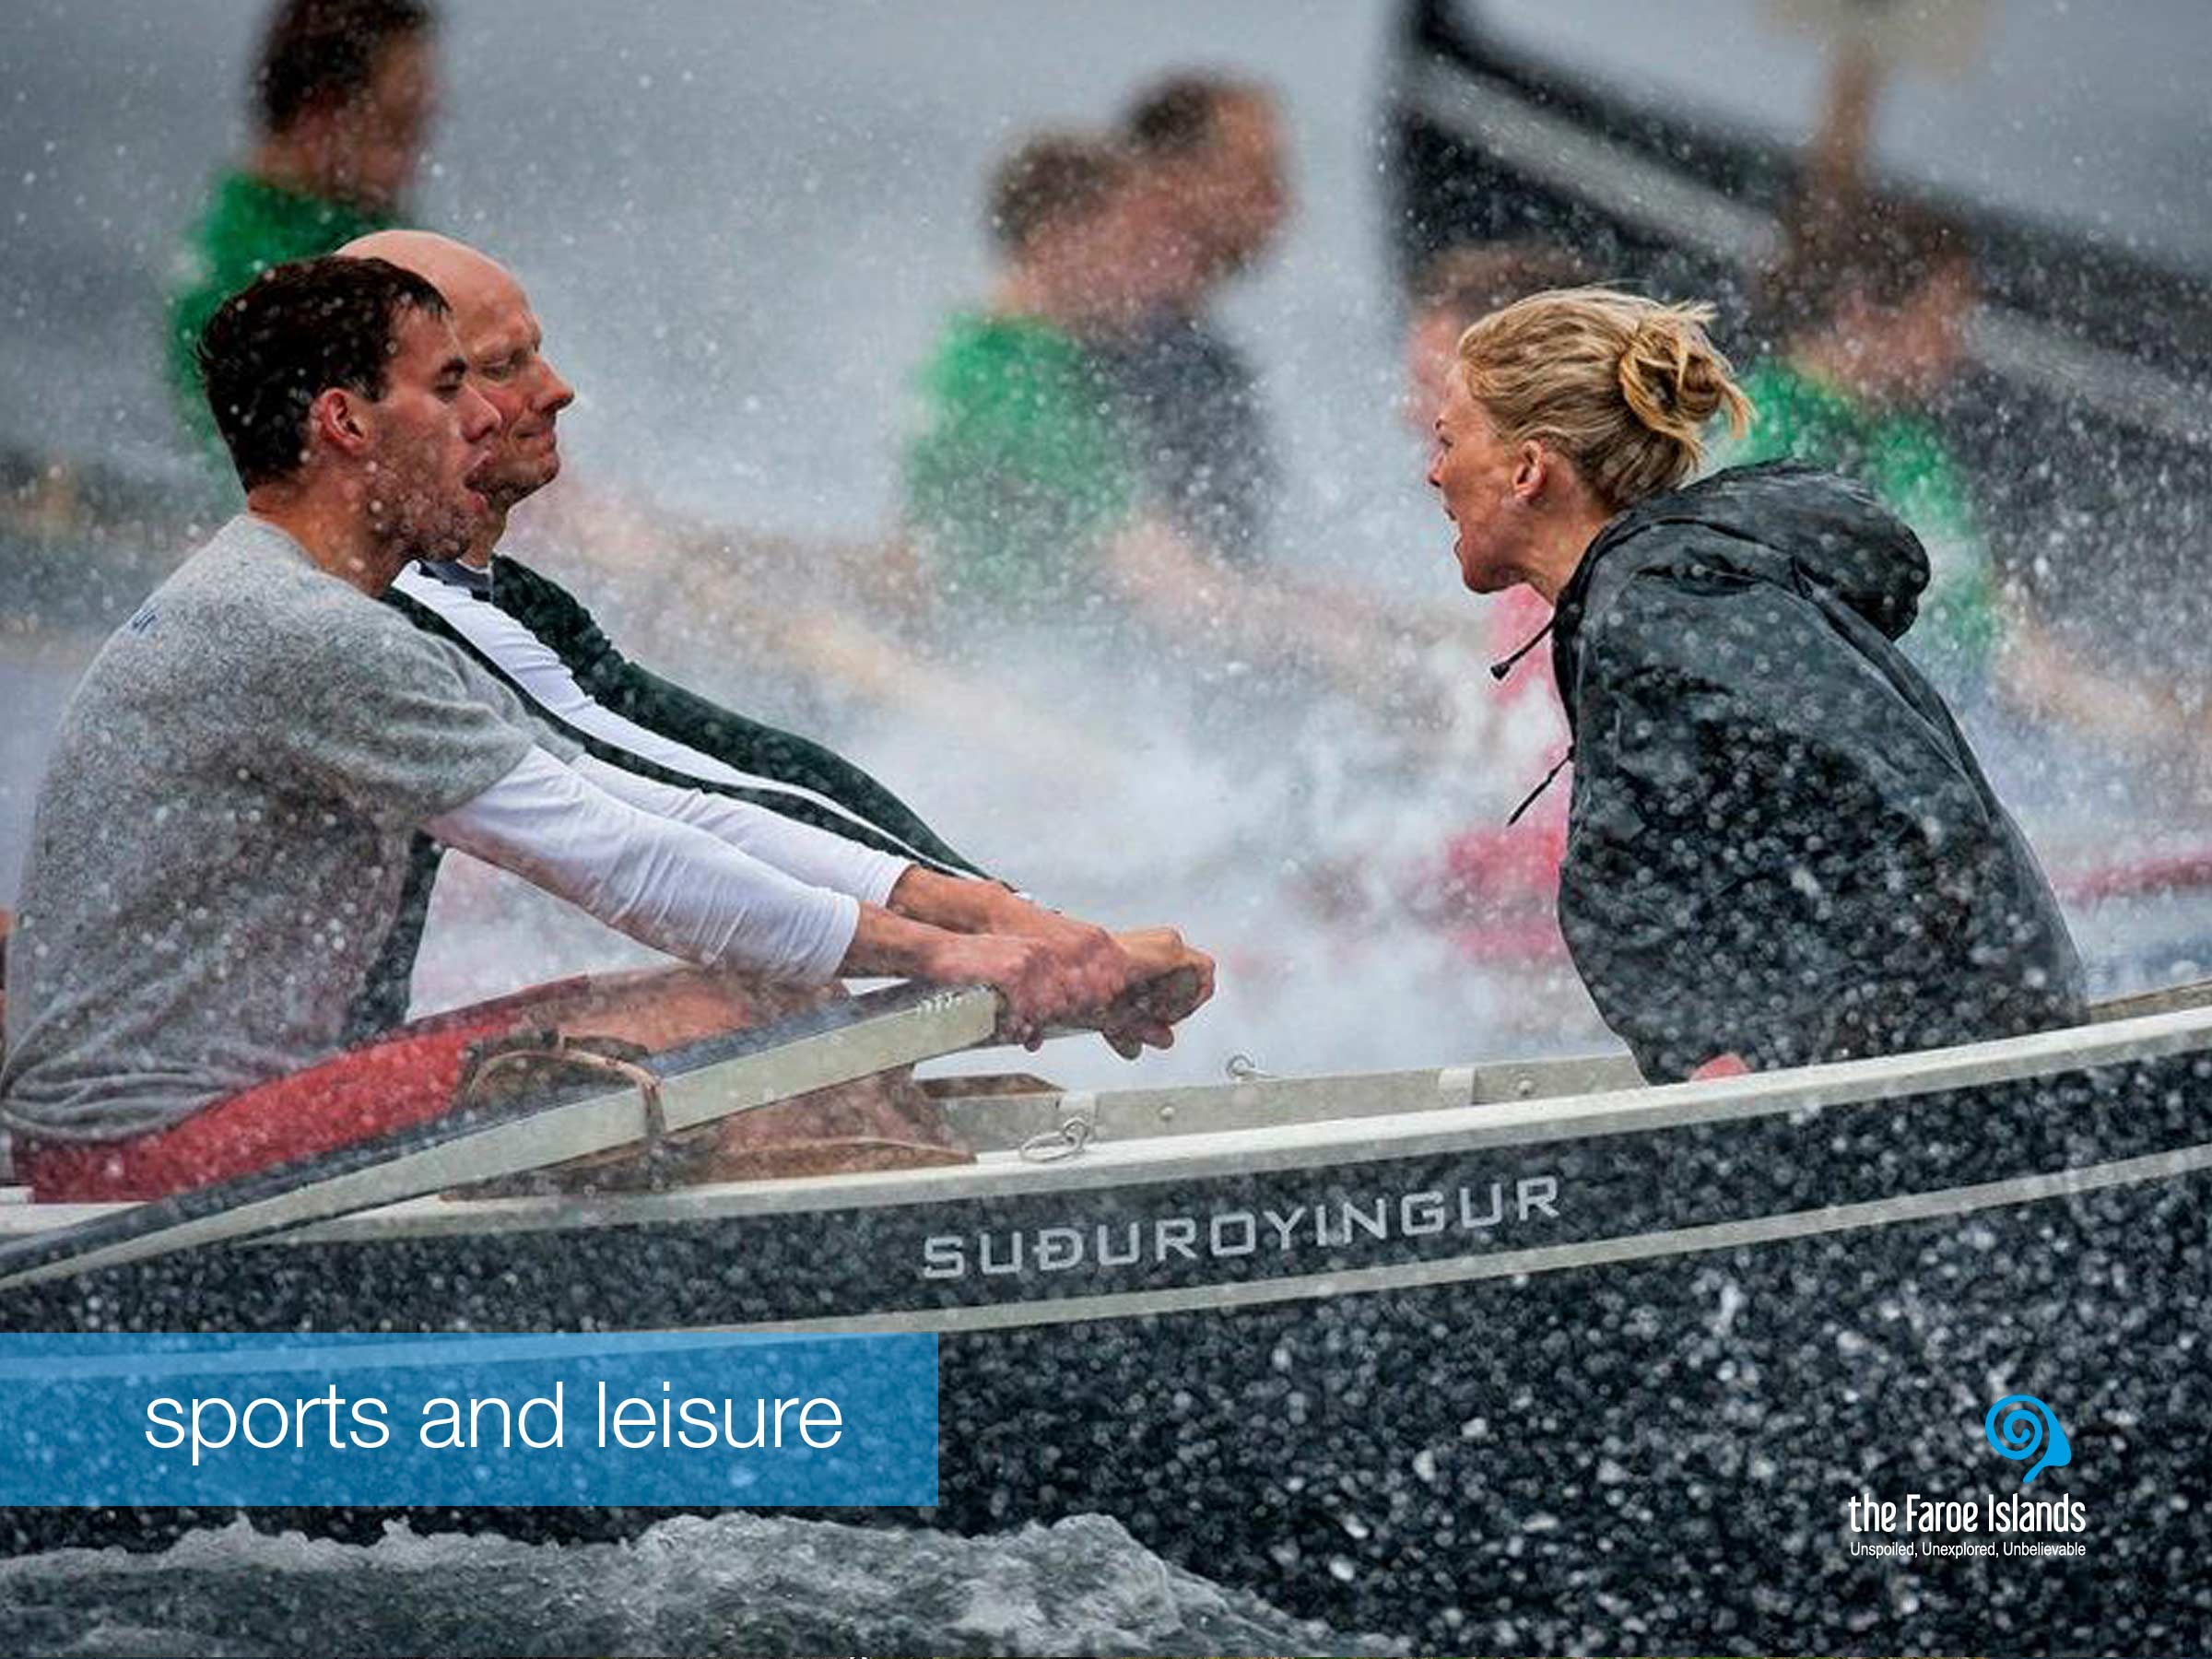
Notes:
The Faroese people are crazy about sports, both as a way of exercising and for leisure. This positive attitude towards keeping active has clear roots in the social and historical circumstances of the Faroe Islands. Before the introduction of modern infrastructure, people often had to walk long distances, hike up mountains, and row from island to island in order to get around. So physical activity is a natural extension of everyday life in the Faroe Islands, and it continues to be so.
The best known Faroese sports team is the men's national football team. But currently, the most accomplished Faroese athlete is the European Championship runner-up and Olympic swimmer Pál Joensen, who has caught the world's attention, and his people’s great pride with his impressive competitive achievements.
Football is the most popular and widespread sport in the country. The clubs are the heart of Faroese football culture, both when it comes to the competitive aspects, and when it comes to the more leisurely and social aspects of the sport. They have competitive teams for children, men and women, and many of them have teams competing in several divisions of the national football league. But football is also a leisurely sport that people play to keep active and socialise with friends.
The official national sport is rowing, which has direct connections to the cultural heritage of the Faroe Islands. Manned by young men and women, rowing teams use traditional open Faroese boats with six to ten oars and compete in the fjords of the Faroe Islands. The rowing season is short, with only seven races between early June and the end of July. Other popular sports are handball, volleyball, swimming and gymnastics.

Slide 20
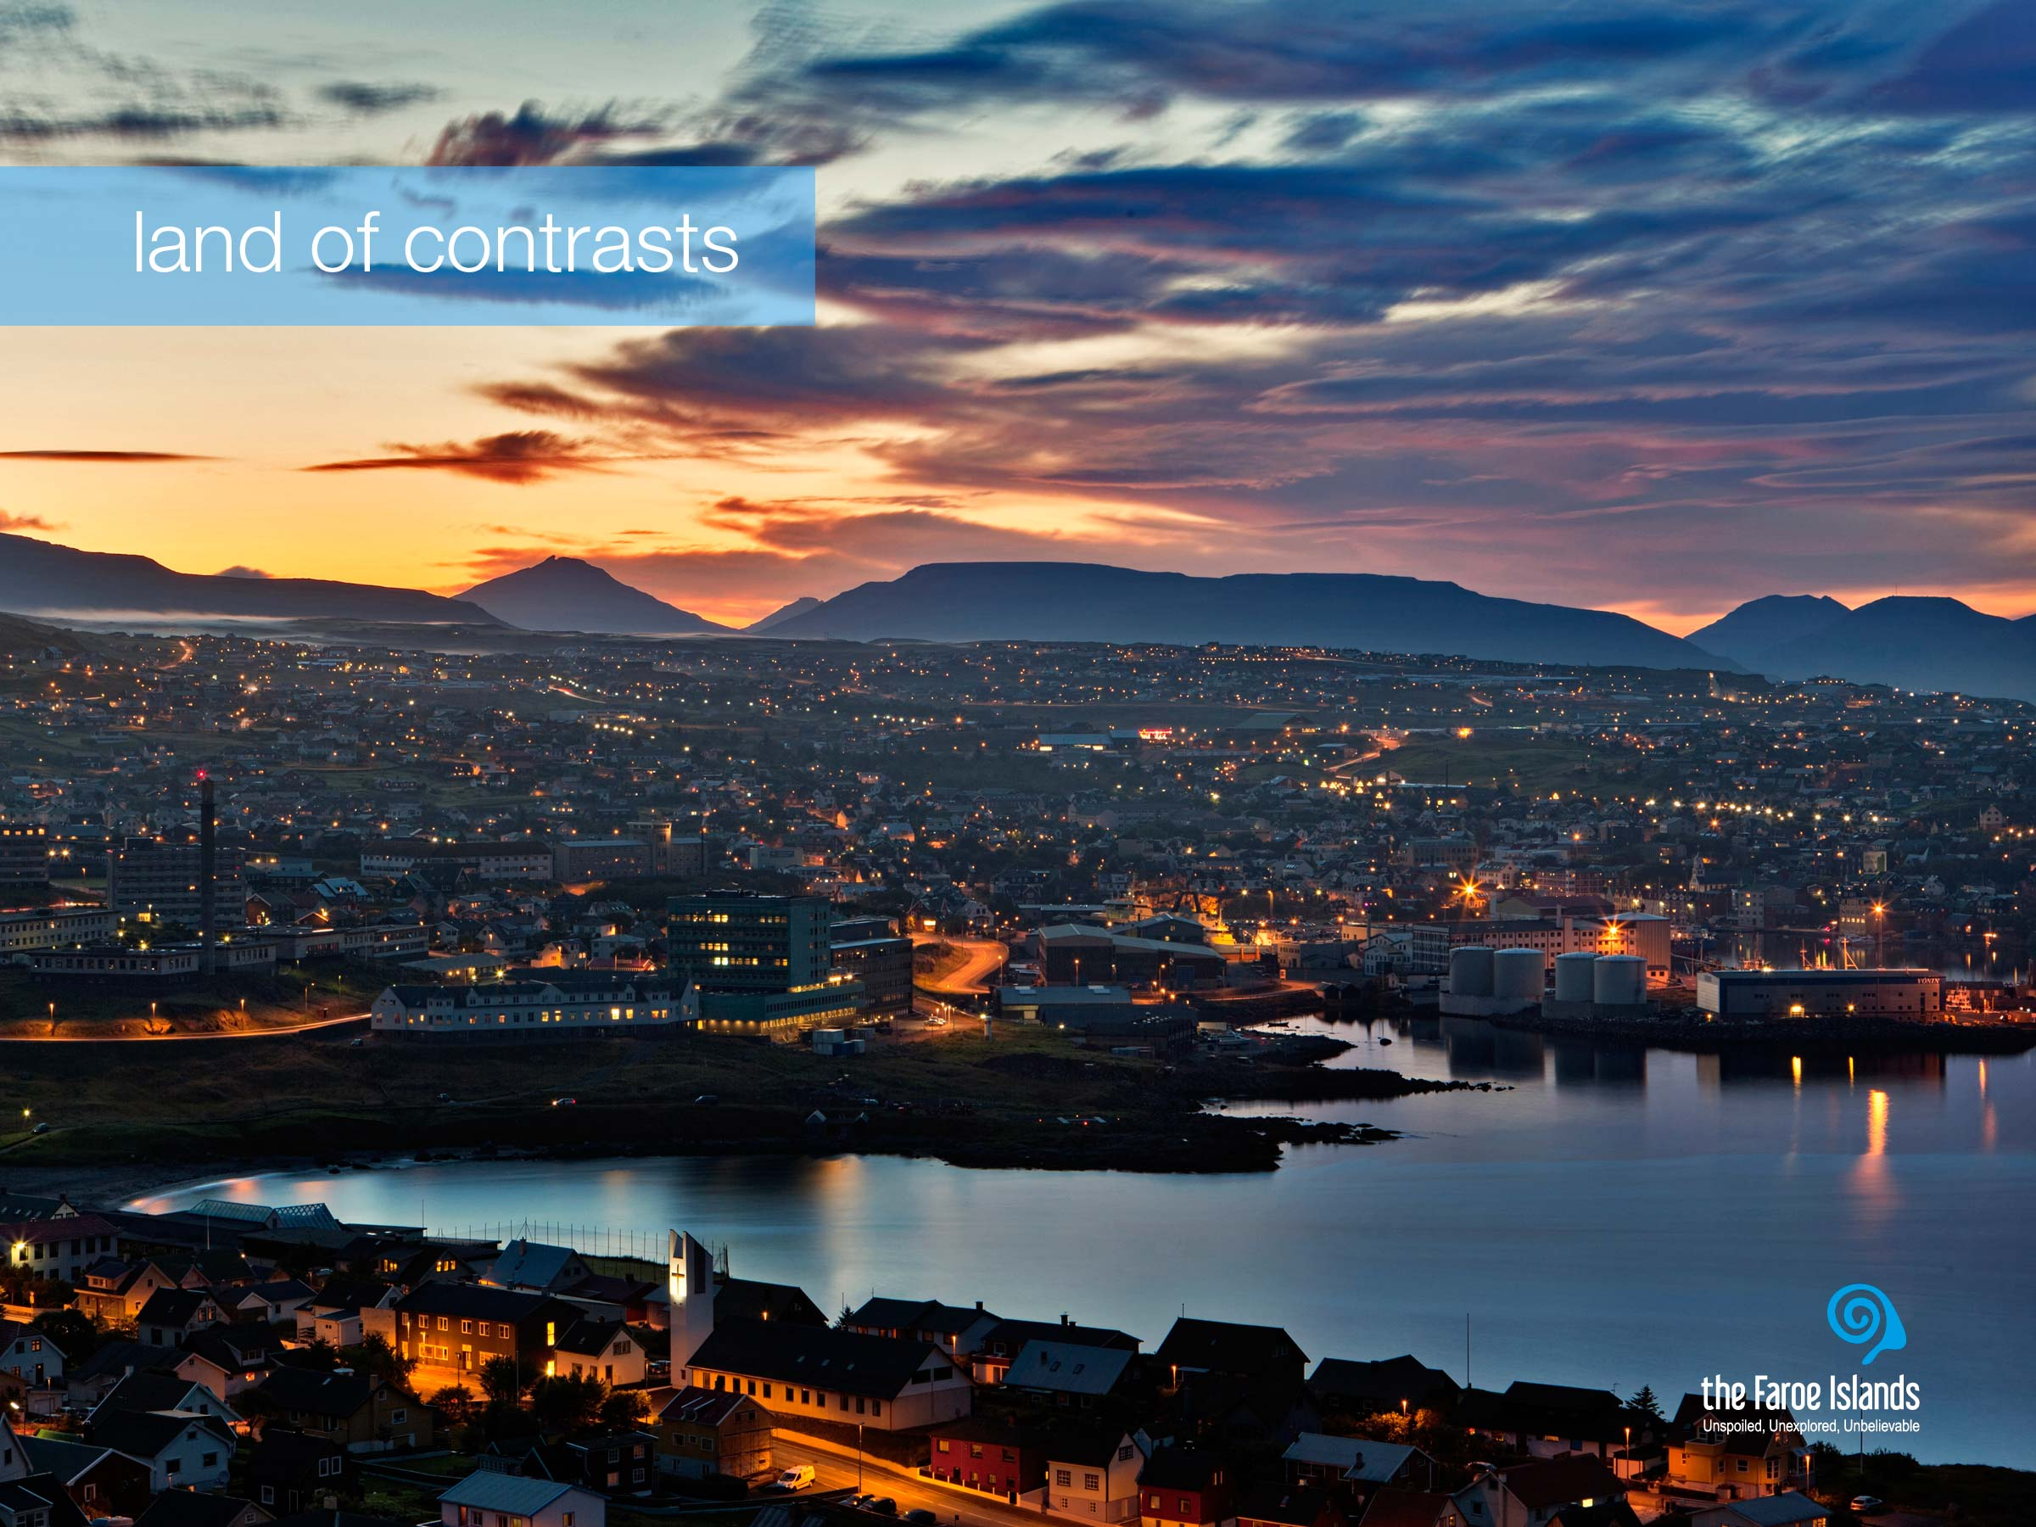
Notes:
There is still something to be said about remoteness, because the relative isolation from the outside world for centuries has meant that the Faroe Islanders have been able to preserve ancient traditions. You could say that the remoteness of the Faroe Islands mixed with the modernisation and globalisation of society has placed the Faroe Islands in a unique position compared to other countries – at the same time rooted deeply in both tradition and modernity.
The contrasts on the Faroe Islands are very dominant, and something we as a people think of as natural, but definitely something tourists notice very clearly when they visit the Faroe Islands. There is the tangible contrast between modern lifestyle and the very present traditions. But as a people, we are full of contrasts too. One moment we may be hierarchically differently placed in a company, but the next we are equals on the football pitch or when tending or slaughtering sheep. Somehow these contrasts also ensure that we are tolerant and open to new trends and norms. There is a curious co-existence of a highly modern society with old-fashioned traditions. In some way, several different decades may be present in one situation or one person. We are a twist of nature, tradition and modernity. We are not an ancient community, but modern with strong roots. The contrasts are also created by nature, because if it had not been so powerful, the good infrastructure would not have been created. The Faroese infrastructure makes modern life possible within our nature.
The capital Tórshavn is a great example. For a city, with just about 20.000 inhabitants, it is surprising, how modern it is. This peaceful, yet energetic capital has managed to meet the demands that any modern people demand. While the old part of town is lovingly preserved in its original shape with small houses close to each other, it still embraces modernity indoors. Tórshavn is first and foremost a town with a cosy city centre and a busy harbour. There are several different cafés, bars and restaurants with matching nightlife. The weekends are lively as Tórshavn has a variety of cultural venues, theatres, great restaurants and music scenes with a lot to offer. Tórshavn is also the perfect meeting and conference city, since the city offers 5 star conference facilities.

Slide 21
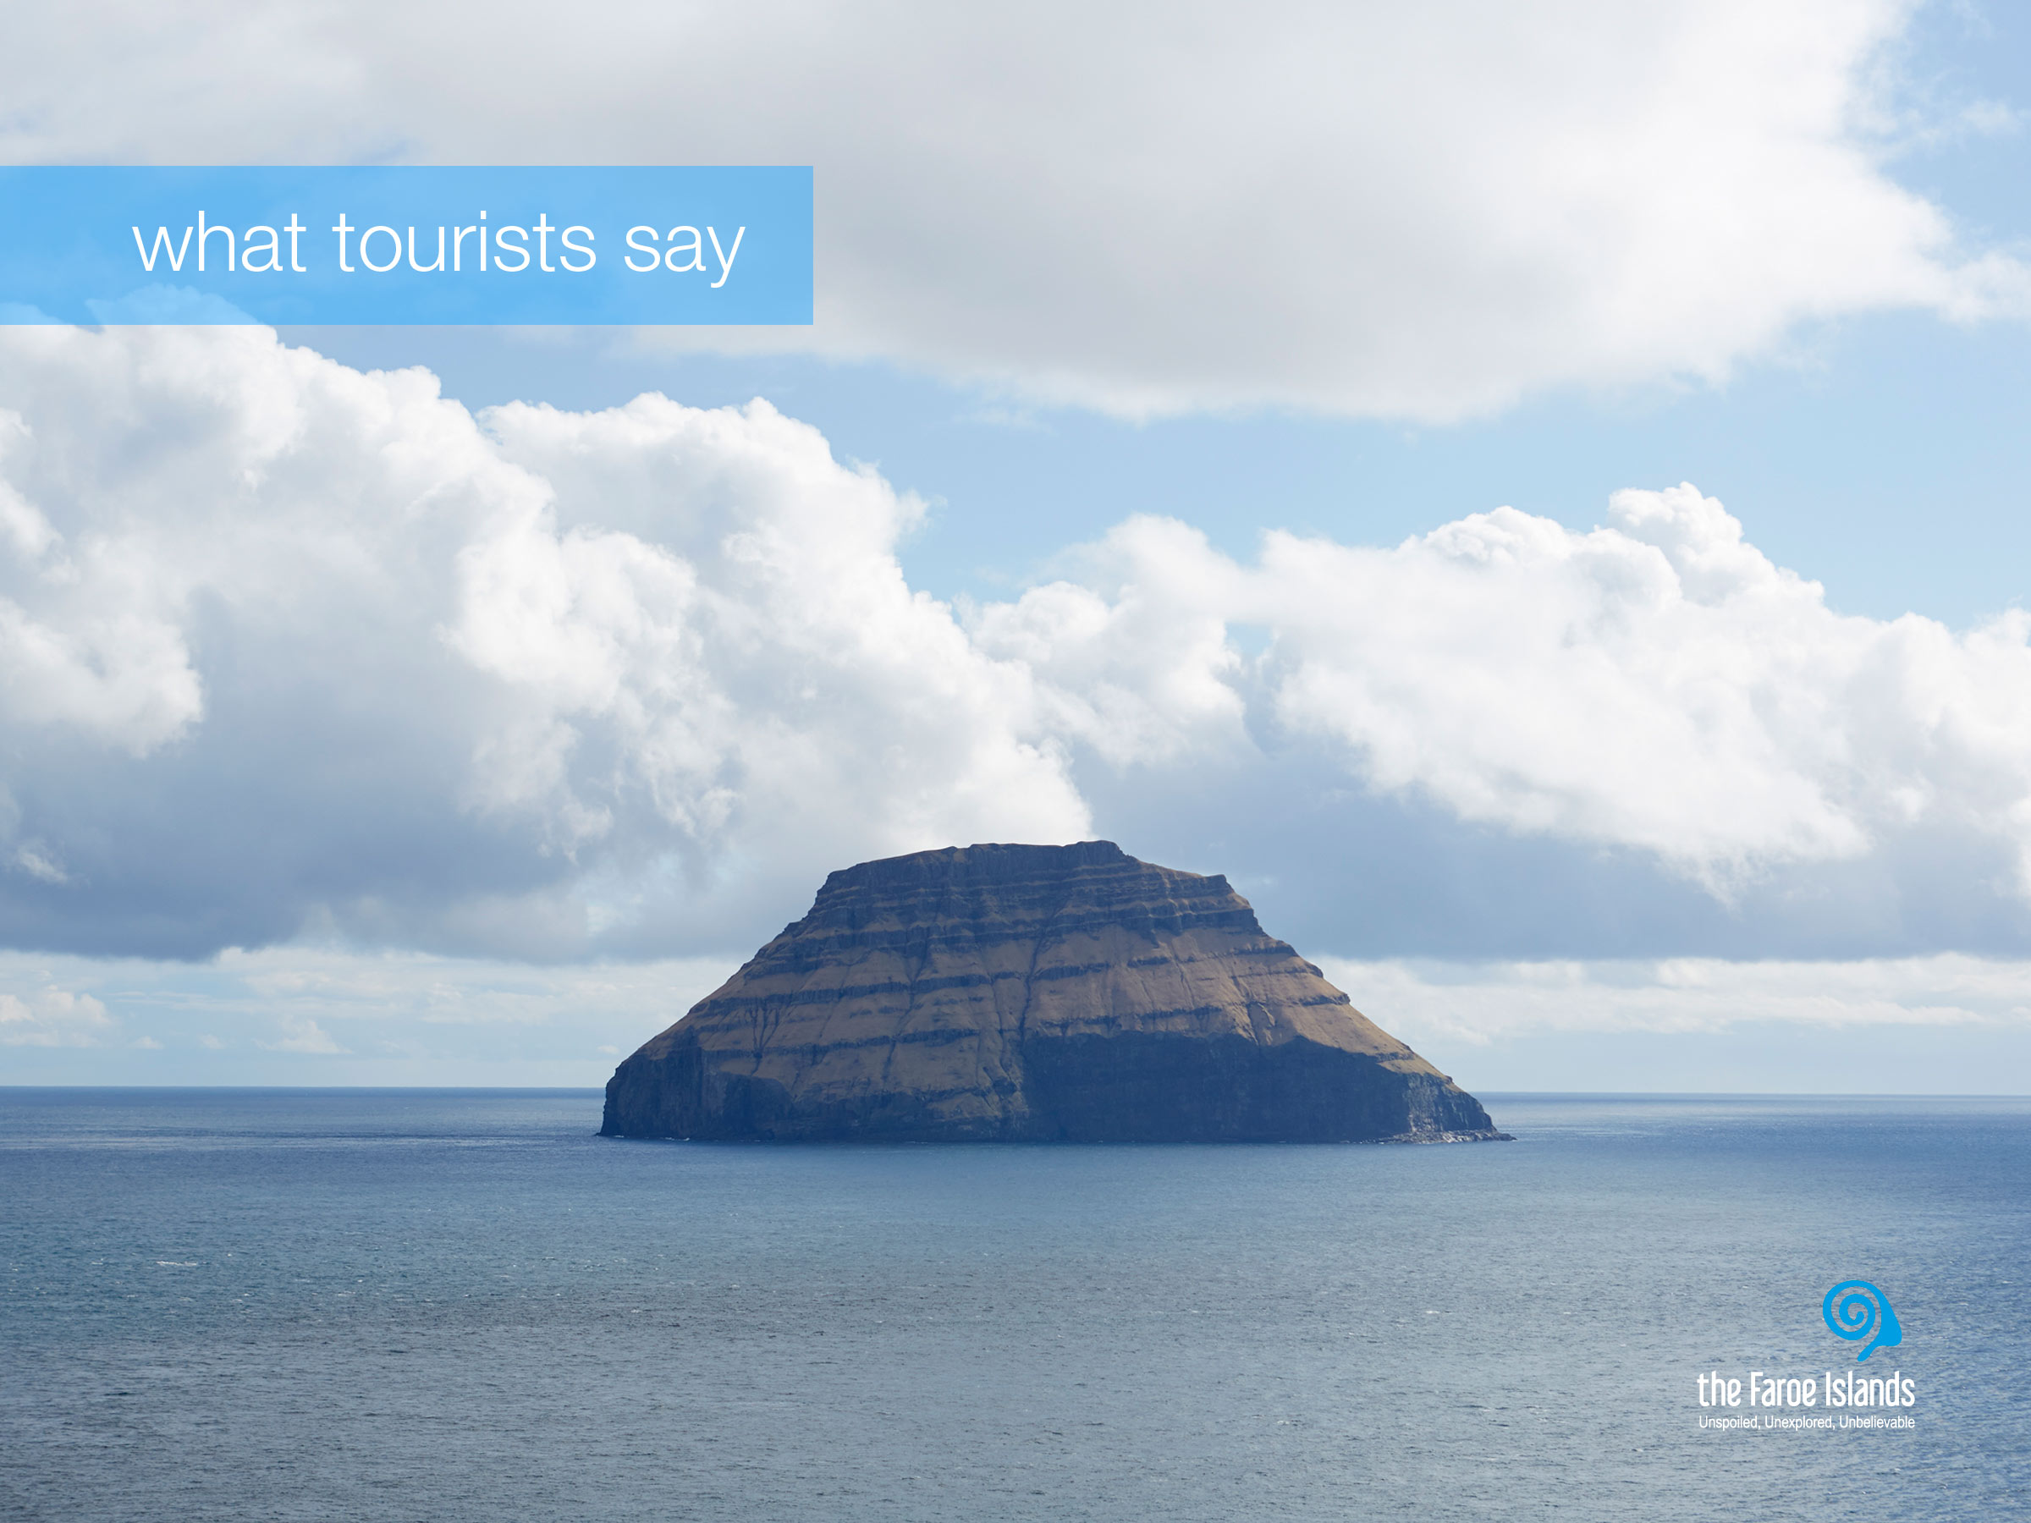
Notes:
A few years back, in 2013, a survey was conducted amongst visitors who had visited the Faroe Islands that summer. 6000 tourists were asked to name what they found unique and essential about the Faroe Islands, what they would take back home with them. The result of the survey was clear: Five attributes are distinct about the Faroe Islands.

Slide 22
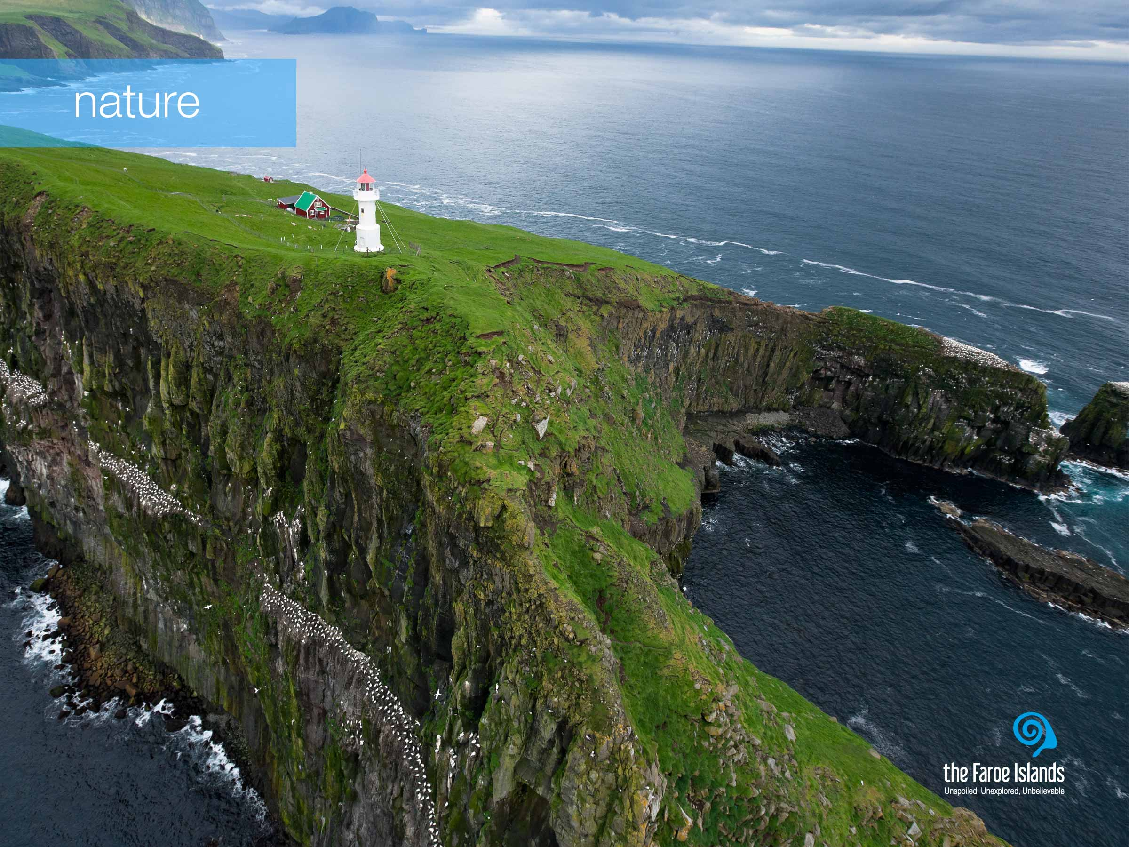
Notes:
First they thought that the Faroe Islands has an unique scenery – the Faroese unique nature. A combination of hard rocks, velvety green grass and dramatic waterfalls. A stunning picture painted in green and blue colors, where your eyes can stretch from the top of a mountain over the endless surrounding ocean at any one time. No matter where you go in the Faroe Islands, you will never find yourself far from the sea.

Slide 23
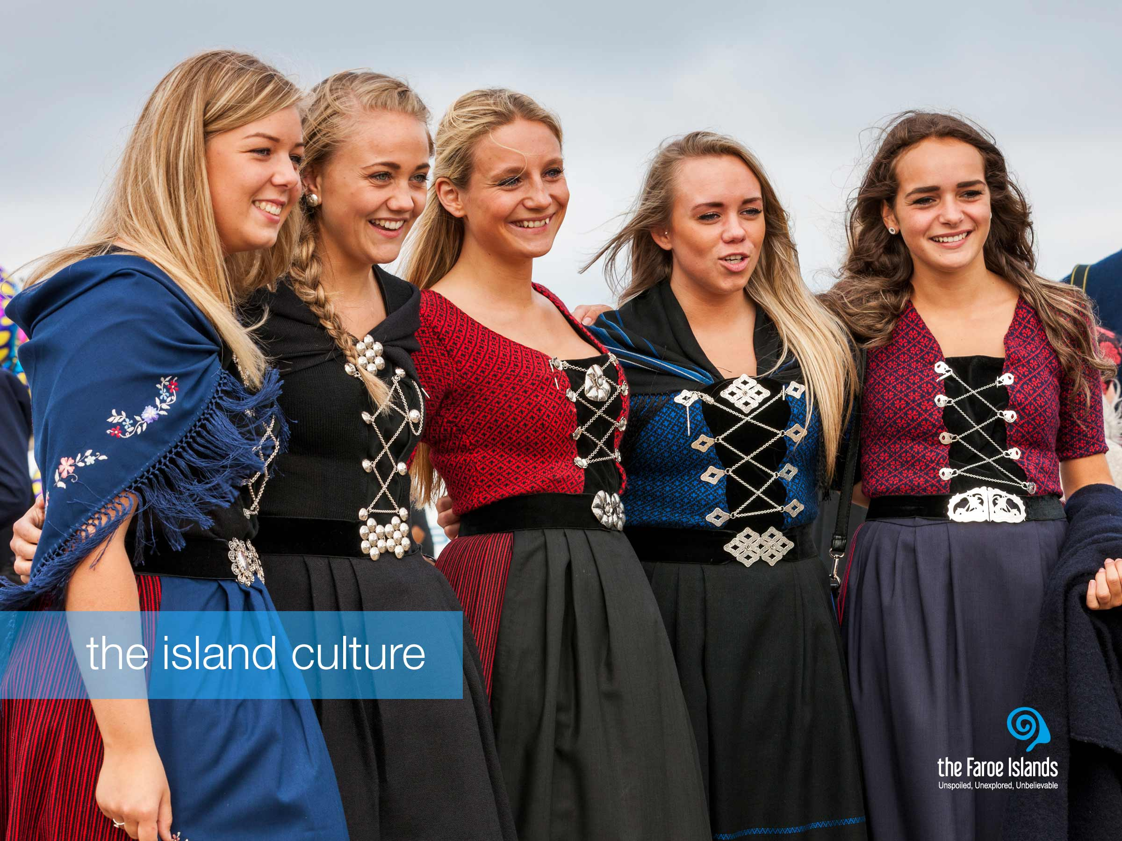
Notes:
The second point that the tourists emphazised on was the people and the island culture. The Faroe Islands are remote and isolated, and so the ocean has served as a great defense against dilution of the islands’ original culture. There are many wonderful examples of the original culture. The national costume, which is worn at weddings, events and at the annual Ólavsøka festival. The language is rooted in the Nordic languages, but it is a unique language in its own right even though we’re only 50.000 people.
Other great examples of the modern yet original culture are the designer shops that sell products rooted in traditional Faroese knitting – that also has won international recognition.

Slide 24
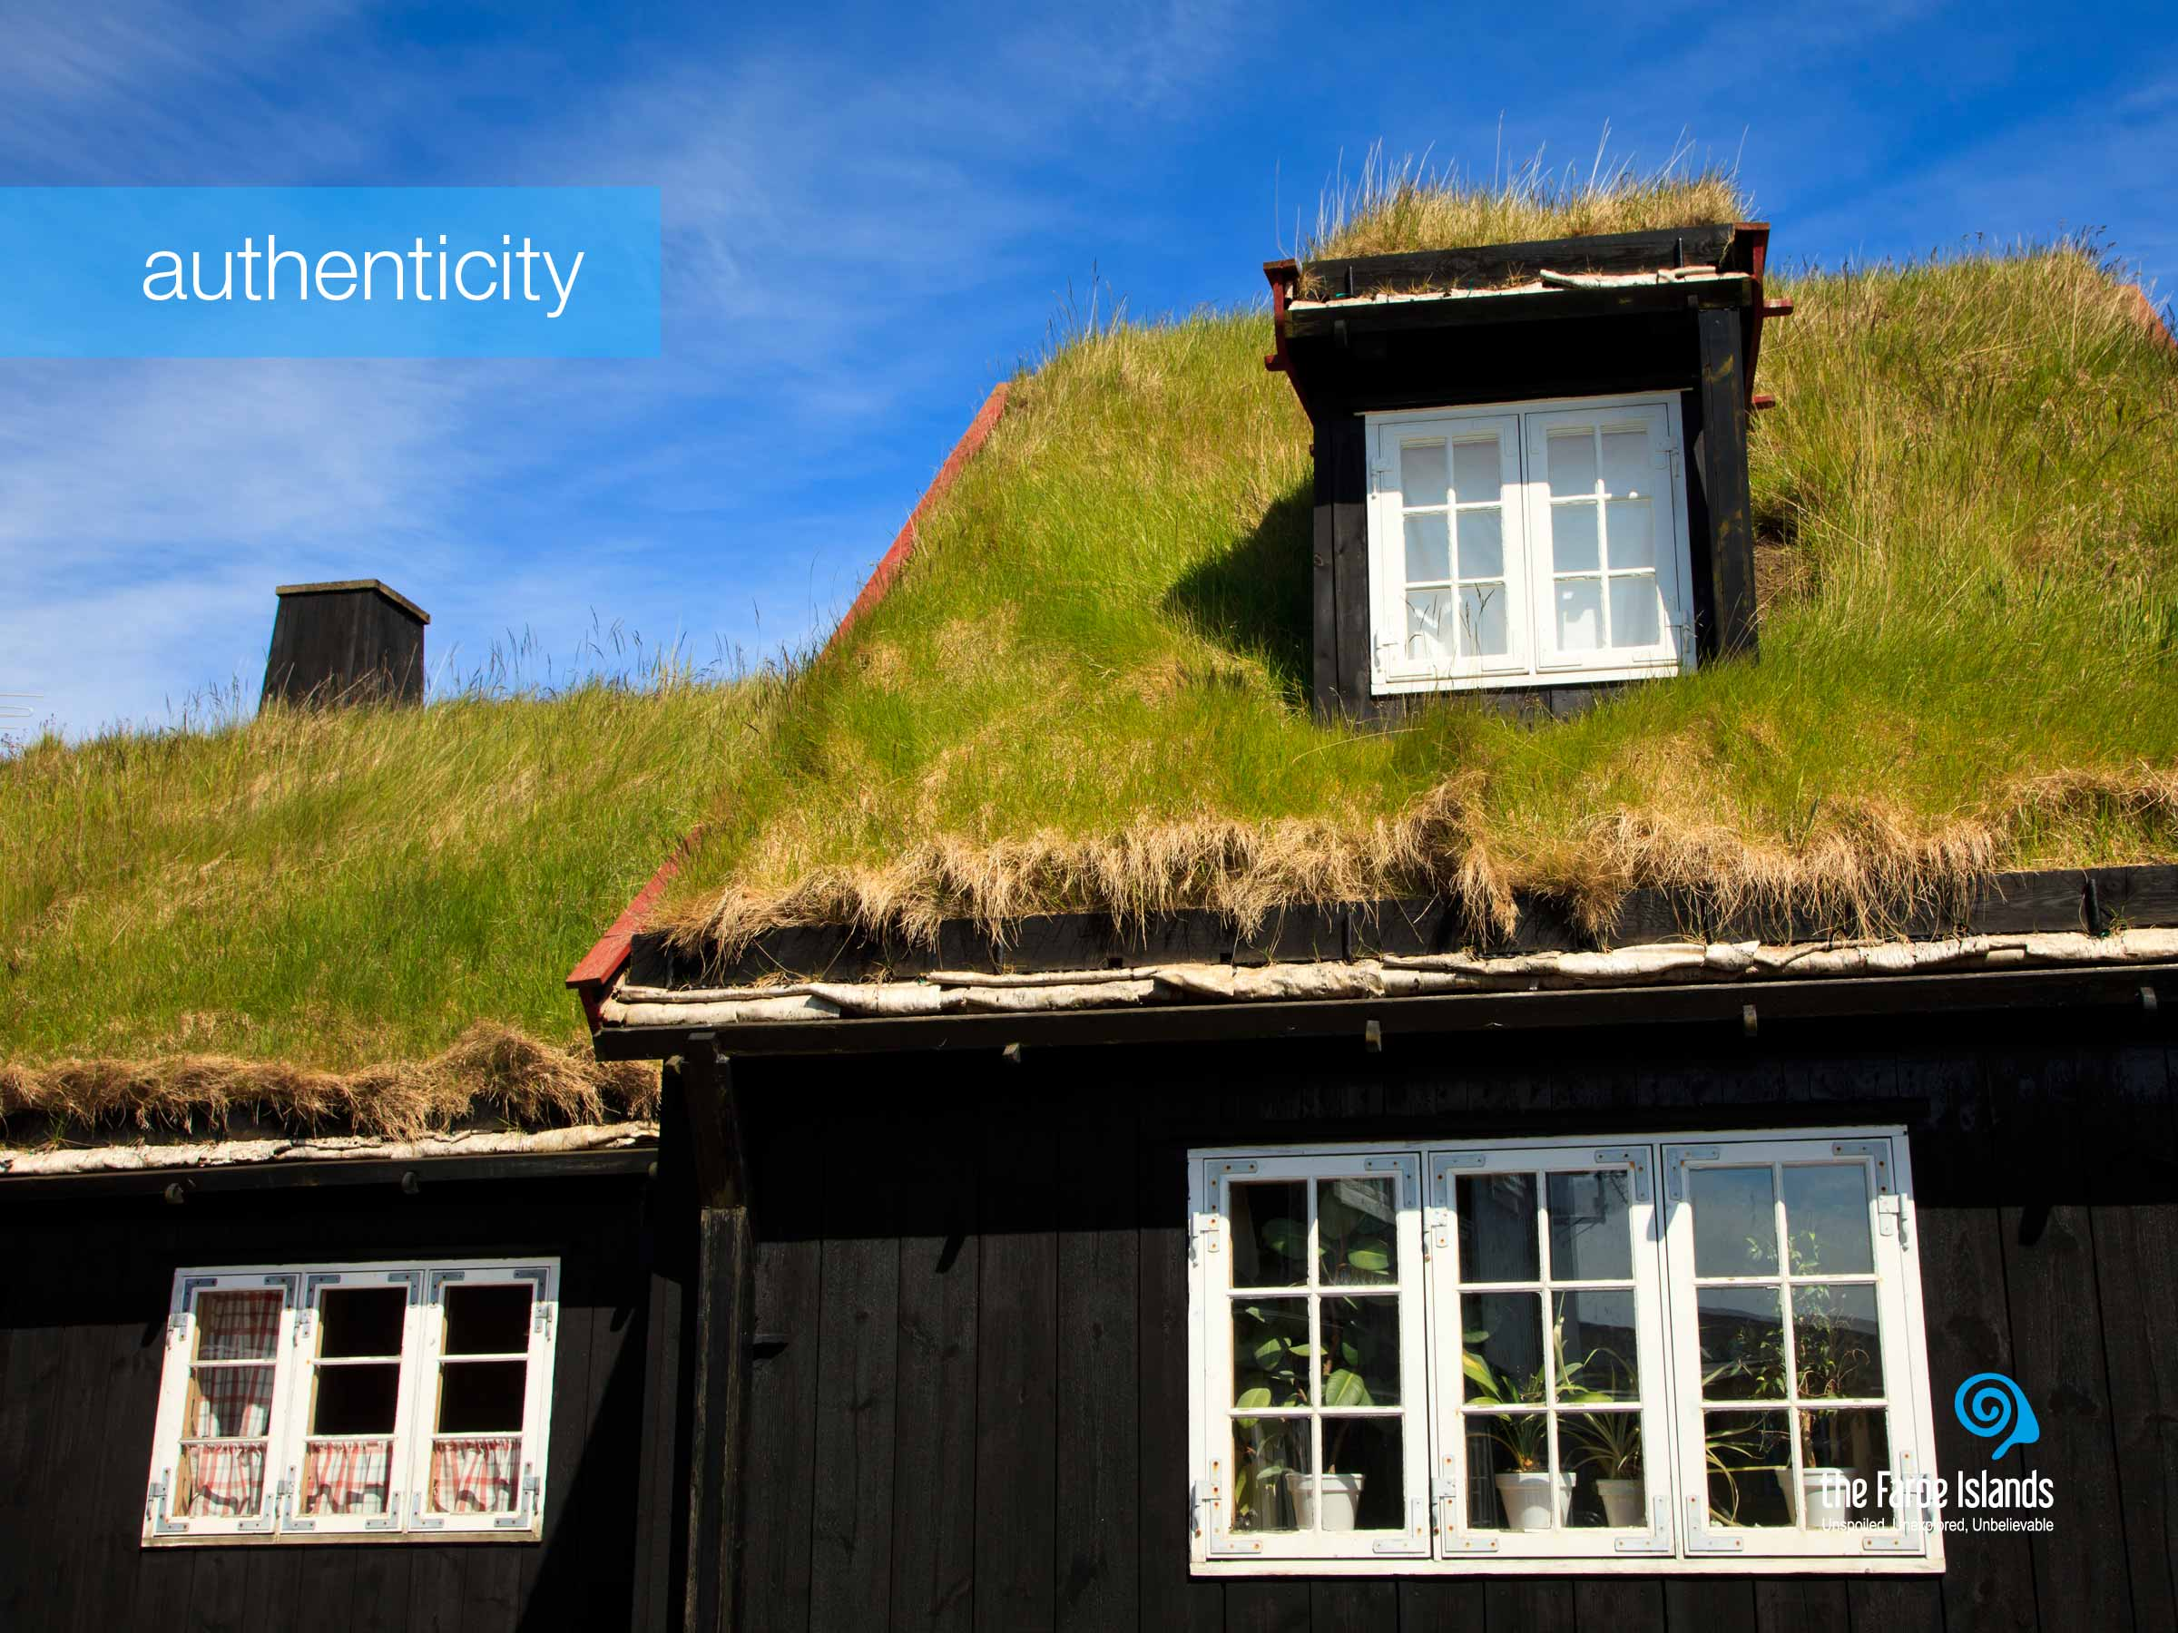
Notes:
Thirdly they mentioned the authenticity. As a traveller you can experience the same food, drink the same coffee and buy the same brands, in the same concept stores in most of the world. But as many destinations seem to be getting more alike, the contrast to the Faroe Islands becomes even greater.
The Faroe Islands have a unique feeling of “real”. Nature is the only true ruler and the humbling effect of nature is evident in the island’s culture. This is in many ways the opposite of Disneyland: In the Faroe Islands nothing is set up - everything is original.

Slide 25
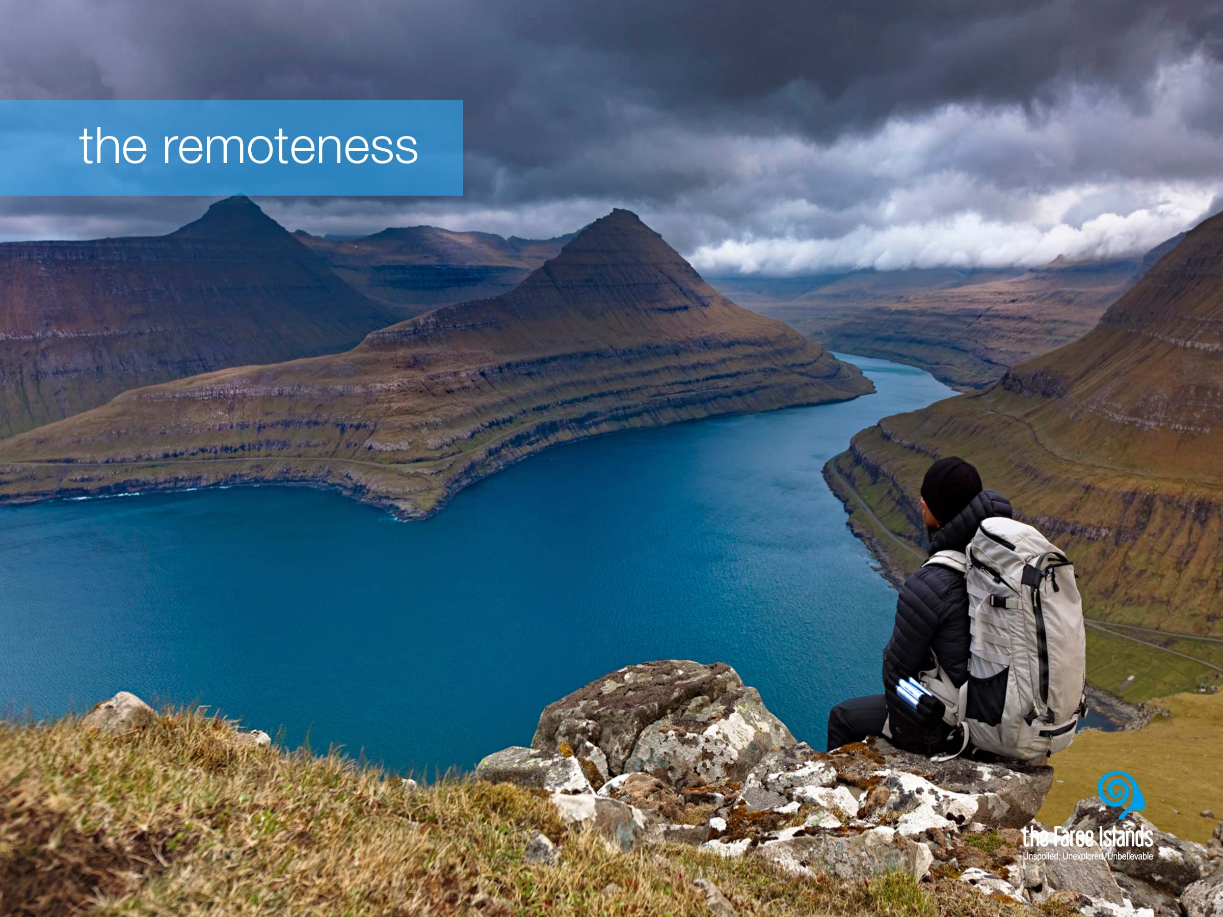
Notes:
The fourth point that the tourists mentioned, was the remoteness. The Faroe Islands may be close in distance but are far, far from everyday life. Far from stressful obligations. Far from traffic jams and crowds. Far from normality and everyday routines. If you find yourself next to another tourist, it is likely to be your own travel companion. In fact the Faroe Islands have even fewer tourists than the Galapagos Islands, so people are likely to return from the Faroe Islands with untold stories.

Slide 26
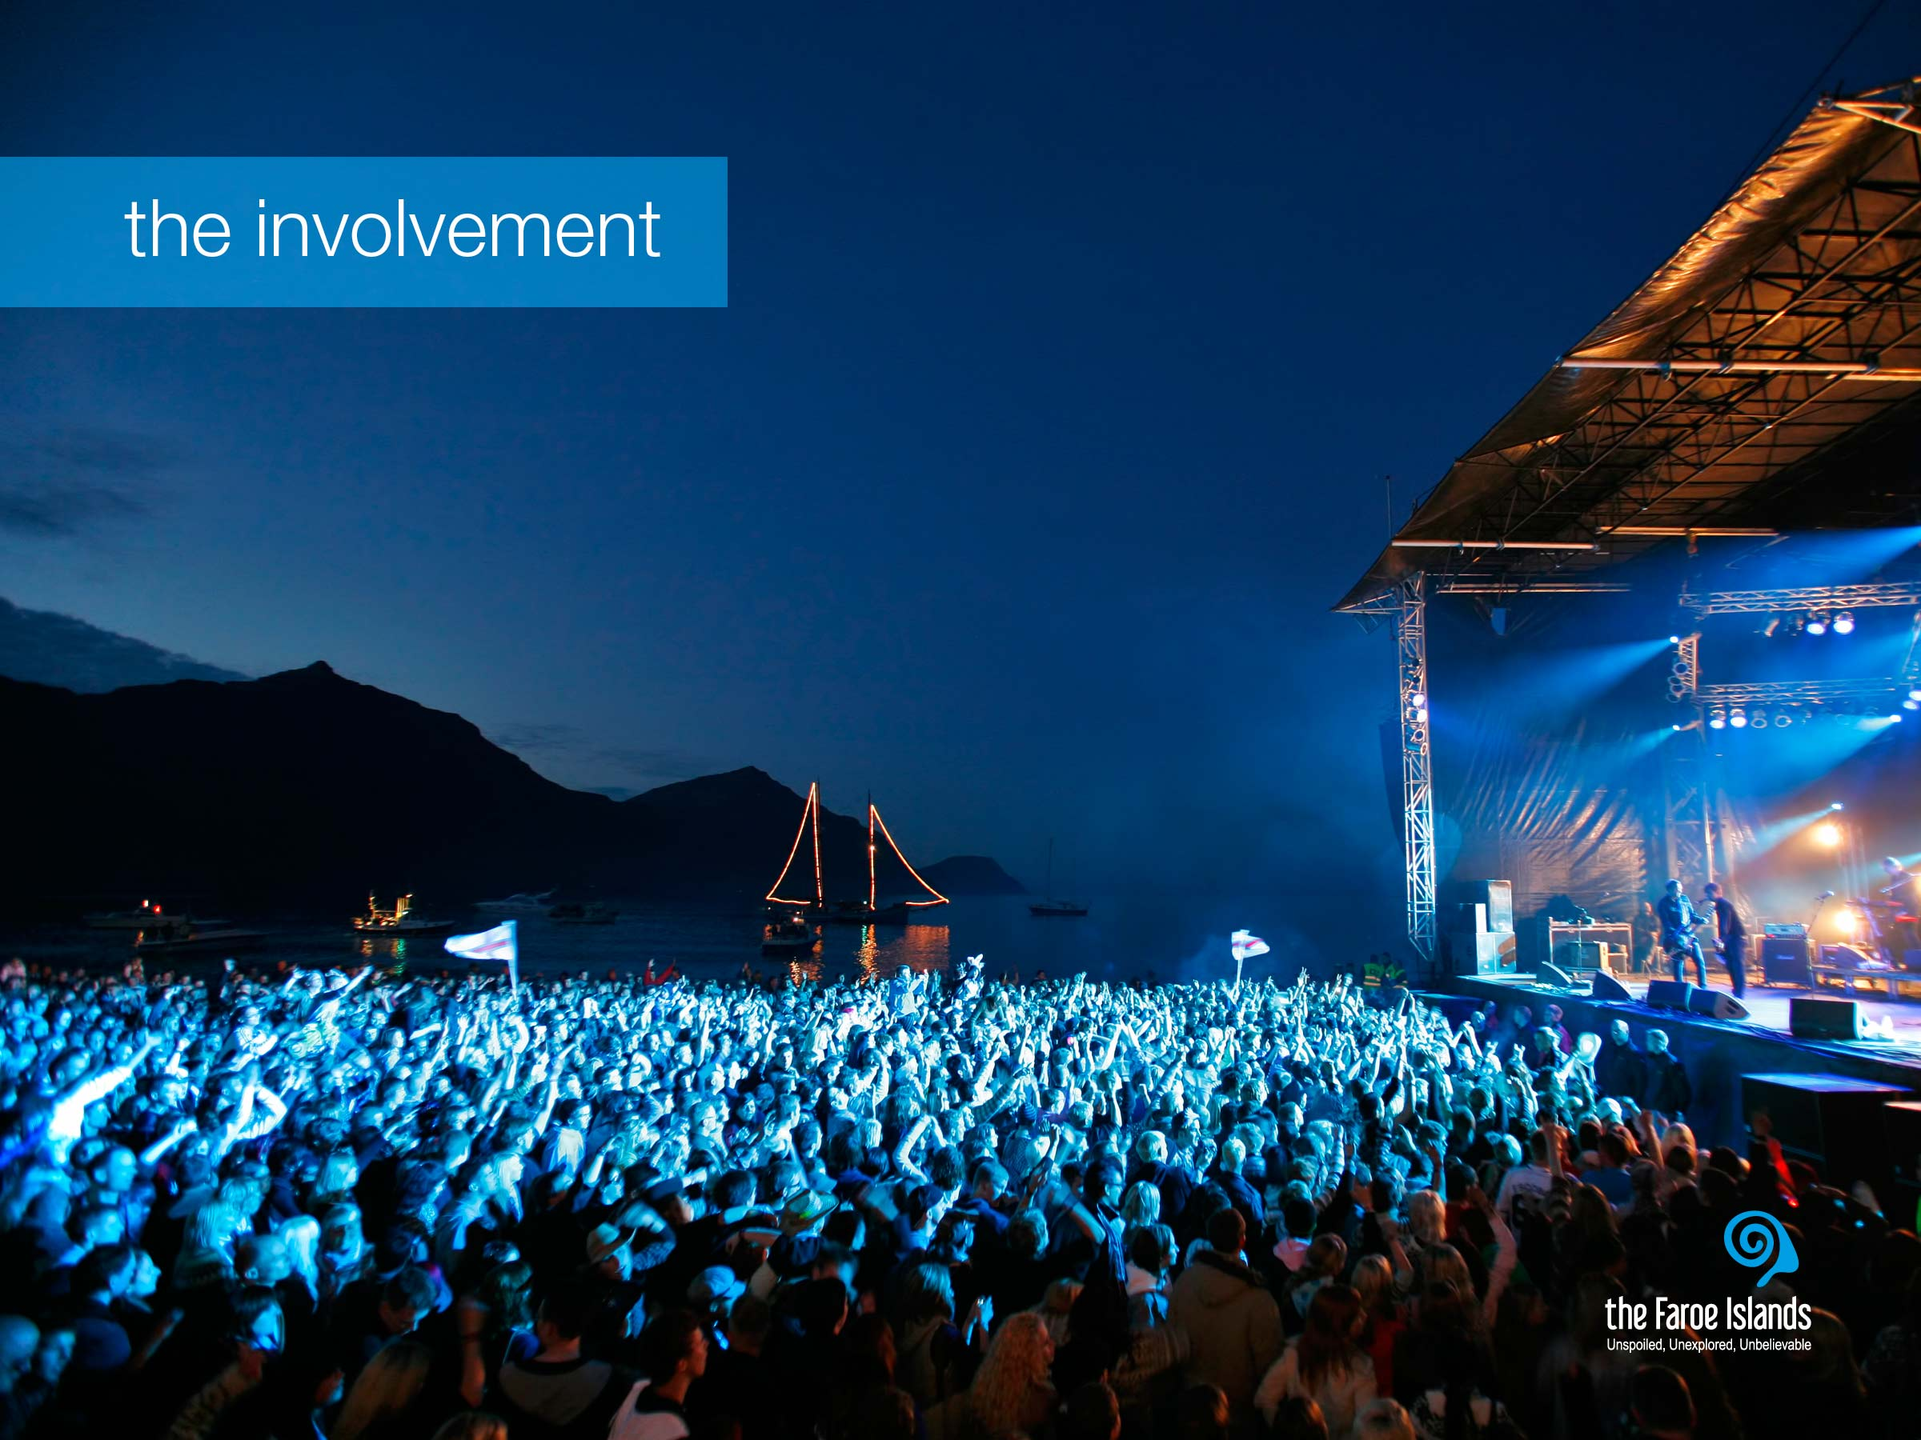
Notes:
The fifth and last quality that the tourists mentioned was the high level of involvement that they experienced in our islands. It is often said that the Faroe Islands have no tourists - only guests. People are welcoming and open and nature invites everyone to participate. The nature is not just something you look at. It’s a place for being – for hiking, painting, angling, diving, sailing and absorbing.
This picture, for instance, is taken at the annual G! Festival. The G! Festival takes place in the small village of Gøta on Eysturoy that transcends from being a quiet little village with children playing on the sand to a thriving music festival. The number of inhabitants of Gøta doubles five times during the festival. The villagers are open and welcoming and you truly feel like you are part of the village during the festival. It is one of the most intimate and surreal music festival experience you can ever imagine - and then some.

Slide 27
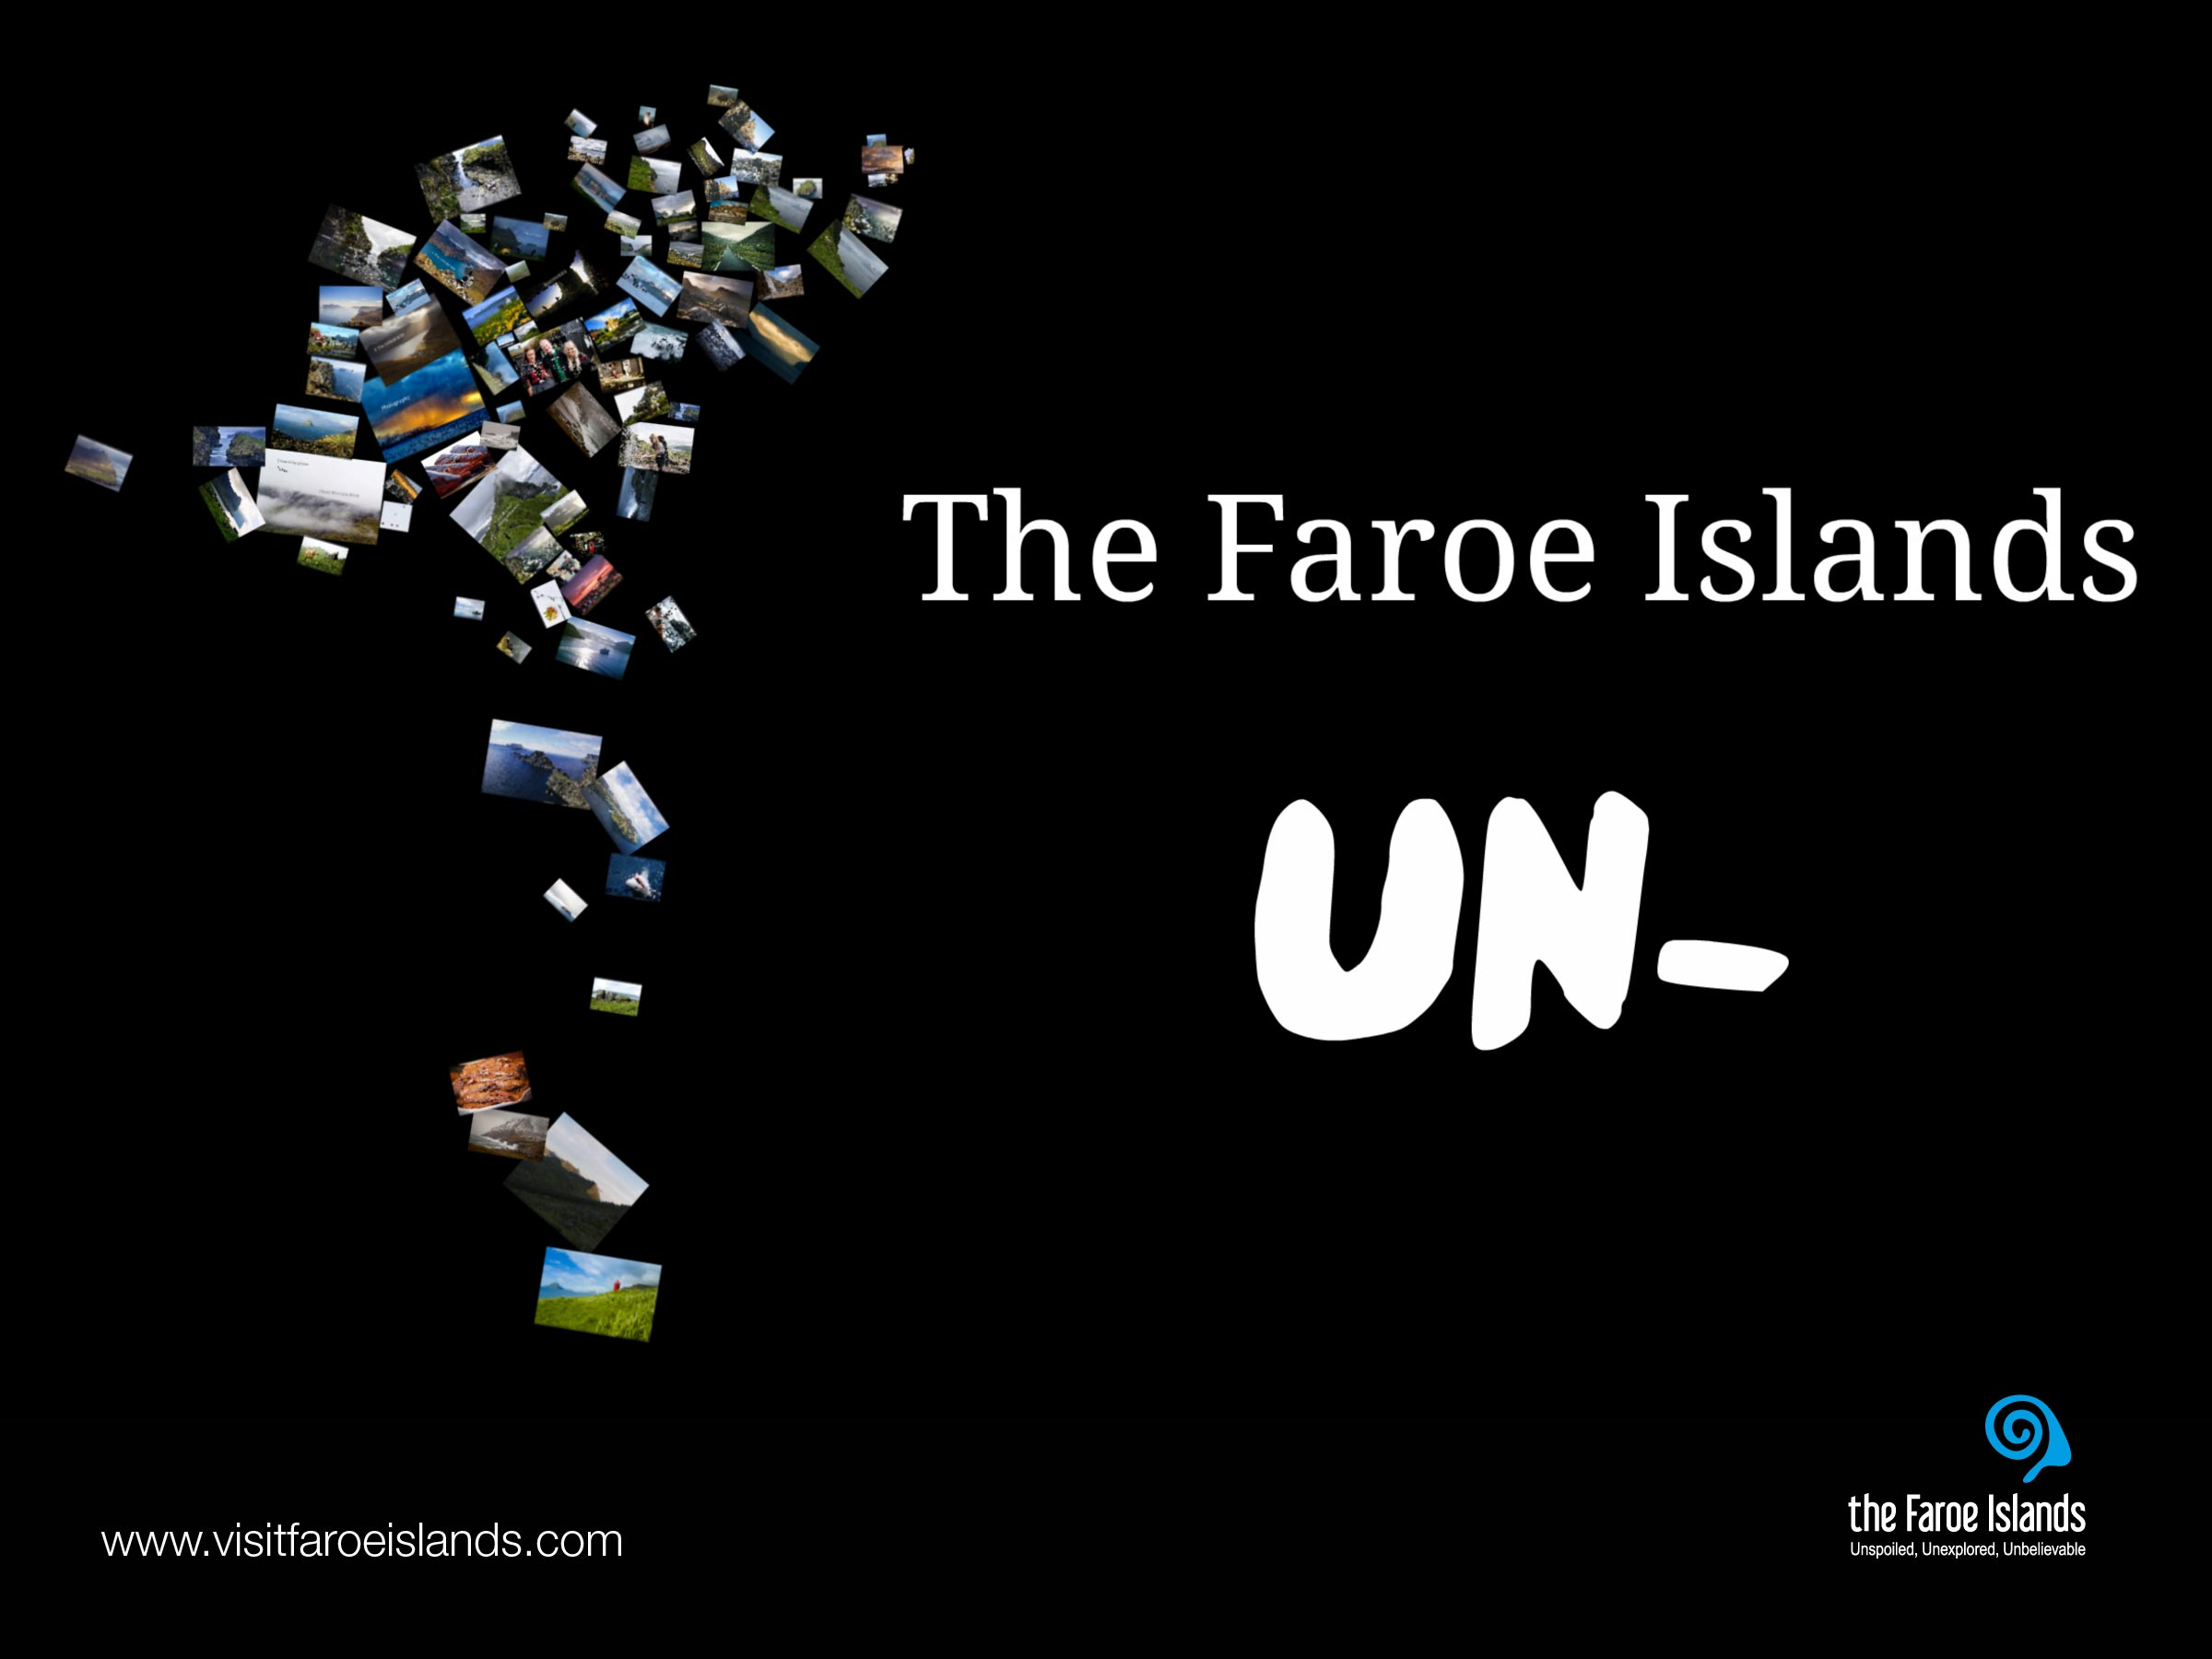
Notes:
The un – destination
When you take a look at all the descriptions of the Faroe Islands that tourists have made, you notice a pattern. Unspoiled, unexploited, unpolluted, unexplored... Many of the words used to describe the Faroe Islands are so-called un-words. Perhaps ordinary descriptive words just aren't adequate. Or perhaps this hidden, treeless land of contrasts, evokes such unique emotions in its visitors, that the best way to describe it is by setting it apart from the rest, by applying the inherent meaning of the small, yet powerful prefix, un.
For more information on the Faroe Islands, visit: www.visitfaroeislands.com and www.faroeislands.fo

